Slide 1
Workshop 1
Public Relation: No Smoking
(Photoshop)

Slide 2
WORKSHOP STAGES
Search for hands and cigarette’s ash pictures
File → New
Copy hands and cigarette’s ash picture
Create cigarette’s smoke
Add No Sign
Type text

Slide 3
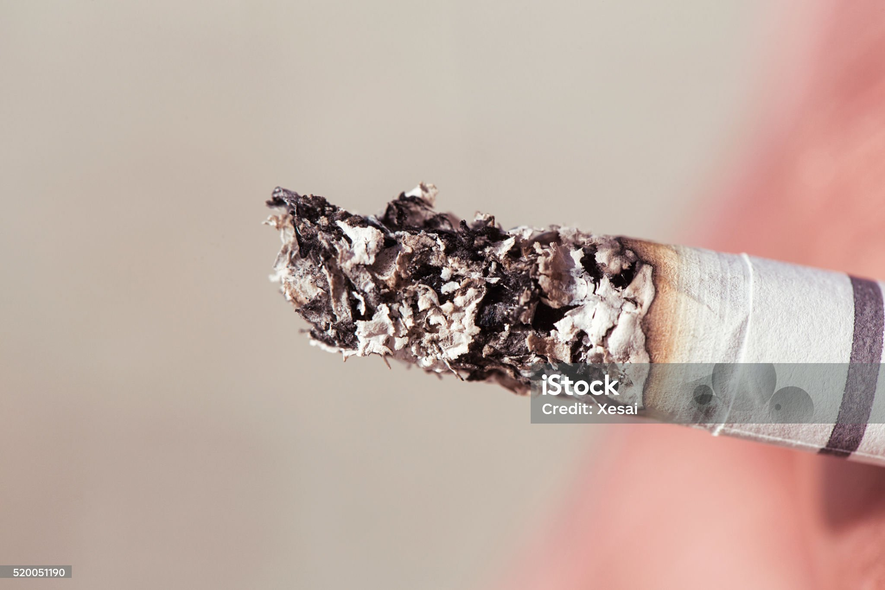
Search for hands and cigarette’s ash pictures

Slide 4
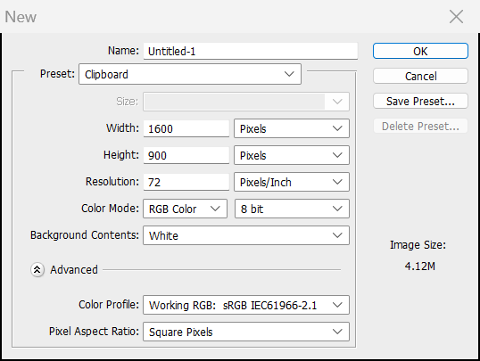
File → New

Slide 5
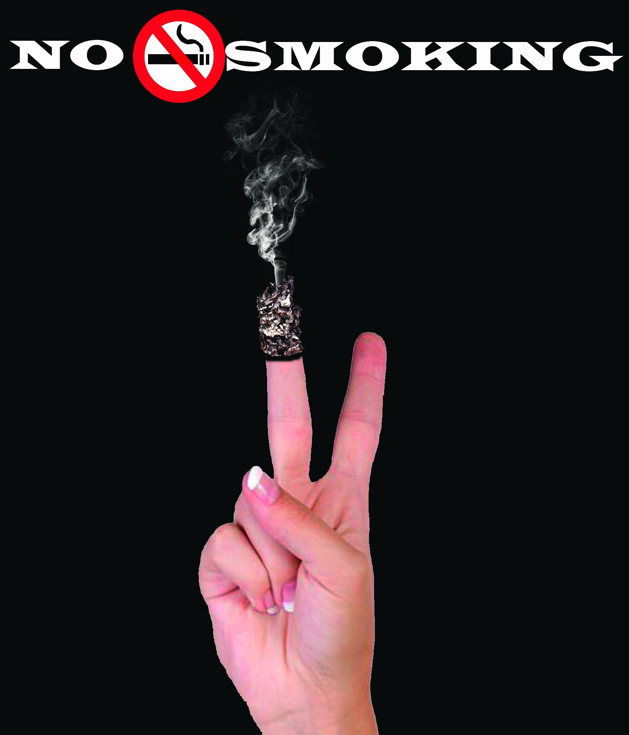
Copy hands and cigarette’s ash pictures

Slide 6
Create cigarette’s smoke

Slide 7
Add No sign & Type Texts

