Slide 1
Workshop 3
Video Creation
(Premiere Pro)

Slide 2
WORKSHOP STAGES
Stage 1: Create video project
Stage 2: Drag and drop video files to the project
Stage 3: Create video on Time line
Stage 4: Front title
Stage 5: Sub title
Stage 6: End title
Stage 7: Video transition effect

Slide 3
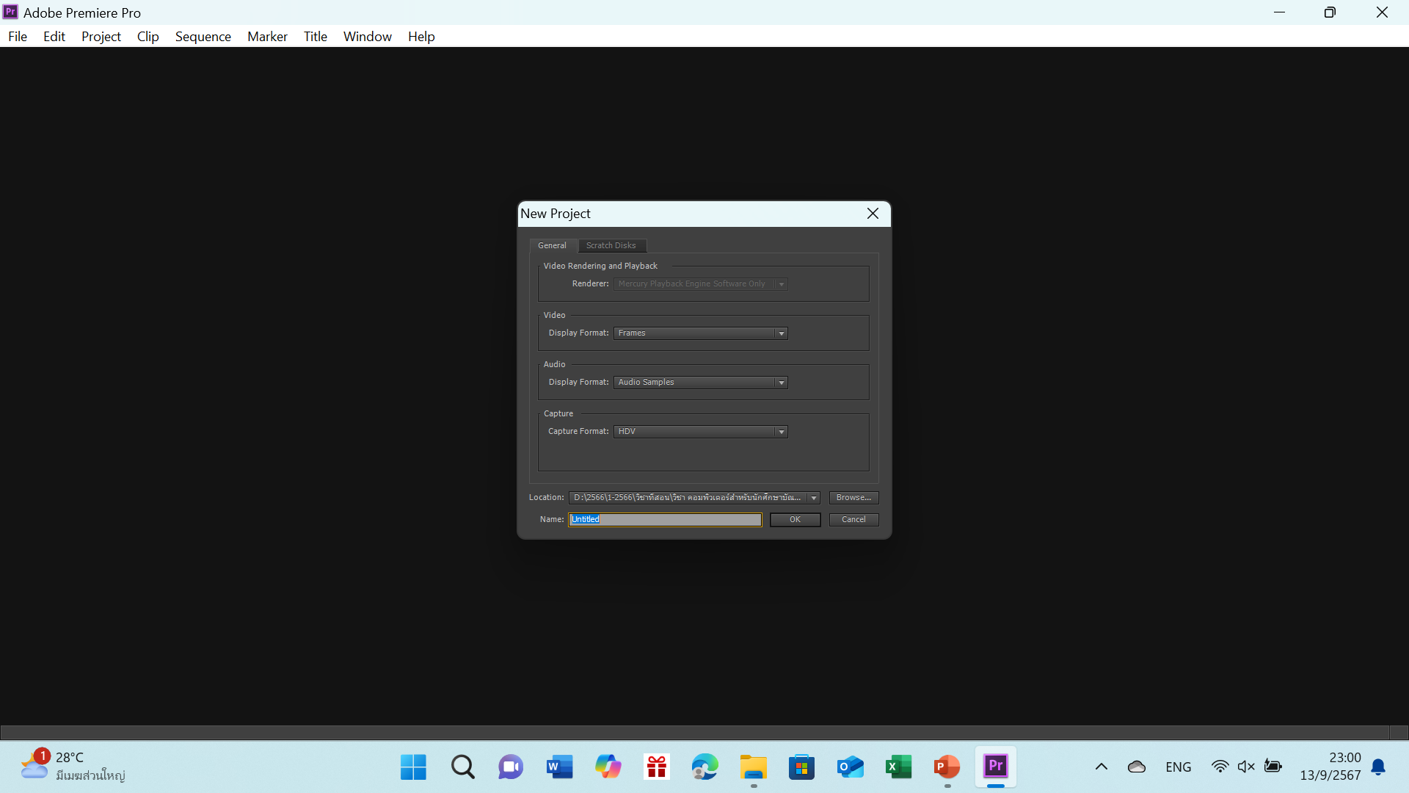
STAGE 1
Create video project

Slide 4
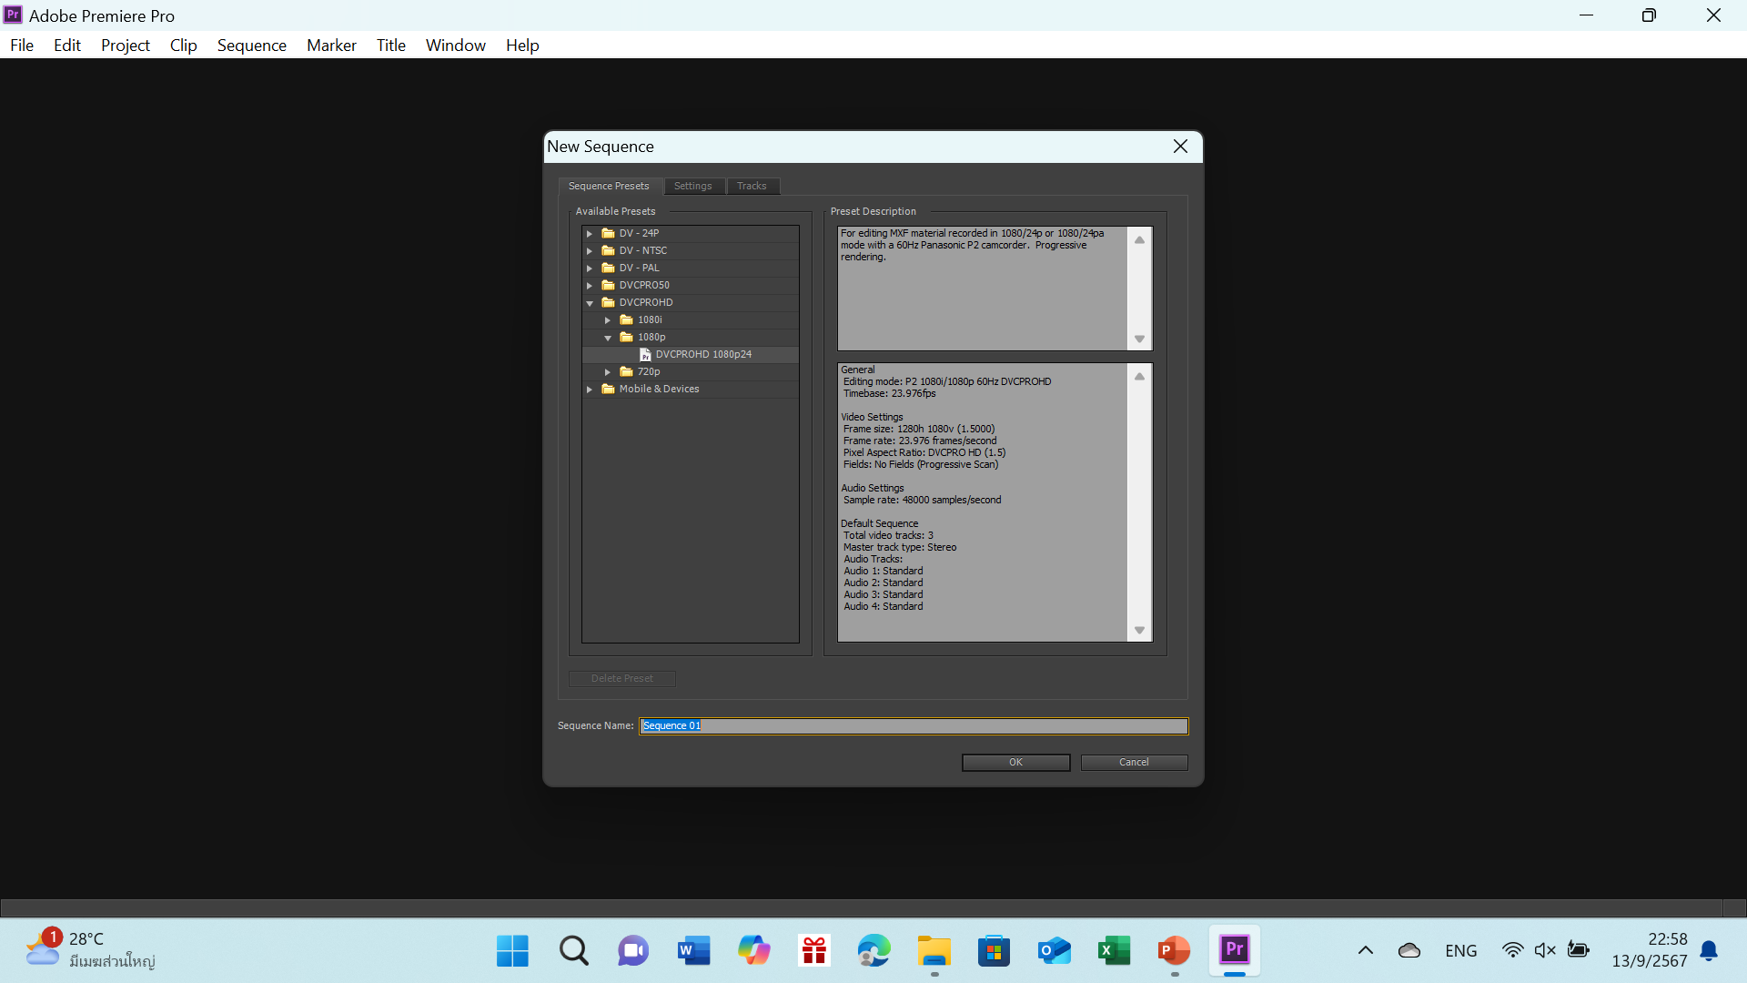

Slide 5
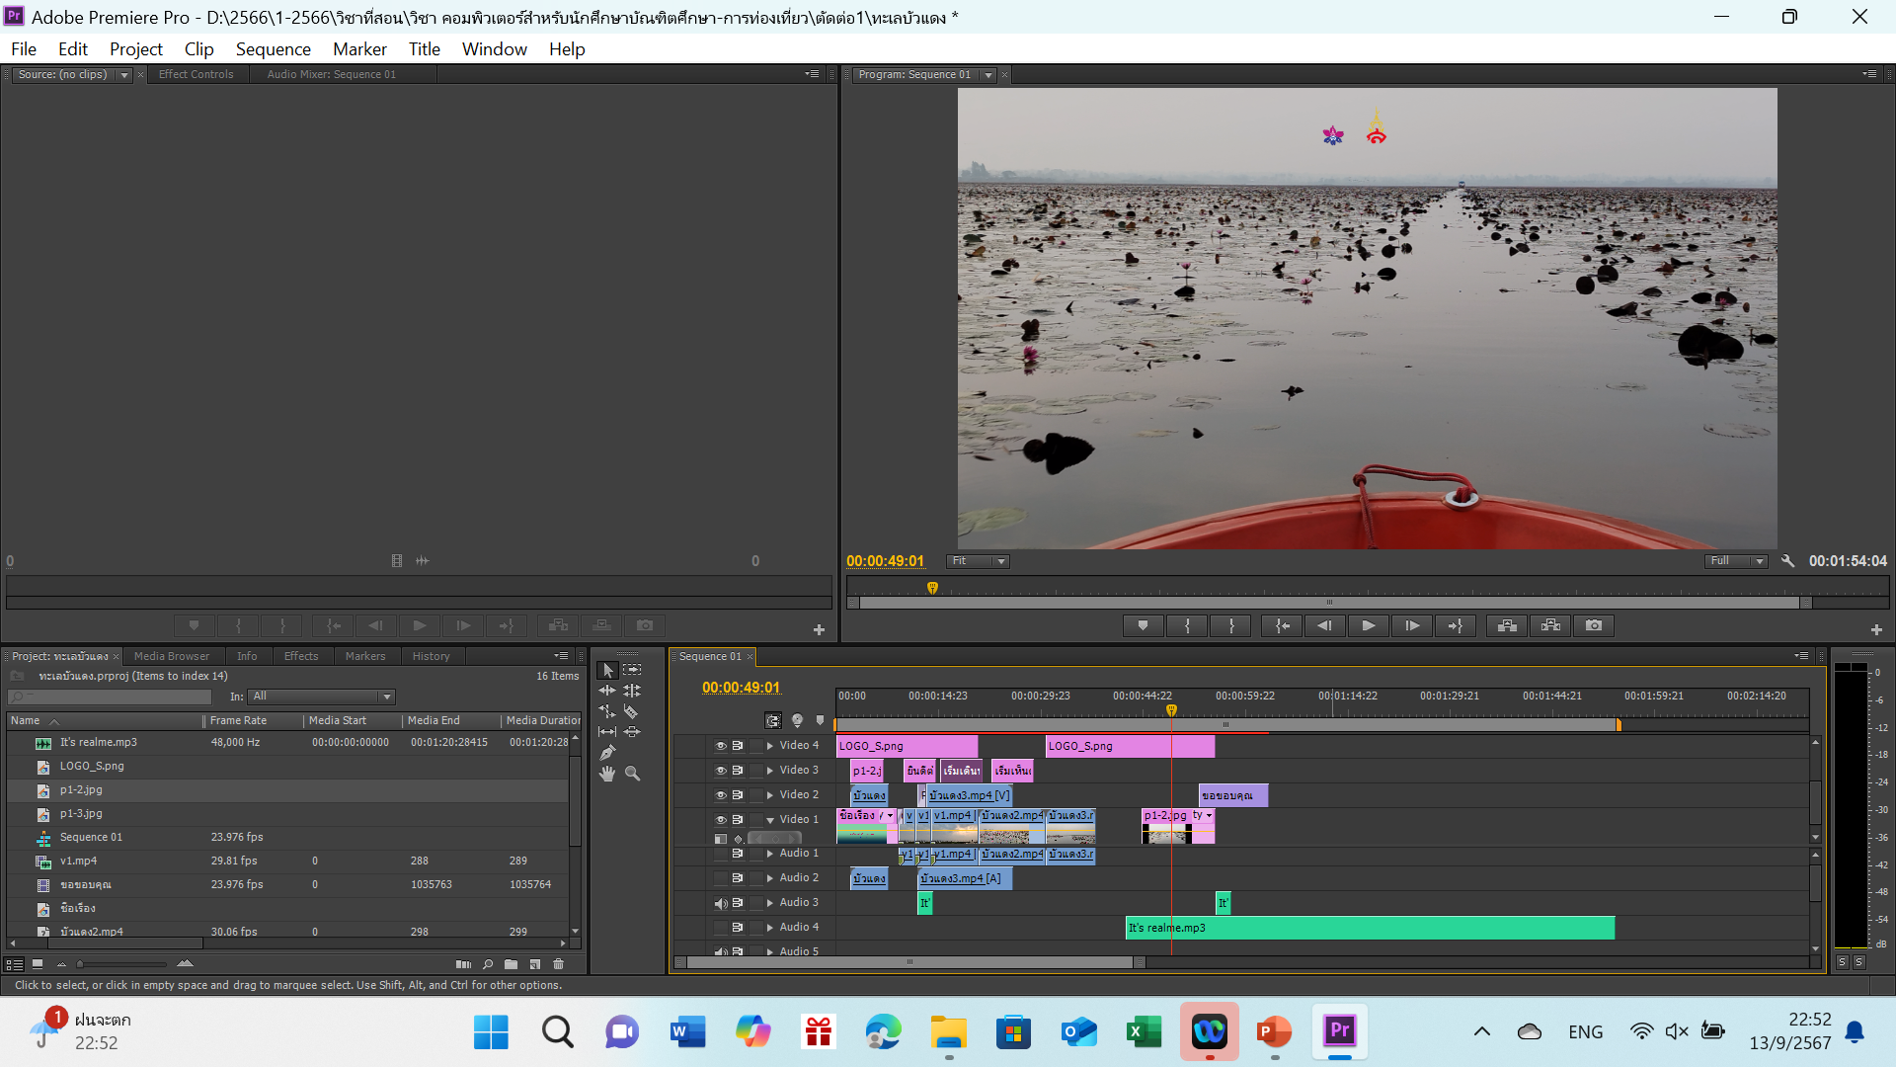
STAGE 2
Drag and drop video files to the project

Slide 6
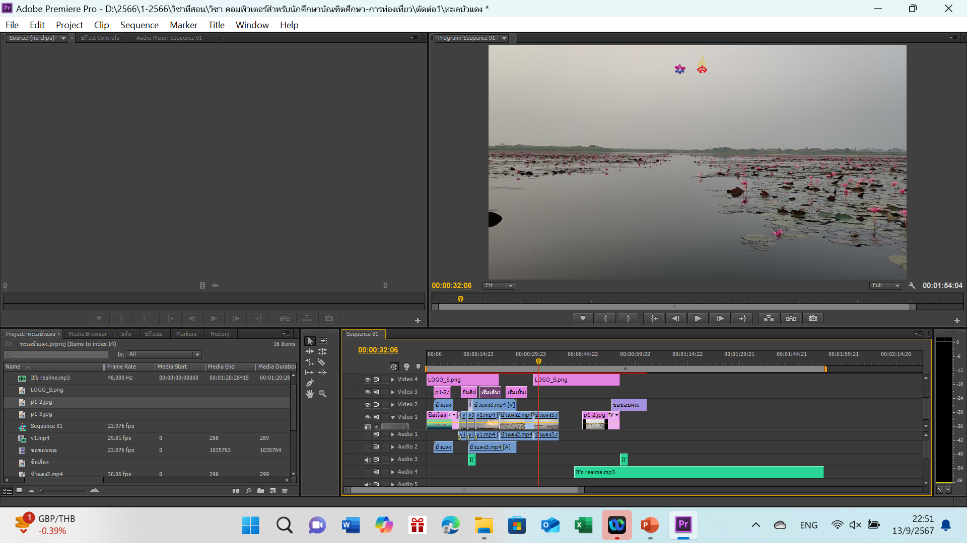
STAGE 3
Create video on Time line

Slide 7
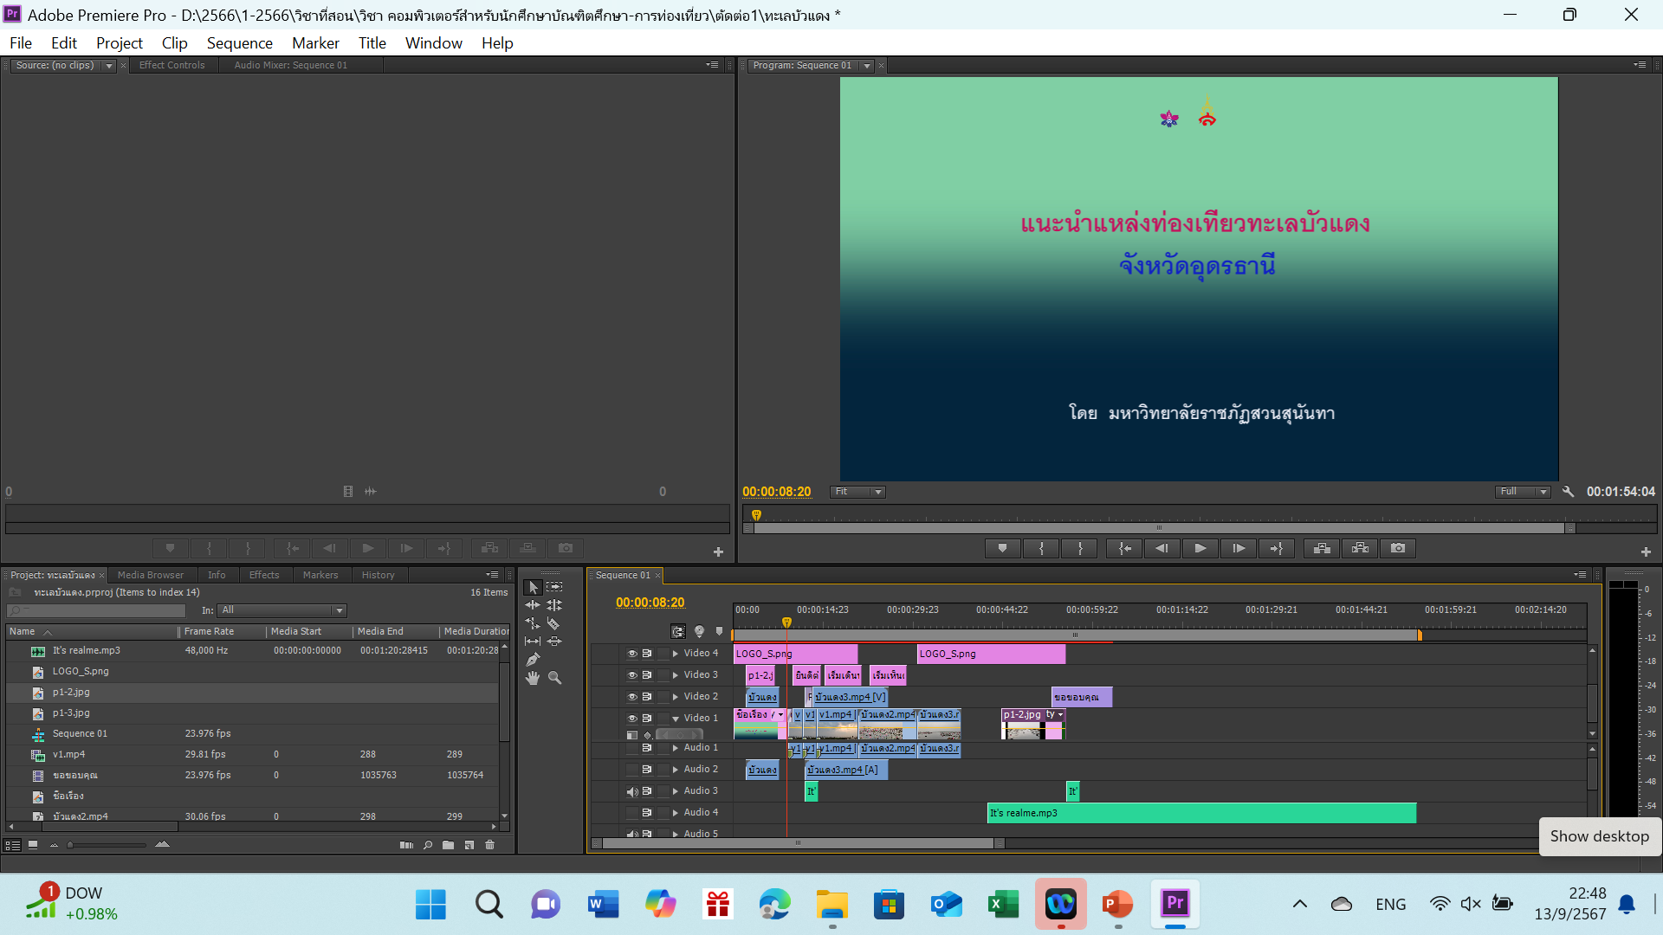
STAGE 4
Front title

Slide 8
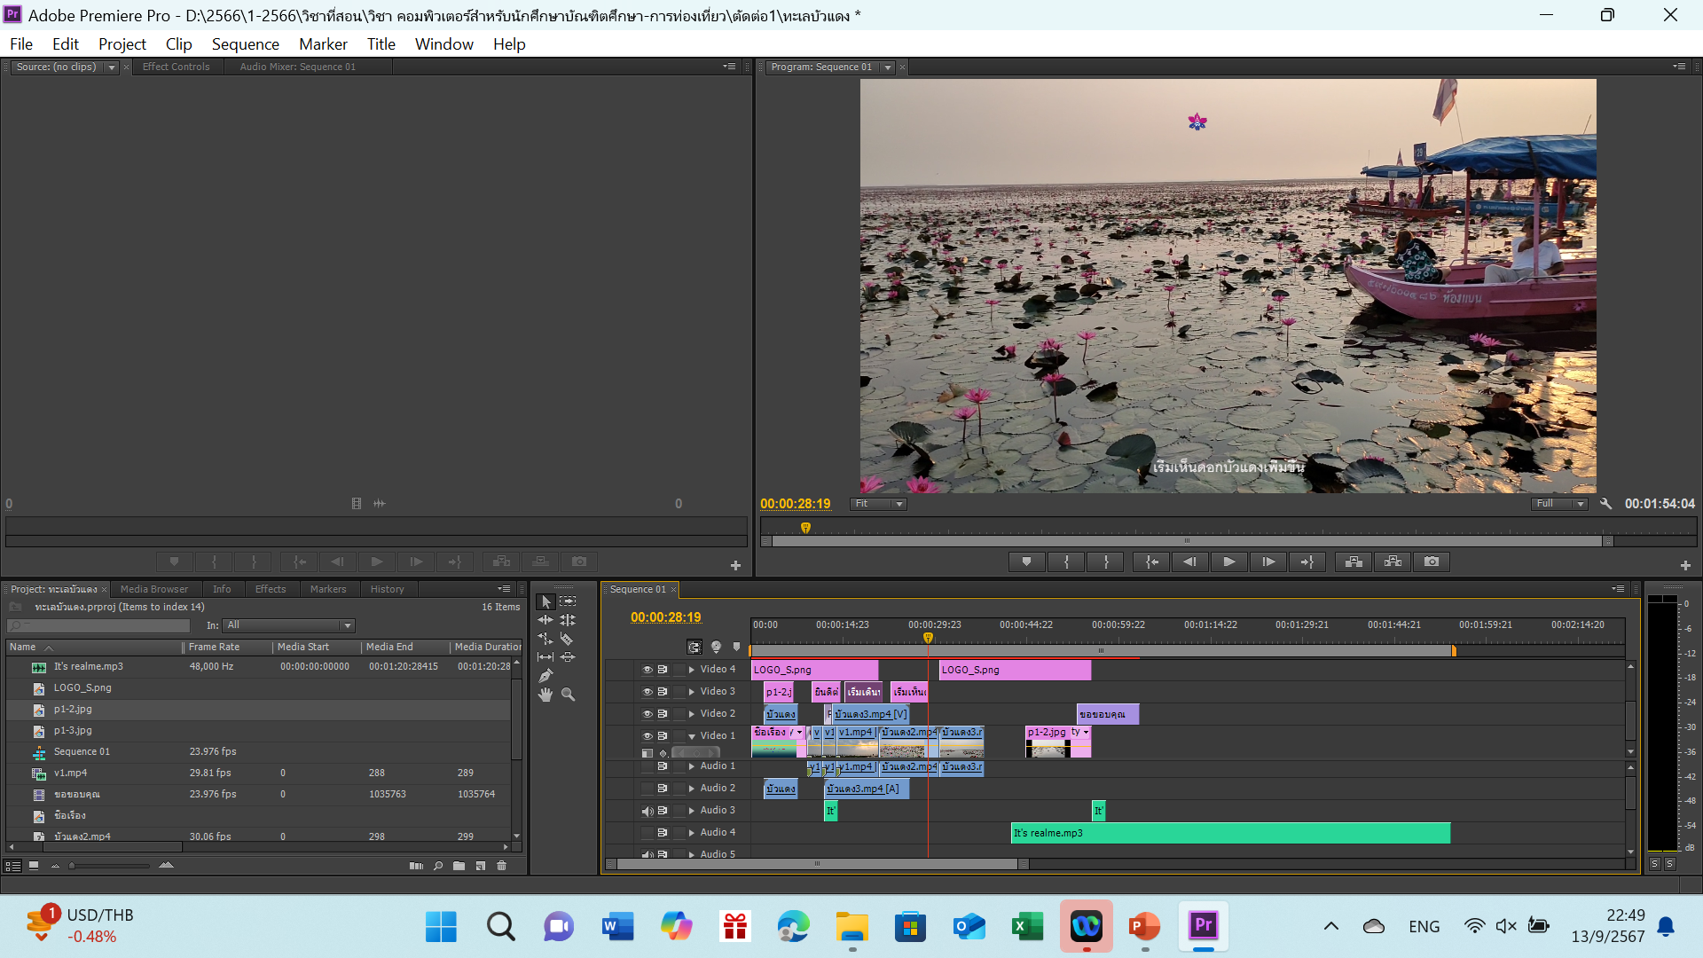
STAGE 5
Sub title

Slide 9
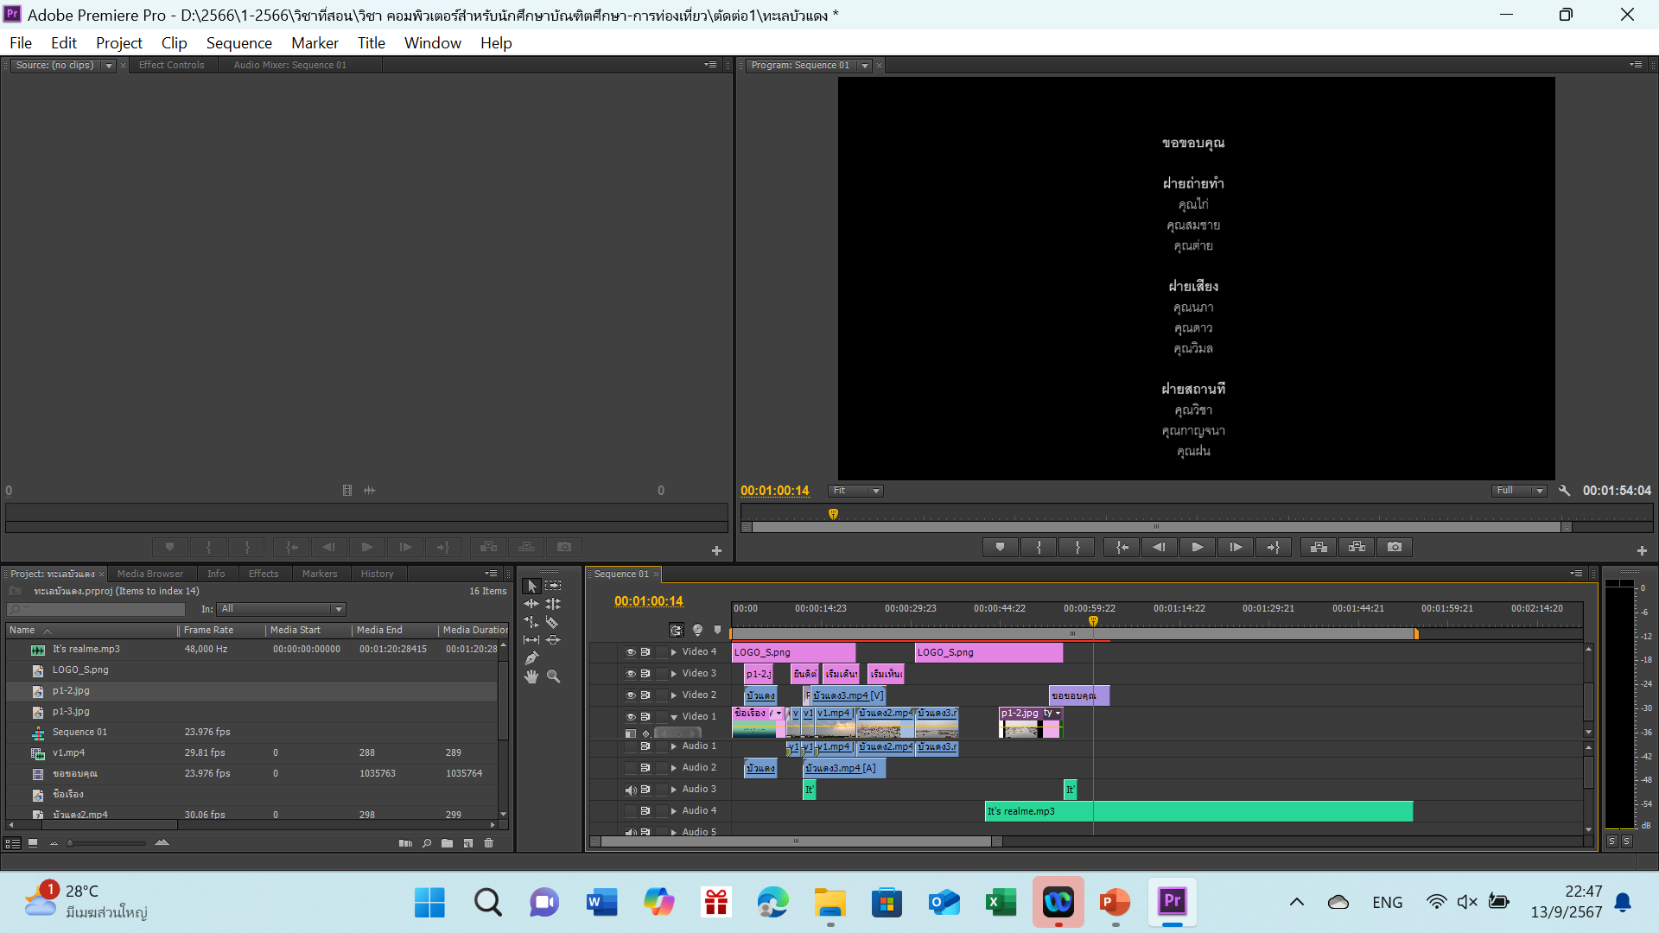
STAGE 6
End title

Slide 10
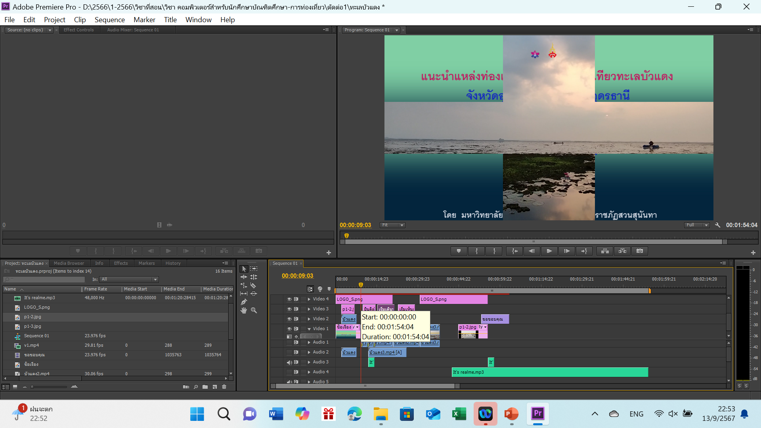
STAGE 7
Video transition effect

