Slide 1

Digital
Transformation

Slide 2
01001001 00100111 01101101 00100000 01100100 01101001 01100111 01101001 01110100 01100001 01101100 00100000 01100010 01111001 00100000 01100100 01101001 01100011 01110100 01101001 01101111 01101110 01100001 01110010 01111001 00101110 00101110 00101110
I'm digital by dictionary.

Slide 3
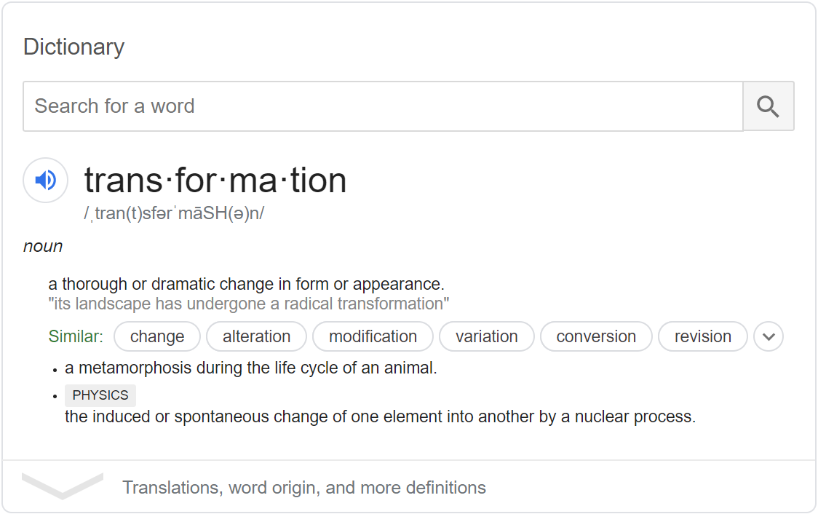

Slide 4

“Digital transformation marks a radical rethinking of how an organization uses technology, people and processes to fundamentally change business performance”
George Westerman, MIT principal research scientist

Slide 5
Why Transformation?

Slide 6

Why Transformation?
DISRUPTED!
New Business

Slide 7
What does a digital transformation look like?

Slide 8





Digital Transformation
are often
cited
Customer experience
Operational agility
Digital technology
integration
Culture and leadership
Workforce enablement

Slide 9
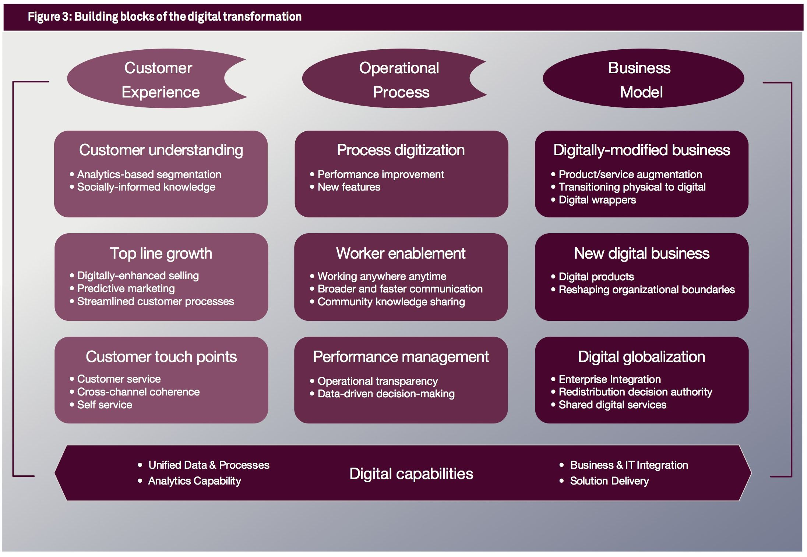
The
Nine
Elements
of
Digital
Transformation
George Westerman, Didier Bonnet, and Andrew McAfee
January 07, 2014

Slide 10
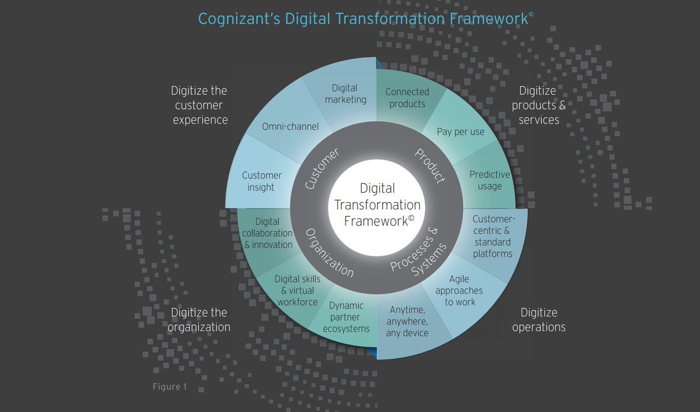

Slide 11
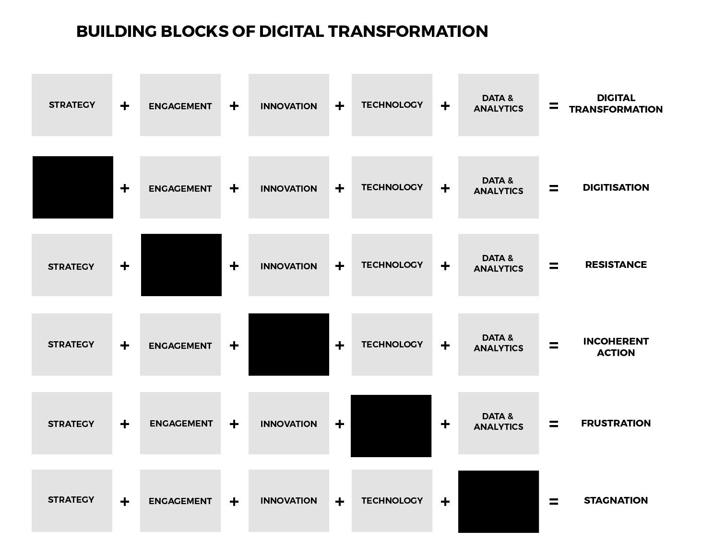

Slide 12
Digitization Example

Slide 13
Digitize the customer experience

Slide 14
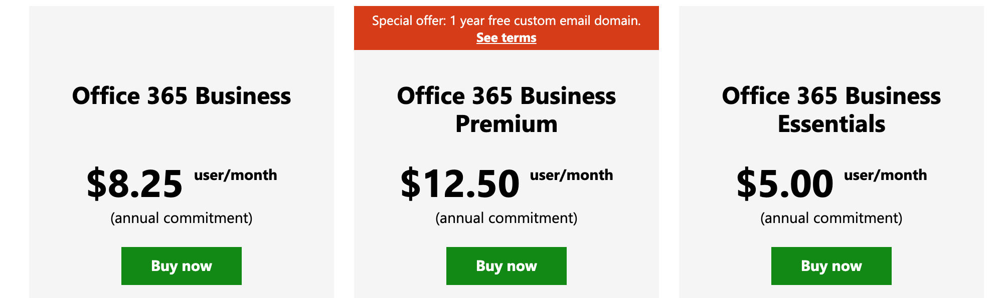
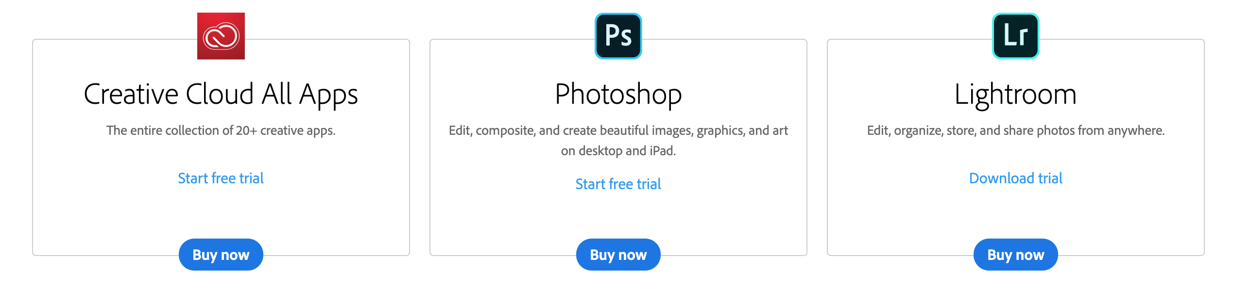
Digitize product and services

Slide 15
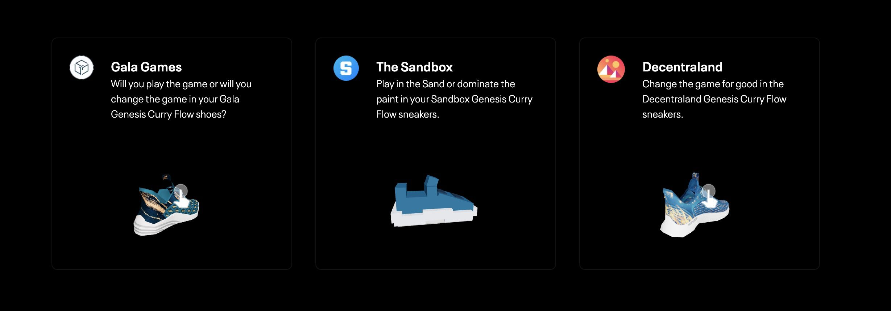
Digitize product and services

Slide 16



Digitize Operations

Slide 17
Digitize the organization

Slide 18
What are the interesting trends in digital transformation in 2022?

Slide 19
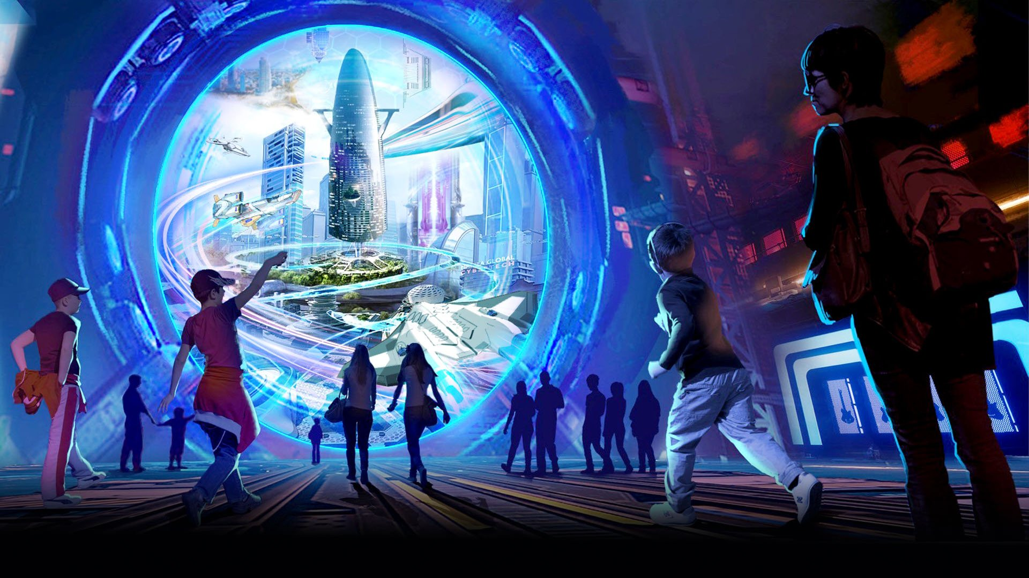
Metaverse

Slide 20
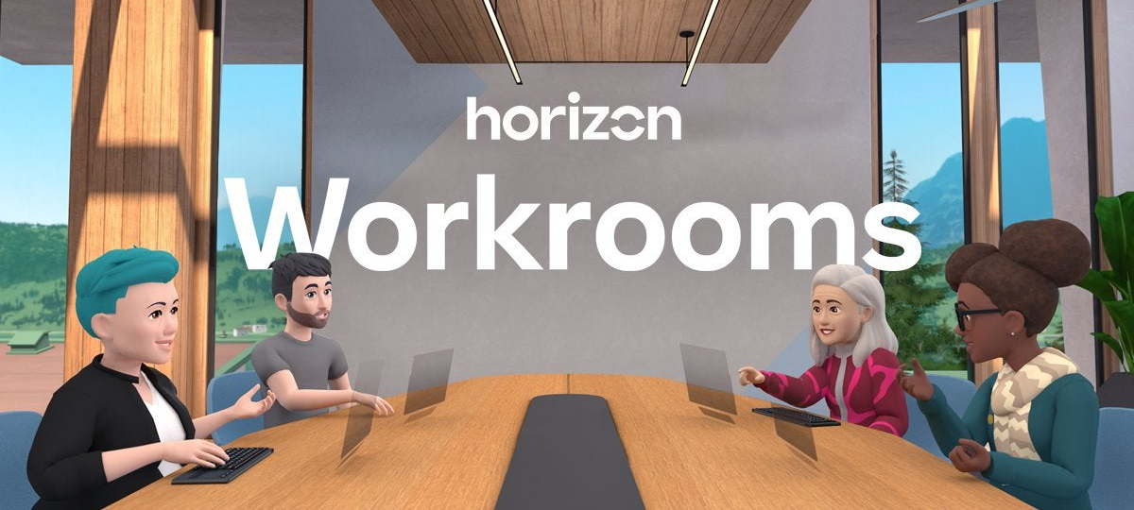
Metaverse

Slide 21
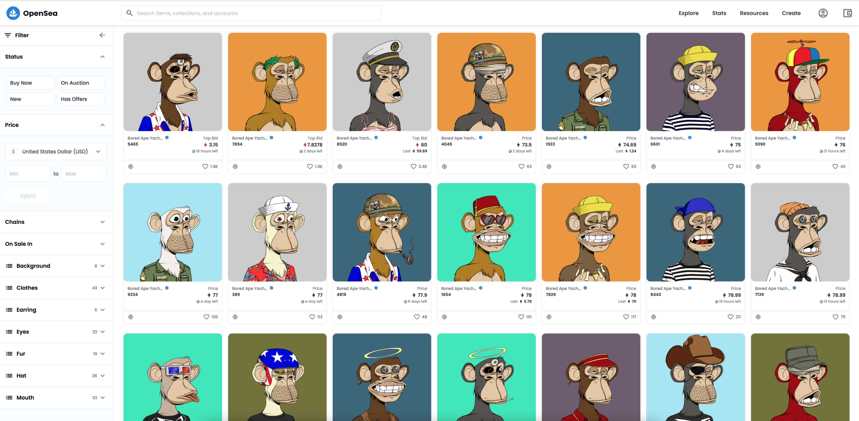
NFT (Non-Fungible Tokens)

Slide 22
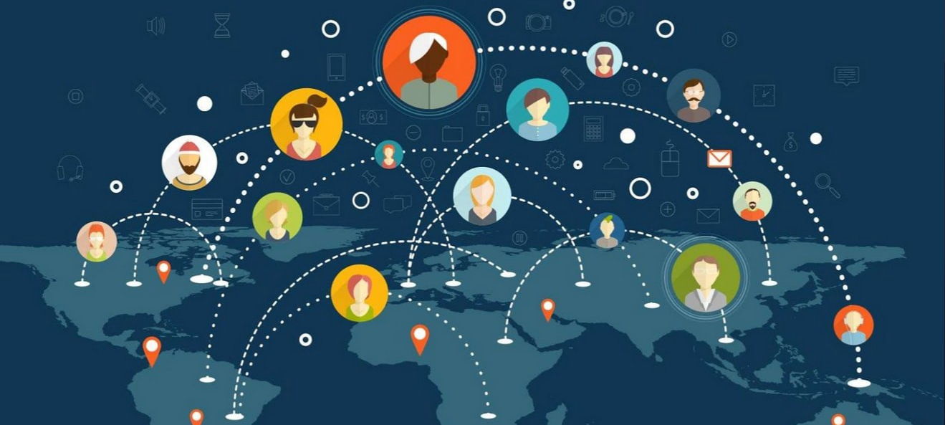
Distributed Companies

Slide 23
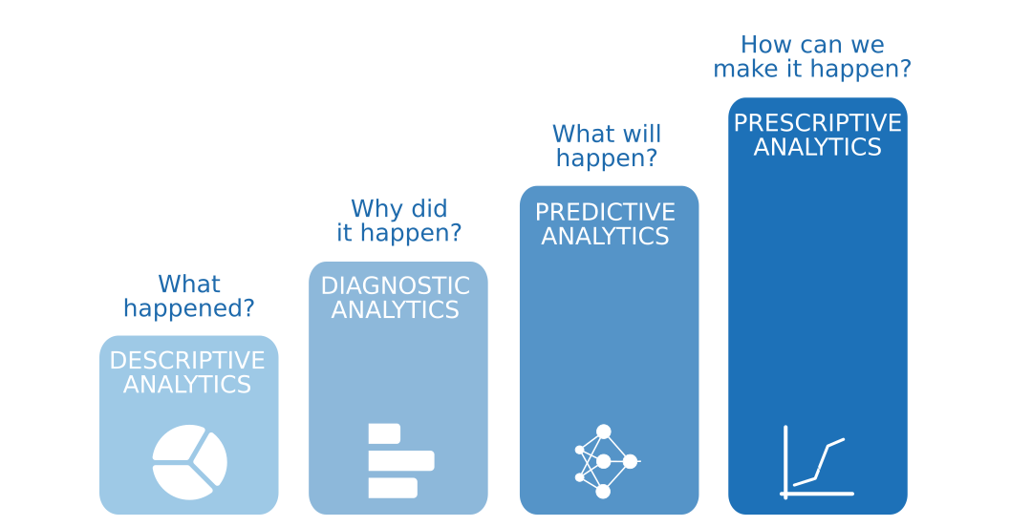
Predictive Analytics

Slide 24
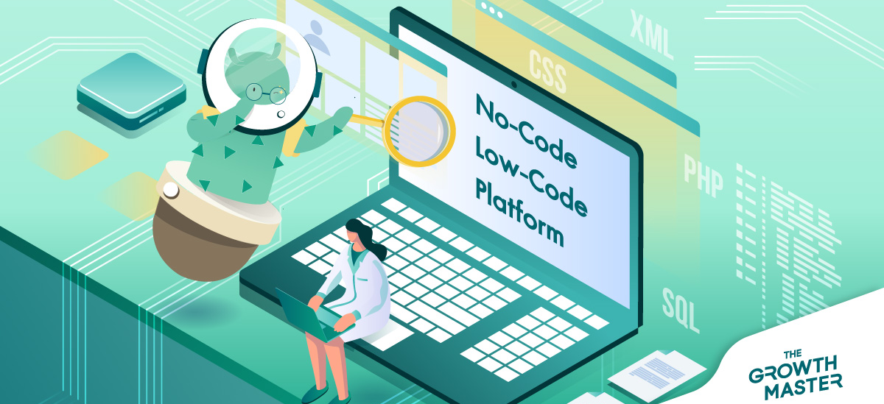
Low-Code Services

Slide 25


Low-Code Services
By 2024, low-code application development will be responsible for more than 65% of application development activity. (Gartner)
70% of new applications developed by organizations will use low-code or no-code technologies by 2025, up from less than 25% in 2020. (Gartner**)
The global low-code development platform market is predicted to generate a revenue of $187 billion by 2030, rising from $10 billion in 2019, and is expected to advance at a fast pace, 31% CAGR, during the forecast period. (GlobeNewswire)

Slide 26
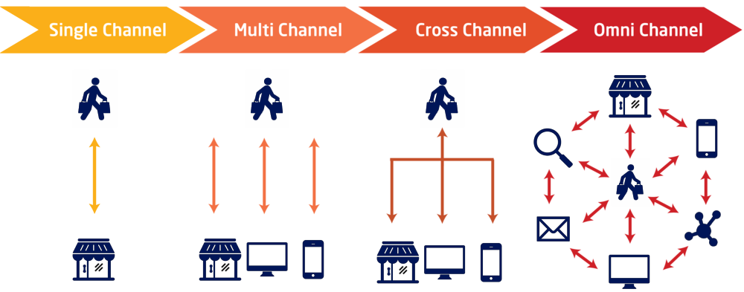
Greater Focus on Omnichannel Retailing

Slide 27

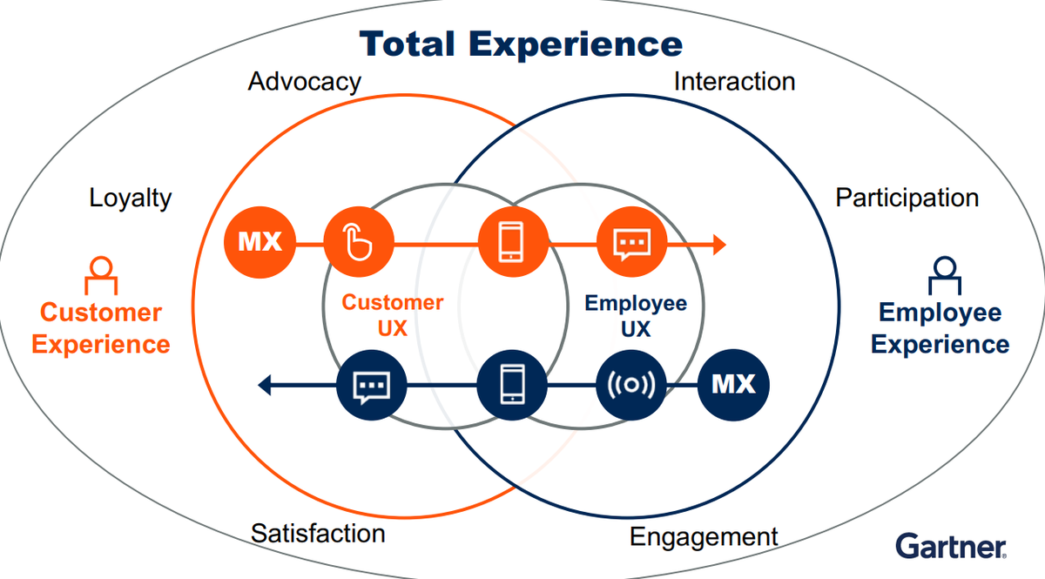
Total Experience (TX)

Slide 28


