Slide 1
Welcome to Business World

Slide 3
Business Plan
What Is a Business Plan?
Why write a business plan?
Understanding Business Plans
Elements of a Business Plan
Types of Business Plans
5 tips to write a great business plan quickly and easily

Slide 4
What Is a Business Plan?

Slide 5
Business Plan
Business plans are important documents used to attract investment before a company has established a proven track record. They are also a good way for companies to keep themselves on target going forward.
Although they're especially useful for new businesses, every company should have a business plan. Ideally, the plan is reviewed and updated periodically to see if goals have been met or have changed and evolved. Sometimes, a new business plan is created for an established business that has decided to move in a new direction.
A business plan is a written document that describes in detail how a business usually a startup defines its objectives and how it is to go about achieving its goals. A business plan lays out a written roadmap for the firm from marketing, financial, and operational standpoints.

Slide 6
Why write a business plan?

Slide 7
Why write a business plan?
Grow your business faster
Writing a business plan is about establishing a foundation for your business. You’re not predicting the future; you’re working through the core strategy of your business that will help you grow. This initial document isn’t meant to be perfect but is designed to be reviewed and adjusted to help you identify and reach your goals.
Without a business plan as a baseline, it will be far more difficult to track your progress, adjust, and have historical information readily available to reference when making difficult decisions. Creating a business plan ensures that you have a roadmap that doesn’t just outline where you plan to go, but where you’ve already been.

Slide 8
Why write a business plan?
Pitch and get funding
Investors and loan providers need to know that you have a solid understanding of the trajectory of your business. You need to prove that there is an attainable and sustainable need for your solution, that you have a strong business strategy, and that your business can be financially stable. This means having the right financial statements, forecasts, and a digestible explanation of your business model available for potential investors.
Writing your business plan helps you put all those pieces together and create connections between them to tell a cohesive story about your business.

Slide 9
Why write a business plan?
Make confident strategic decisions
Often the biggest decisions you’ll make for your business are amidst volatile periods of growth, decline, or even external crises. This requires you to make highly consequential decisions far more quickly than you may like. Without up-to-date planning and forecast information, these decisions may be less certain or strategic than they need to be.
By having a written business plan that you’re regularly reviewing, you can make confident decisions. You’ll have all the information necessary to know when you can hire new employees, launch a new product line or make a major purchase. At the same time, you can also plan in case a decision doesn’t work out as expected, minimizing your potential risk.

Slide 10
Understanding Business Plans

Slide 11
Understanding Business Plan
Operating without a business plan is not usually a good idea. In fact, very few companies can last very long without one. There are more benefits to creating and sticking to a good business plan including being able to think through ideas without putting too much money into them and, ultimately, losing in the end.
A good business plan should outline all the projected costs and possible pitfalls of each decision a company makes. Business plans, even among competitors in the same industry, are rarely identical. But they all tend to have the same basic elements, including an executive summary of the business and a detailed description of the business, its services, and its products. It also states how the business intends to achieve its goals.

Slide 12
Elements of Business Plans

Slide 13
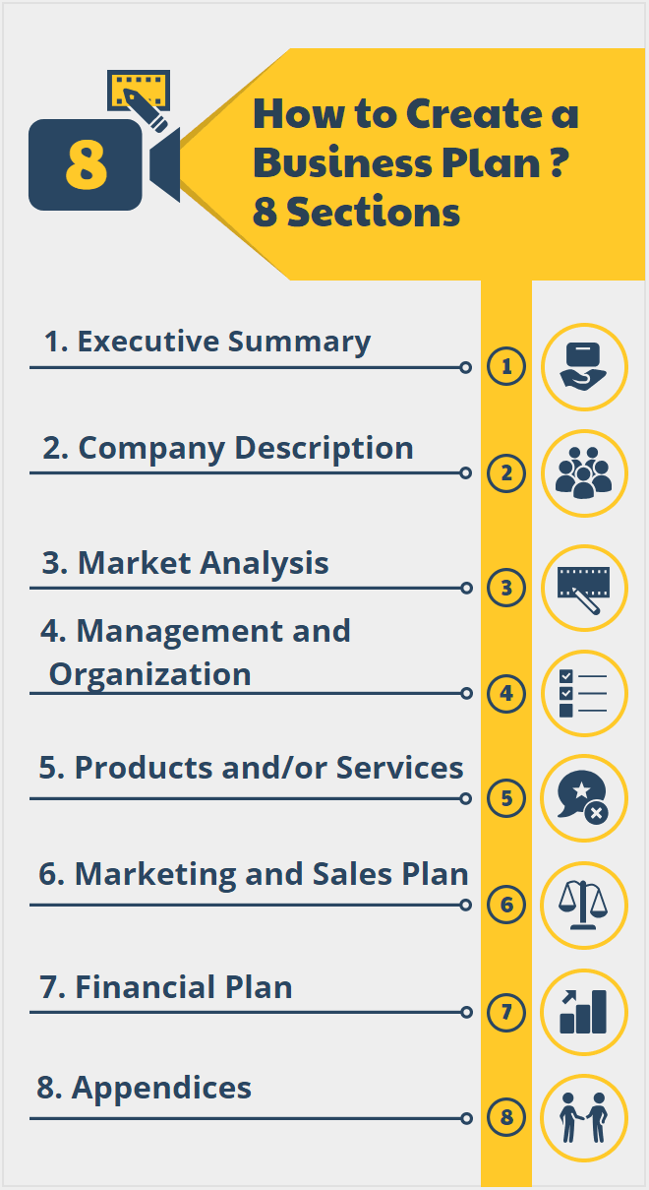
Elements of Business Plan
The length of the business plan varies greatly from business-to-business. All the information should fit into a 15-20 pages document. If there are crucial elements of the business plan that take up a lot of space such as applications for patents they should be referenced in the main plan and included as appendices.

Slide 14
Elements of Business Plan
Executive summary
This section outlines the company and includes the mission statement along with any information about the company's leadership, employees, operations, and location.

Slide 15
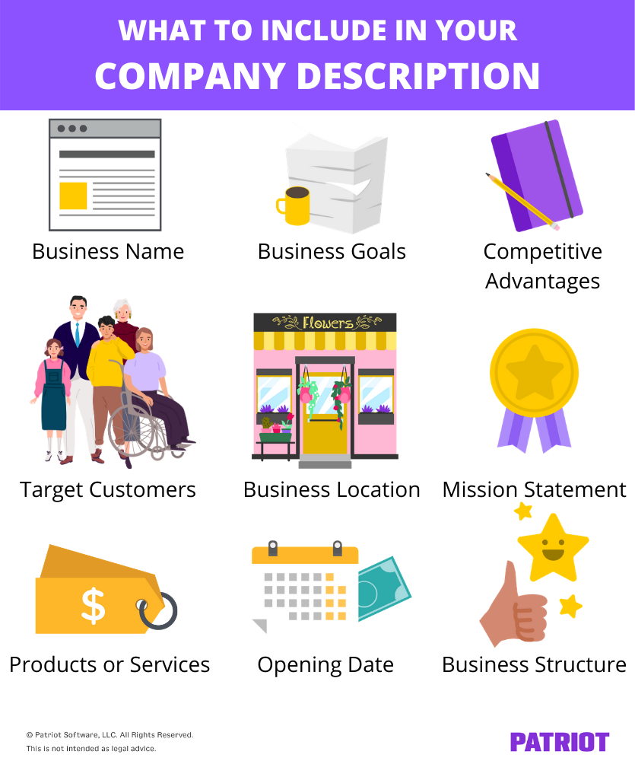
Elements of Business Plan
Company description
Use your company description to provide detailed information about your company. Go into detail about the problems your business solves. Be specific, and list out the consumers, organization, or businesses your company plans to serve.
Explain the competitive advantages that will make your business a success. Are there experts on your team? Have you found the perfect location for your store? Your company description is the place to boast about your strengths

Slide 16
Elements of Business Plan
Market analysis
You'll need a good understanding of your industry outlook and target market. Competitive research will show you what other businesses are doing and what their strengths are. In your market research, look for trends and themes. What do successful competitors do? Why does it work? Can you do it better? Now's the time to answer these questions.

Slide 17
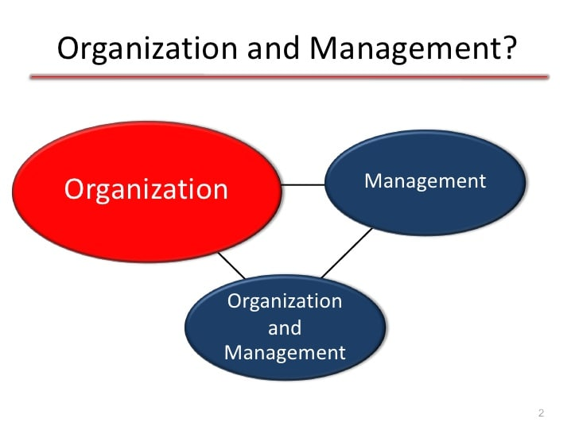
Elements of Business Plan
Organization and management
Tell your reader how your company will be structured and who will run it.
Describe the legal structure of your business. State whether you have or intend to incorporate your business as a C or an S corporation, form a general or limited partnership, or if you're a sole proprietor or limited liability company (LLC).
Use an organizational chart to lay out who's in charge of what in your company. Show how each person's unique experience will contribute to the success of your venture. Consider including resumes and CVs of key members of your team.

Slide 18
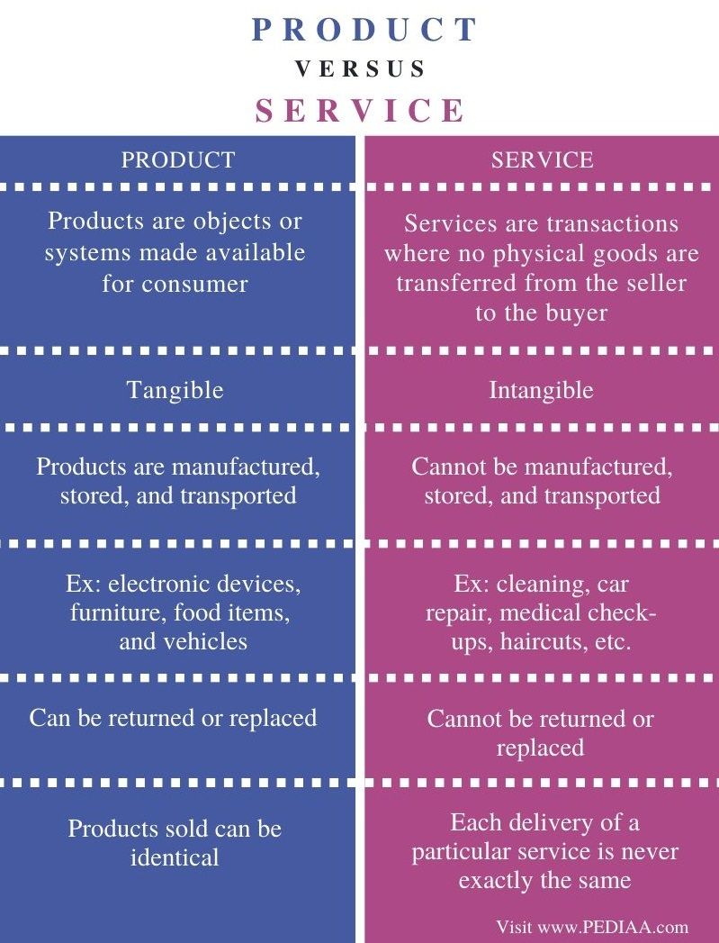
Elements of Business Plan
Products and services
Here, the company can outline the products and services it will offer, and may also include pricing, product lifespan, and benefits to the consumer. Other factors that may go into this section include production and manufacturing processes, any patents the company may have, as well as proprietary technology. Any information about research and development (R&D) can also be included here.

Slide 19
Elements of Business Plan
Marketing strategy
This area describes how the company will attract and keep its customer base and how it intends to reach the consumer. This means a clear distribution channel must be outlined. It will also spell out advertising and marketing campaign plans and through what types of media those campaigns will exist on.

Slide 20
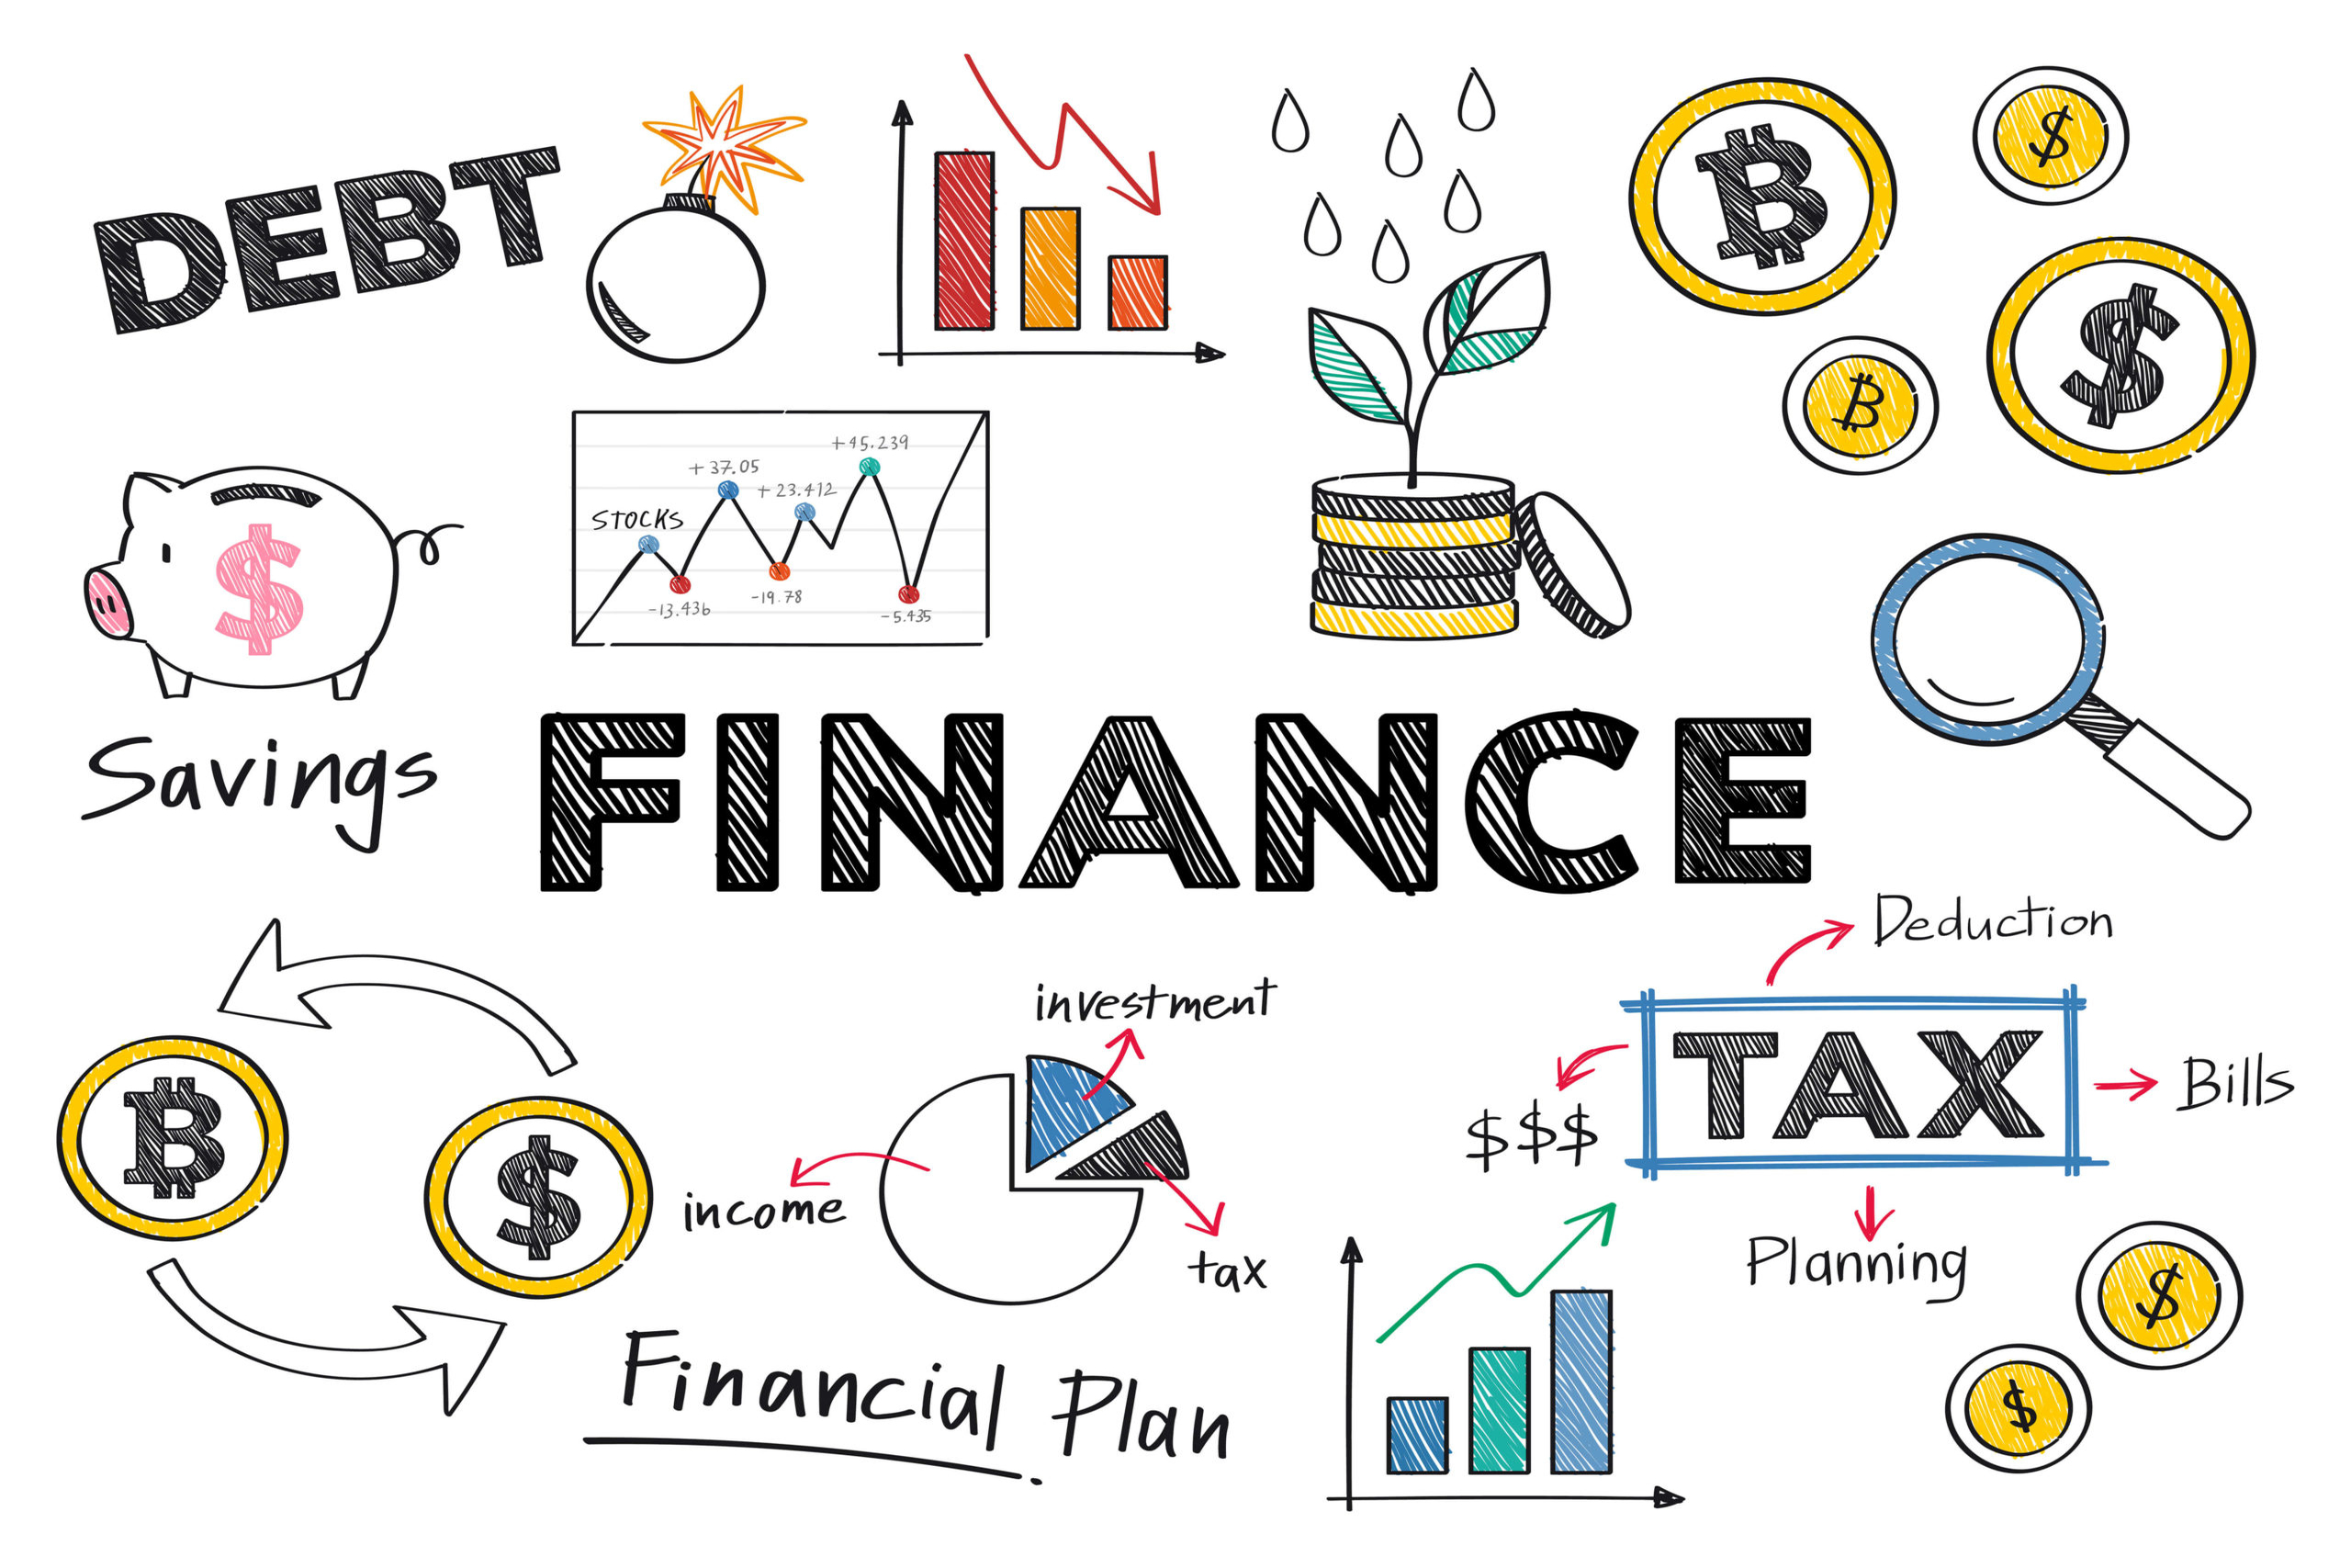
Elements of Business Plan
Financial planning
In order to attract the party reading the business plan, the company should include its financial planning and future projections. Financial statements, balance sheets, and other financial information may be included for already-established businesses. New businesses will instead include targets and estimates for the first few years of the business and any potential investors.

Slide 21
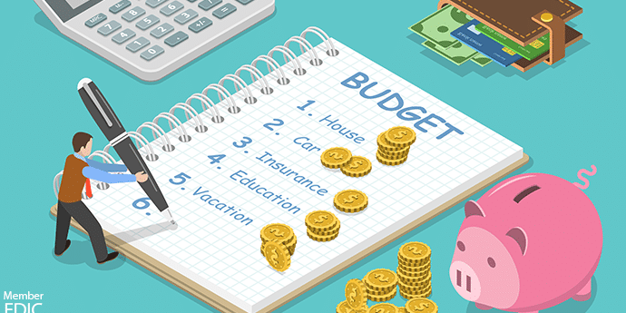
Elements of Business Plan
Budget
Any good company needs to have a budget in place. This includes costs related to staffing, development, manufacturing, marketing, and any other expenses related to the business.

Slide 22
Types of Business Plans

Slide 23
Types of business plan?
Although there are no right or wrong business plans, they can fall into two different categories—traditional or lean startup. According to the Small Business Administration, the traditional business plan is the most common. They are standard, with much more detail in each section. These tend to be much longer and require a lot more work.
Lean startup business plans, on the other hand, use a standard structure even though they aren't as common in the business world. These business plans are short—as short as one page—and have very little detail. If a company uses this kind of plan, they should expect to provide more detail if an investor or lender requests it.

Slide 24
5 tips to write a great business plan quickly and easily

Slide 25
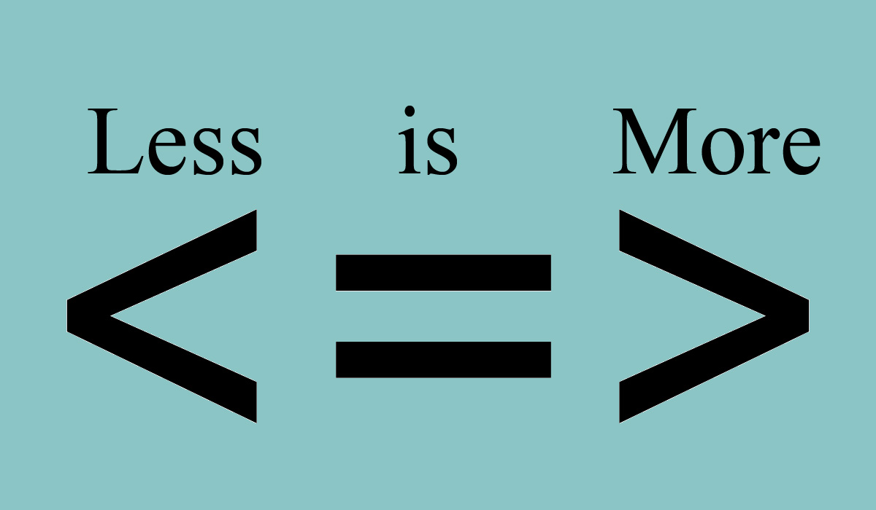
1. Keep it short
First, you want your business plan to be read. No one is going to read a 100-page or even 40-page business plan. Sure, you may need supporting documentation for specific sections, but you can include those elements in your Appendix.
Second, your business plan should be a tool you use to run and grow your business. Something you continue to use and refine over time. An excessively long business plan is a huge hassle to revise you’re almost guaranteed that your plan will be relegated to a desk drawer, never to be seen again.

Slide 26
2. Know your audience
Write your plan using language that your audience will understand.
For example, if your company is developing a complex scientific process, but your prospective investors aren’t scientists, avoid jargon, or acronyms that won’t be familiar.

Slide 27
3. Test your business idea
Working through your business plan, and starting with a one-page pitch, can help you test the viability of your business idea long before launching. As you work through everything from your branding and mission statement, to your opportunity and execution, the best thing you can do is get feedback and test different elements of your business. This can be as simple as having a mentor or partner review elements of your plan or conducting market research and speaking directly to your potential customer base.
The more you test and review elements of your plan, the better your plan and business will be. This can save you from spending days developing a strategy that just isn’t feasible.

Slide 28
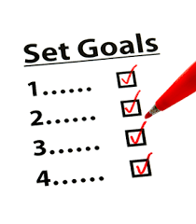
4. Establish goals and objectives
You should know what you want to get out of your business upfront. Are you wanting to turn a side hustle into a full-time business? Trying to expand your team or launch an additional location? Knowing what you’re trying to accomplish, and having questions like these in mind, can help you develop your business plan specifically to reach these goals.
Now, you may not have every milestone or even specific steps in mind to reach your goals before starting. But that’s the beauty of working through your business plan. It will help you define metrics of success, flesh out your goals and further develop elements of your business to meet specific objectives. You just need a vision or even aspirational goals to start with to better home in on what’s important.

Slide 29
5. Don’t be intimidated
Did you know that most business owners and entrepreneurs aren’t business experts? They don’t have MBAs or accounting degrees. They’re learning as they finding tools and resources to help them.
Writing a business plan may seem like a big hurdle, but it doesn’t have to be. You know your business you’re the expert on it. For that reason alone, writing a business plan and then leveraging your plan for growth won’t be nearly as challenging as you think.
And you don’t have to start with the full, detailed business plan that I’m going to describe here. In fact, it can be much easier to start with a simple, one-page business plan what we call a Lean Plan and then come back and build a slightly longer, more detailed business plan later.

Slide 30
THANK YOU
HAVE A NICE DAY

