Slide 1
SWOT ANALYSIS

Slide 3
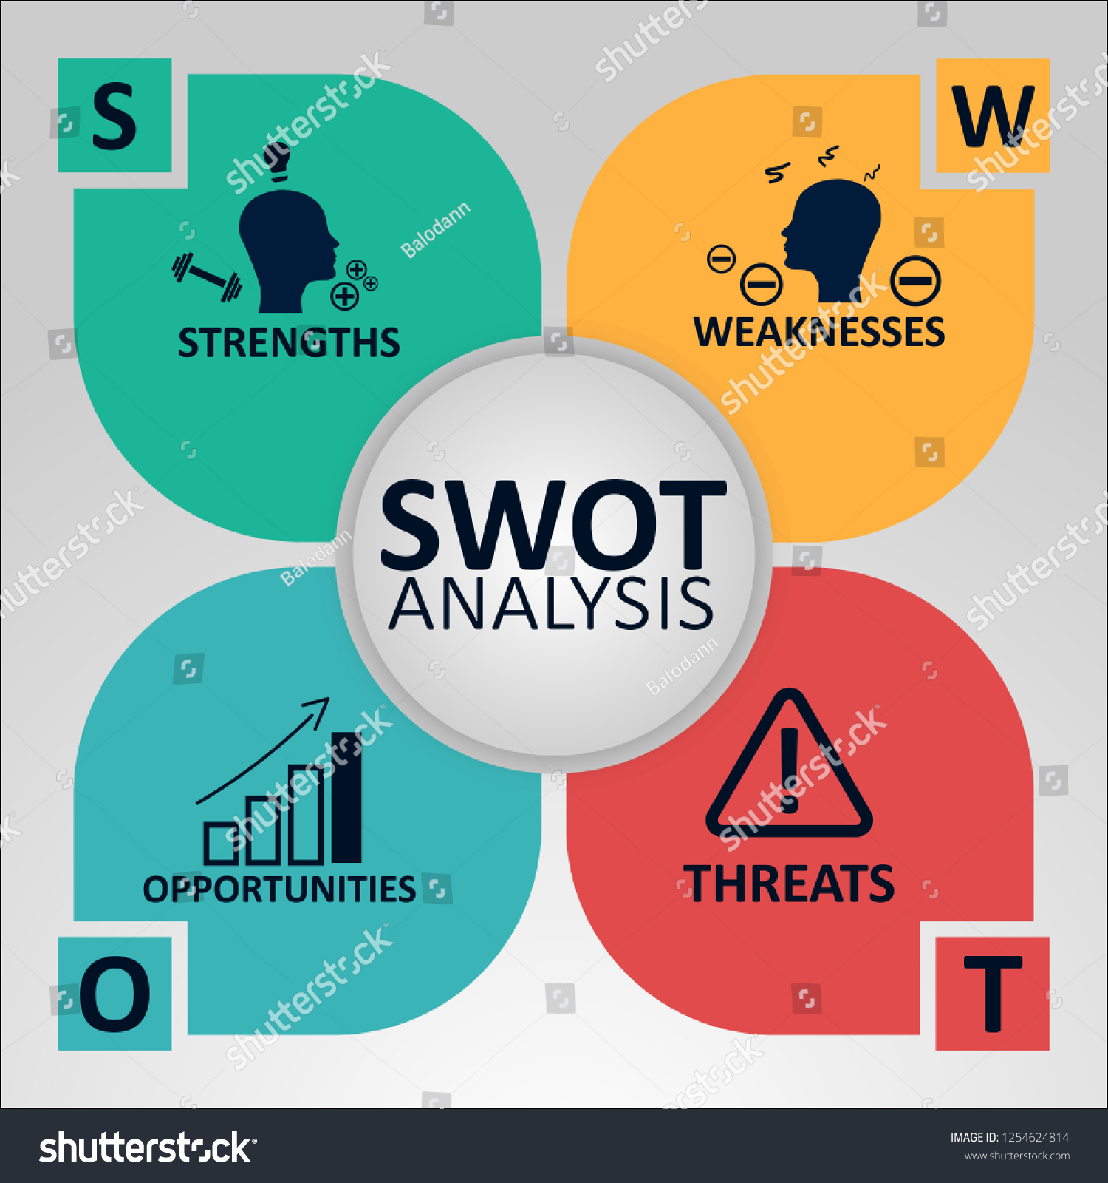
Table of Contents
= WHAT IS SWOT ANALYSIS ?
= WHY MOST PEOPLE USE SWOT ?
= DISADVANTAGES OF swot ANALYSIS
= HOW TO ANALYSE SWOT ?
=> STRENGTH / WEAKNESS / OPPORTUNITY / THREAT
= SWOT ANALYSIS STEPS
=> Let's start with the objectives of SWOT.
=> Understanding businesses, industries and markets
=> starting from strength
=> WEAKNESS ANALYSIS
=> WRITE AN OPPORTUNITY
=> CONSIDERATION OF THREAT
=> Priority factors
=> Create a Strategic Plan

Slide 4
WHAT IS SWOT ANALYSIS ?
=> Finding ways to gain a business advantage and avoid failure from factors that can be easily overlooked, we use SWOT as a tool to analyze the environment and business potential. The projects or individuals and will separate SWOT into Internal & External Factors.
=> Internal factors are 'strengths' and 'weaknesses' as referring to factors that the company can control such as products, employees, or marketing methods.
=> External factors are 'opportunities' and 'threat' refer to factors that the company cannot control (but can be avoided or exploited) such as economic conditions, competitors, raw material prices or customer purchasing habits, etc.

Slide 5
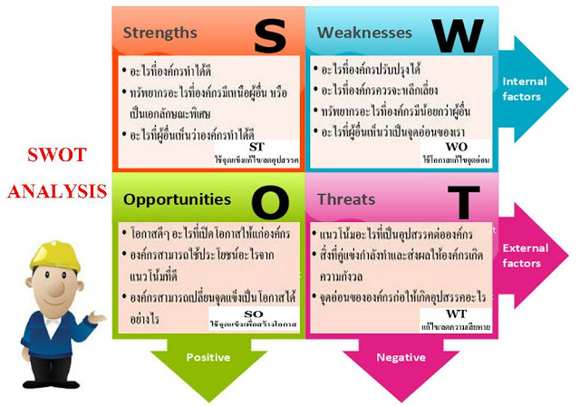

Slide 6
WHAT IS SWOT ANALYSIS ?
Strengths (Internal factors)
=> strength or s is a factor that is an organization's advantage to distinguish competitors. It is difficult to imitate. For example, as a lower-cost, because has been invested for a long time and there are more well-known brands, etc.

Slide 7
WHAT IS SWOT ANALYSIS ?
weakness (Internal factors)
=> weakness or W is a factor that is an organization's weakness, making it less favorable than its competitors. This is a negative factor from organizational defects that should be corrected. There are fewer known products or varieties of products than other competitors.

Slide 8
WHAT IS SWOT ANALYSIS ?
opportunity (External factors)
=> Opportunity or the O of SWOT is a factor and environment outside as the organization that is an opportunity to produce good results. Organizations can use it to develop or gain an advantage over competitors. For example, Competitors now have bad news. The government has a project to support or during this time the market is rising the product might sell well.

Slide 9
WHAT IS SWOT ANALYSIS ?
threat (External factors)
=> Threat or T of SWOT is a factor and external environment that 'threat' causes negative effects. That organization must go through and adapt to survive for example competitors launch new products to compete in the market or new technology trends that will replace the old products that sell well for the organization

Slide 10
WHY MOST PEOPLE USE SWOT ?
=> SWOT is a simple and comprehensive approach. SWOT tools can help reduce factors in four categories. Only in this way can we decide how best to manage resources.

Slide 11
DISADVANTAGES OF swot ANALYSIS ?
In business, It's said strategy is not important, no matter how much information you have and what your plan is. If you can't get the results, your plan or information is worthless. SWOT It’s our strengths, weaknesses, opportunities and obstacles analysis tool. This analysis allows us to see the internal and external perspectives of ourselves or the organization, but it is not enough to formulate strategies. This means that SWOT users need to guide the further analysis of this information to create actions with business value.
What popular people do Another is to bring SWOT internal and external data into action through another called TOWS. or how to reduce our weaknesses under certain obstacles

Slide 12
HOW TO ANALYSE SWOT ?
Strengths
From the perspective of competitors, customers or industries, we must understand. What are the advantages of competitors? If all products meet the standards, it is not the advantage of customers. At the same time, if you say the good quality and good service, it means that your competitors have bad products and services.
What are the advantages compared to competitors?
What can you do better than others?
Is there anything different, or is it cheaper or faster than the competition?
What made you sell?
What is your selling point?

Slide 13
HOW TO ANALYSE SWOT ?
weakness
You should try to look at it from the perspective of your competitors as customers or people in the industry. And when you write down for weaknesses you shouldn't think for yourself. Some businesses even require surveys to find their weaknesses with the least bias.
Is there any part that can still be developed?
Which parts should be avoided?
People in the industry see which areas are weak?
What prevents you from closing a sale or losing a customer?

Slide 14
HOW TO ANALYSE SWOT ?
Opportunity
Good opportunity analysis is to first look at your strengths and see how each strength can help in new opportunities. You can, of course, look at the weaknesses to find out. 'Opportunity to mitigate your weaknesses as well.
What business opportunities are you able to access easily?
What business trends can help you?
Has there been any technology change?
Have there been any changes in law or politics regarding you?
Will the habits and behaviour of customers change?
What activities or events can affect us?

Slide 15
HOW TO ANALYSE SWOT ?
Threat
External factors that affect the organization Or something to be extra careful because if it happens, it will be a big problem.
What obstacles are there now?
What are your competitors doing?
Is there a change in the industry standard of your work, product or service?
Is there any new technology that will affect your business?
What weaknesses can hinder your business?

Slide 16
Thank you !
Flora@contoso.com
http://www.contoso.com/

