Slide 1
How to write your Business Plan
** Midterm Points **

Slide 2
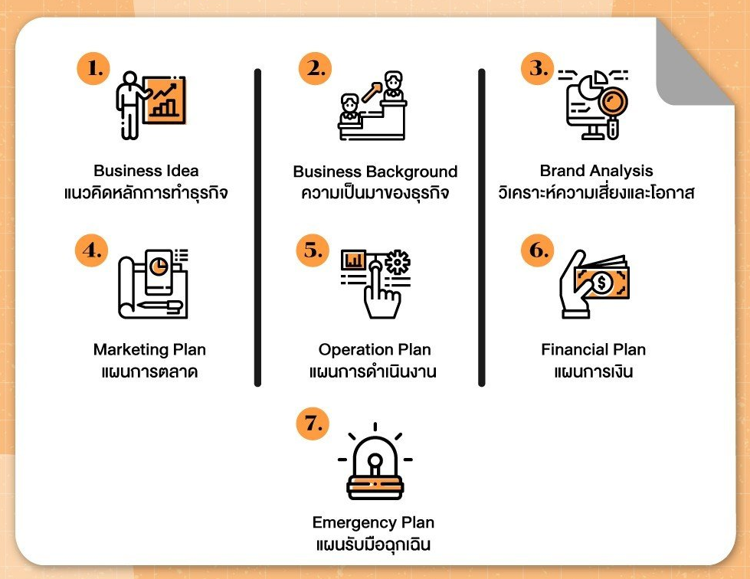
7 Steps to write a business plan for beginners
Writing a good business plan must add value and attract sources of capital to the business because these plans will help your business as able to survive in any situation

Slide 3
1. Business Idea
Business Overview = Writing about the idea, origin and core of our business.
Opportunity and Competition = How we survive in a highly competitive market growth forecast.
Our Goal = To establish a business goal, and we can see the guidelines for short-term and long-term business development.
The strategy = To explain how to do business successfully.
An investment plan = a cost plan to assess investment risk, as we can see how to establish the best value of a business allocation fund?
The expected return = the determination of the return that will be obtained from the risk assessment of business development, such as sales, number of branches or number of members.
This part that we will use in the presentation to build an understanding of the structure and overall business outlook for consumers. Therefore, it is a very important part of the business plan. Because this information can be used to attract service providers interested in our business.

Slide 4
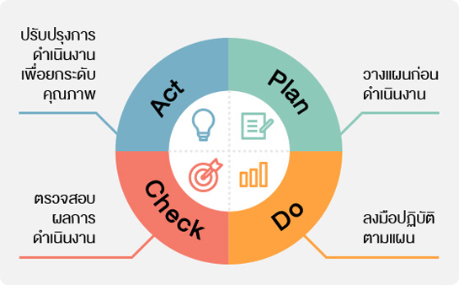
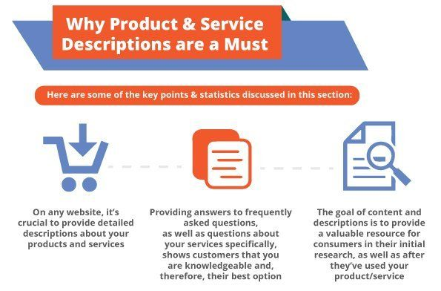
2. Business Background
Type of business
Development Plan
A business background = a description of the nature of the business today, and what will be developed in the future whether it is history Partner Information about products and services address, including various factors that affect business growth
Product & Service Information

Slide 5
3. Business Analysis
Implementation of all business plans Let's analyze strengths, weaknesses and various risks that may arise. To allow us to see both internal factors and external factors that affect the growth of the business Most of them are analyzed in the form of SWOT Analysis.

Slide 6
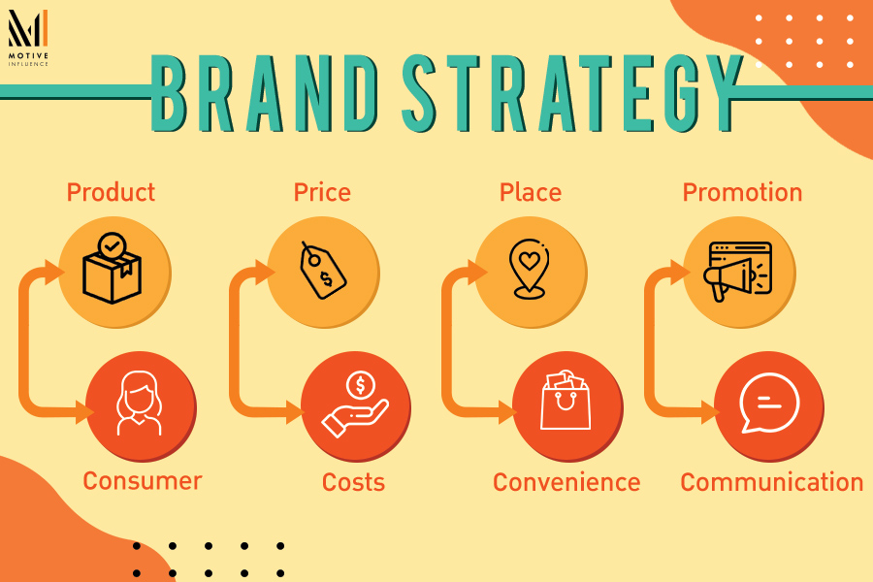
4. Marketing Plan
Explain marketing strategies marketing communication and how to reach customers Most of them are summarized by using a marketing mix (4P Marketing), which is another tool that helps the source of funds to see the way of doing business. Possibility to reach customer groups and would like to invest with us more
Customer Strategy Plan

Slide 7
5. Operation Plan
Production Plan
Quality Control Plan
Scheduling to build a business Each establishment will have different forms and guidelines for operation. For example, a restaurant business may add a POS management system assistant to the raw material and warehouse control process as well. The main steps in the process will consist of;
Employee Management Plan
Raw Material Control Plan
Logistics Plan
Inventory Control Plan
Customer Service Plan

Slide 8
6. Financial Plan
Investment Financial Plan
Estimate Incoming Plan
Financial plans are a very important part of business planning. because it is a high-risk part and if it's not well planned, it can put your business at risk of loss. This part greatly affects the decision of the financial services institution.
Company's financial status
such as profit and loss, cash flow
Sales Forecast Plan
Pay Back Period Plan
Break-even Point Plan

Slide 9
7. Emergency Plan
Planning for resolving emergencies such as natural disasters, economic crisis or complaints from customers to allow the business to continue smoothly, for example, planning to deal with economic problems after the Covid-19 outbreak

Slide 10
Business Plan
A good business plan is the beginning of enterprise success, so a business plan is a business plan. Like a secret, every company has its own.
What is the importance of business planning?
= It is the starting point for business success – the business plan is like a road map. to prepare for starting a business. A good plan would be to bring business success
= Financing - a business plan. It is one of the important documents in sourcing for business financing. Funding providers often consider business credit approvals. From the business plans of entrepreneurs as well.
= Weapons for competition – A good and strong business plan is the strength of the business in analyzing data. and develop the business to be able to compete with business competitors sustainably

Slide 11
Business Plan
Practical by yourself for making
your company plan
Business Plan of Starbucks by Naina Upadhayay on Prezi Next

Slide 12
THANK YOU!

