Slide 1
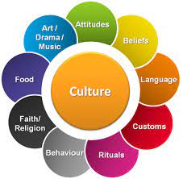
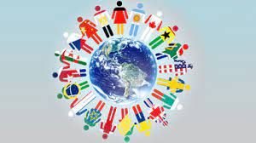
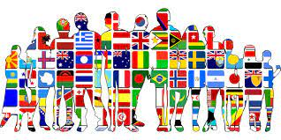

Slide 10
Why Is Culture Important?
Culture gives us a definite starting point when beginning to search for our roots. Knowing where a person comes from will help to define how they look at their family obligations as well as how they celebrate important milestones in life.
Culture is extremely important if a tribe or ethnic group intends to continue living in the same fashion as their ancestors.

Slide 11
CULTURE SHOCK
Are you adaptable?

Slide 12
Adapt, modify, adjust
Explain how you understand the words:
Adaptability
Adaptation
Adaptive
Adaptor

Slide 13
Adaptable – able to change or to be changed to deal successfully with new situations
If you are adaptable, what can you do?
What kind of people are adaptable?
People say cockroaches are very adaptable insects. Why is this?
Are you an adaptable person?

Slide 14
HOW ADAPTABLE ARE YOU?
Work in pairs.
Ask and answer the questions below.

Slide 15
- Have you had to move to a new house several times? How did you feel about this change?
- Have you had to change jobs or schools several times? Do you find it difficult to adapt to a new job or school?
- Have you travelled to different countries? Which ones? Did you enjoy the experience?
- What is the longest time you have lived outside of your country?
- Do you think you are open to different ideas and different cultures?
- Would you go and live in a different country if you spoke the language?
- Would you go and live in a different country if you didn’t speak the language?
- Do you know what culture shock is?

Slide 16
Culture shock
Culture:
way of life – the customs and beliefs, art, way of life and social organization of a particular country or group: European, Islamic, African,
Beliefs /attitudes - the beliefs and attitudes about something that people in particular group share
Culture shock:
a feeling of confusion and anxiety that somebody may feel when they live or visit another country or social group

Slide 17
https://youtu.be/z5EEz_R_RiE

Slide 18
For the past thirty years psychologists and anthropologists have been researching culture shock.
They have studied the reactions and experiences during the first few months in a new country of travellers and diplomats, businesspeople and international students.
Research has shown that what most of these people have in common is a series of reactions to the new culture.
Culture shock can affect people to different degrees, but there is a predictable sequence of stages that people undergo.

Slide 19
Adaptation Re-entry shock Honeymoon Shock Acceptance
Read and explain the stage to the others (Worksheet 1, cards for 5 groups)
Decide what is the order of the stages that someone goes through.

Slide 20
I shall overcome…
Do you think it is possible to avoid culture shock? Why? / Why not?
Is it possible to prepare for culture shock? If ‘yes’, what a person can do?

Slide 21
Experts say that if you have the following characteristics, you will not suffer from culture shock so seriously: open-mindedness, curiosity, a sense of humour, tolerance, a strong sense of self, adaptability and flexibility.
Why do you think this is true?

Slide 22
Speak about culture shock
Do you know anyone who has had culture shock?
Have you ever had culture shock?
People can have culture shock if they change place where they work, or their school, for example. Has this ever happened to you?
Imagine you have a friend who is suffering from culture shock: what would you recommend them to do to suffer less?

Slide 23
Using materials from :
Oxford Advanced Learner’s Dictionary
www.onestopenglish.com – Culture shock , speaking lesson.
Face2Face Pre-intermediate. C.Redston & G.Cunningham. Cambridge University Press
New Opportunities Intermediate (Russian edition). M.Harris, D.Mower and others. Pearson Education ltd

