Slide 1
Doing Business between Thai & CHINA
Aj. Oraphan Decha (Tammy)

Slide 2
Classroom Evaluation
Content | Score
Attendance | 10
Quiz | 10
Exam Midterm + Final | 30 + 30
Work on short clips (Selling your products) | 20
TOTAL | 100

Slide 3
Do you want to have your own business?

Slide 4
5 Reasons to Start Your Own Business
1. You’ll be following your passions.
Many entrepreneurs start their own business to follow their dreams and ”fulfill their passion”. Following your dreams will fulfill you in a way that working for someone else may not do. You oversee creating your business from the ground up, so you can shape your company to be something you’re proud of and that you may even be able to pass on to your children as your legacy.

Slide 5
5 Reasons to Start Your Own Business
2. Each day at the office will be motivating.
When you’re working for someone else, it can be tough to find the motivation to do the best possible work. No matter how much work you put in, the owners of the company will get the ultimate rewards.
When you’re your own boss, you’ll find motivation at work every day. Following your dreams is exciting, and you’re in control of your own success. The day-to-day vitality of your business depends on you, so you’ll be driven to make each day as productive as you can. You’ll know that your own hard work and drive will help you reap the rewards, and that’ll keep the fire burning in your belly to make each day count.

Slide 6
5 Reasons to Start Your Own Business
3. You can achieve financial independence.
Many people commit to starting a business with the dream of financial comfort. While it’s true that getting your company off the ground can take grit and result in some lean times while you’re getting started, the goal of being your own boss is cultivating financial independence. With determination and hard work, there’s no cap on how lucrative your own business can be. If you aspire to build wealth, there’s no reason why you can’t achieve that goal.
Starting your own business has several financial benefits over working for a wage or salary. First, you’re building an enterprise that has the potential for growth – and your wallet grows as your company does. Second, your business itself is an asset. As your business grows, it’s worth more and more. You may decide to sell it, or you may hold on to it and pass it down to your heirs. Either way, it’s valuable.

Slide 7
5 Reasons to Start Your Own Business
4. You can control your lifestyle and your schedule.
Perhaps you’ve spent years in the corporate world, and you feel ready to turn over a new leaf after years of reporting to a superior. Starting your own business can give you a more flexible lifestyle and schedule so you don’t feel like you’re running in circles on that corporate hamster wheel. You can opt to schedule meetings around your family schedule, or you can opt to work from home – the sky’s the limit when you’re the boss. You still must get the work done, but nobody’s looking over your shoulder making sure you do it their way on their time.
Starting a business is hard work, and that flexible schedule may not happen right away. Even if you’re working long hours, however, you know that you’re doing it for yourself and your family and not for a distant boss or shareholder.

Slide 8
5 Reasons to Start Your Own Business
5. You can be creative.
It’s up to you to decide what your business will produce, sell, or which services it will offer – that’s exciting! Rather than following the formula of those who came before you, you’re looking at a chance to develop a concept or an idea that nobody else ever has. Even if you stay mainstream with your product or service, each day as an entrepreneur allows you to find new, outside-the-book ways to problem solve. Innovation and creativity are necessary traits for a successful entrepreneur, and you’ll hone those skills daily.

Slide 10
The steps to start your business
Market Research
Business
Plan
Business
Location
Business
Bank Account
Business
Name

Slide 11
The steps to start your business
Conduct market research
Market research will tell you if there’s an opportunity to turn your idea into a successful business. It’s a way to gather information about potential customers and businesses already operating in your area. Use that information to find a competitive advantage for your business.

Slide 12
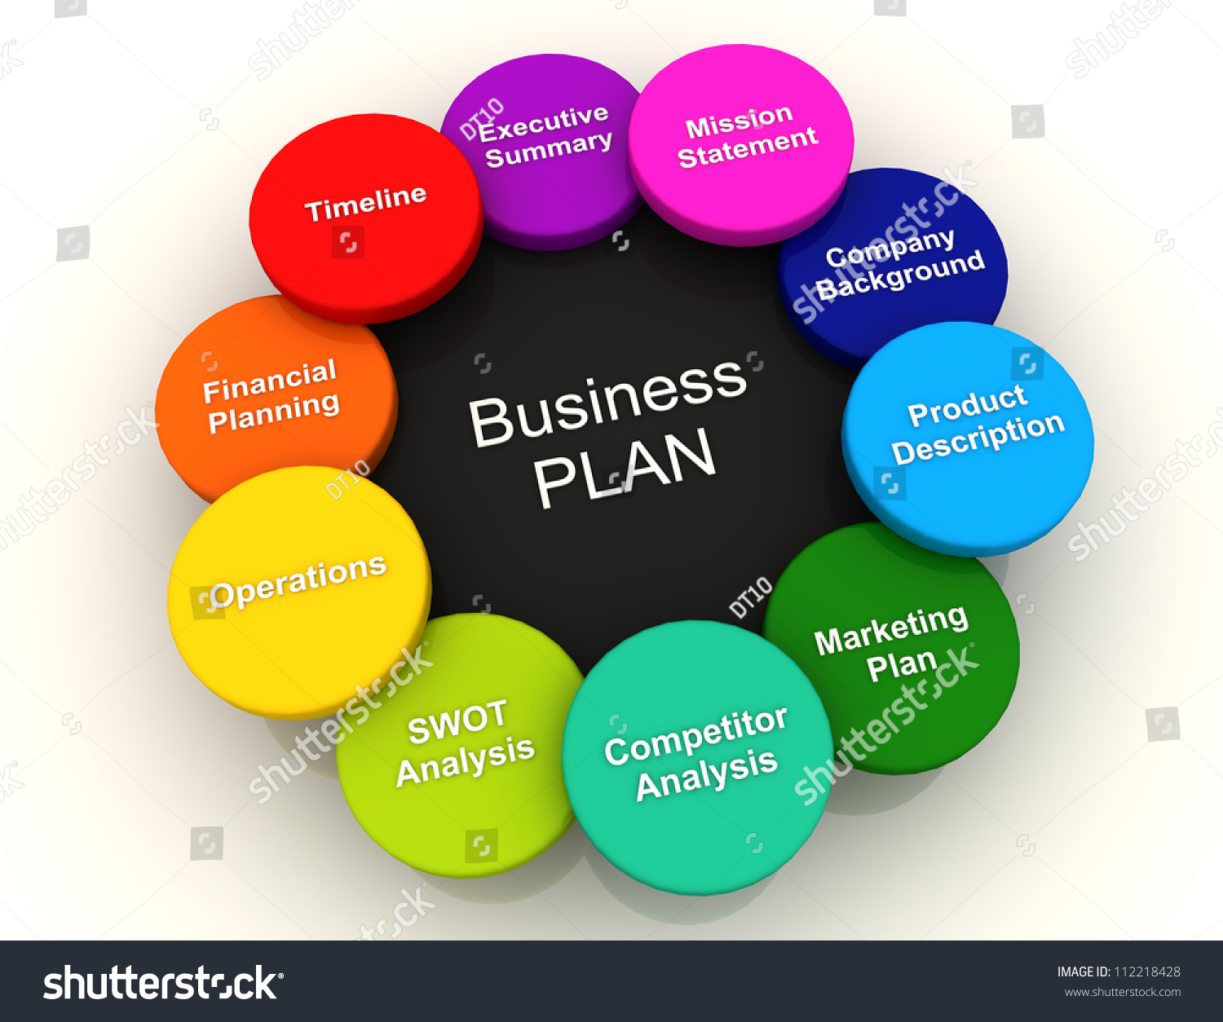
The steps to start your business
Write your business plan
Your business plan is the foundation of your business. It’s a roadmap for how to structure, run, and grow your new business. You’ll use it to convince people that working with you — or investing in your company — is a smart choice.

Slide 13
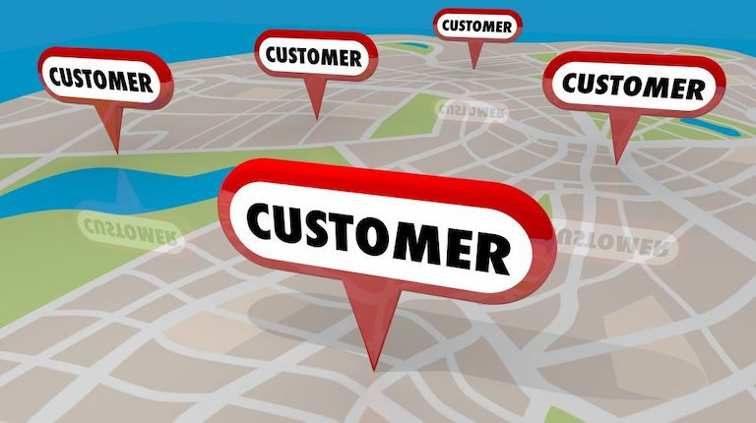
The steps to start your business
Pick your business location
Your business location is one of the most important decisions you’ll make. Whether you’re setting up a brick-and-mortar business or launching an online store, the choices you make could affect your taxes, legal requirements, and revenue.

Slide 14
The steps to start your business
Choose your business name
It’s not easy to pick the perfect name. You’ll want one that reflects your brand and captures your spirit. You’ll also want to make sure your business name isn’t already being used by someone else.

Slide 15
The steps to start your business
Open a business bank account
Open a business account when you're ready to start accepting or spending money as your business. A business bank account helps you stay legally compliant and protected. It also provides benefits to your customers and employees.

Slide 16
Activities in class
Presenting for your own business in the future.
What is your business name?
Where is your business Located?
What is your product?

