Slide 1
Creating an introduction

Slide 2
Creating an introduction
Whether you are speaking to a room of 700 people, the introduction is your opportunity to hook the interest of your listeners. You have the most power to make an impact on your audience at the beginning and the end of your presentation. Most audiences make up theirs minds about your credibility within the first 3 minutes of hearing your introduction. Consequently, the way you begin talking is critical to your success. A good opener creates expectations for more good things to come

Slide 3
Tips for a successful introduction
1. Watch your time = Make the length of the introduction appropriate for the length of the talk, For most presentations, this is the best way to allocate your time:
Introduction = 5-10% of your allotted time
Body = 80-90% of your allotted time
Conclusion = 5-10% of your allotted time

Slide 4
Tips for a successful introduction
2. Don’t rush into talking = It’s temping to start speaking just as soon as you are in front of the audience, take a breath, and look at the audience. Connect with some friendly eyes.
** Speaking of ….. Great starts **
A great opening can help you feel confident and comfortable very quickly. The feeling is like that of a sports team that takes a commanding lead early in the game. The feeling of “I really can do this” begins to take over.

Slide 5
Tips for a successful introduction
3. Don’t read your introduction = A speaker who begins by reading the introduction will almost always lose the connection with the audience. Reading removes the advantages of eye contact, facial expressions and natural-sounding speeds.
** Bonus Point **
Don’t begin your presentation with an apology. Don’t start with “I’m sorry I didn’t have much time to prepare” or “I’m sorry my voice may not hold out” or “I’m sorry meeting on short notice”. Just do your introduction.

Slide 6
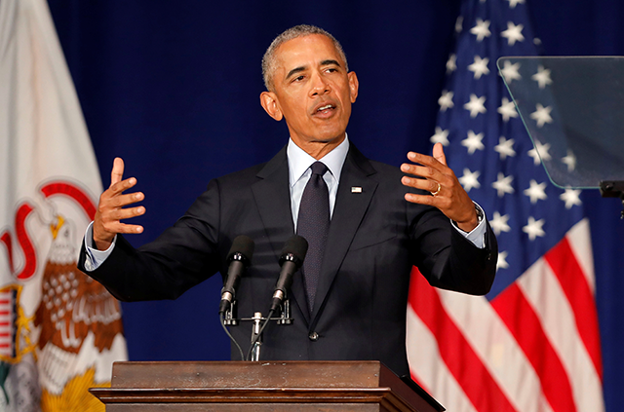
Goals for your introduction
1. Gain Attention = It’s important that your introduction to hook your audience right way. You won’t get another chance to make that first impression, so you need to get it right the first time. If your listeners aren’t involved from the beginning, it’s especially challenging to get them interested in the middle. “You can, but it’s difficult”
2. Set the Tone = Setting the tone refers to the mood or atmosphere that you establish at the beginning of your talk. The tones creates the emotions that your audience will use to evaluate your message.

Slide 7
Goals for your introduction
3. Stay Relevant to your Topic = The introduction must relate to you message in content, tone and style. An interesting story that gets our attention and has an impact but no relevance to the content of speech is attention getter. Can choose something can supports your message.
4. Create a Positive Relationship = Establish a positive relationship with the audience by letting them know how listening will benefit them such as “We are in this thing together. I’m here to share something. I think you will find useful, turn off by displaying my superior knowledge”. Or make something that you feel comfortable.

Slide 8
Goals for your introduction
5. Put your message in context= Your introduction will create the setting that surrounds the topic. In the intro you can define the scope, your point of the view, and cue the audience where you will be going during the presentation.

Slide 9
Creating great slides

Slide 10
Creating Great Slides
1. Templates: Provide the overall background and theme for your slide presentation.
= Create style with your template: Choose a template that matches the style or an atmosphere as you intend to create for your audience. Choose colors that support your message.
= Choose templates with small borders: You will have more room for the content of your slides.
= Choose a background based on lighting: Dark background with light letters gives you the best results. But when you will be presenting in a bright room, a light background is a better choice.

Slide 11
Creating Great Slides: Speaking of Colors
Colors and What they mean?
= Black: Heavy, technical, formal, Authority, and Sophisticated.
= Blue: Secure, Peace, Trustworthy, Loyalty.
= Red: Caution, Excitement, Danger, Intensity.
= Yellow: Cheerful, Optimism, Fresh, Youth
= Green: Clean, Environmentally, Friendly, Calm, Wealth, Military
= White: Simplicity, purity, clean
= Pink: Feminine, Love, tranquil
= Purple: Royalty, Luxury, Wealth and sophistication

Slide 12
Creating Great Slides
2. Fonts: Provide the overall background and theme for your slide presentation.
= Capitalize words in your life: Capitalize the first letter of each word in
the title slide. Capitalize the first word the bullet only subsequent.
= Choose the large font size: Font size should be 24 points or larger.
= Use white space: Keep slides uncluttered for maximum effect.
= Don’t use more than 2 fonts format per slide: A change of font is good way to get attention, but more than 2 format in a slide is make districting.
** Bonus Point **
- Use the whole screen. Don’t use borders that take space you need for the data. Let your slides fill the screen and your graphics fill the slide.

Slide 13
Creating Great Slides
3. Wording: Many slides will contain words to convey your message.
= Use words sparingly: If everything you will say it’s unnecessary and redundant show on the slide. Use keywords and simple phrases to make you point
= Remember “6 by 6”: Use no more than 6 liner per slide and no more than 6 words per line. Use fewer lines and words if possible.
= Don’t repeat: If each bullet point starts with the same word, please use in the title followed by a colon.
= Use phrases rather than sentences: Short phrases are usually more effective than full sentences. Using a quote is the exception to this rule.
= Spell-check: Proofread and check again. Ask someone else to look at your slides with fresh eyes.

Slide 14
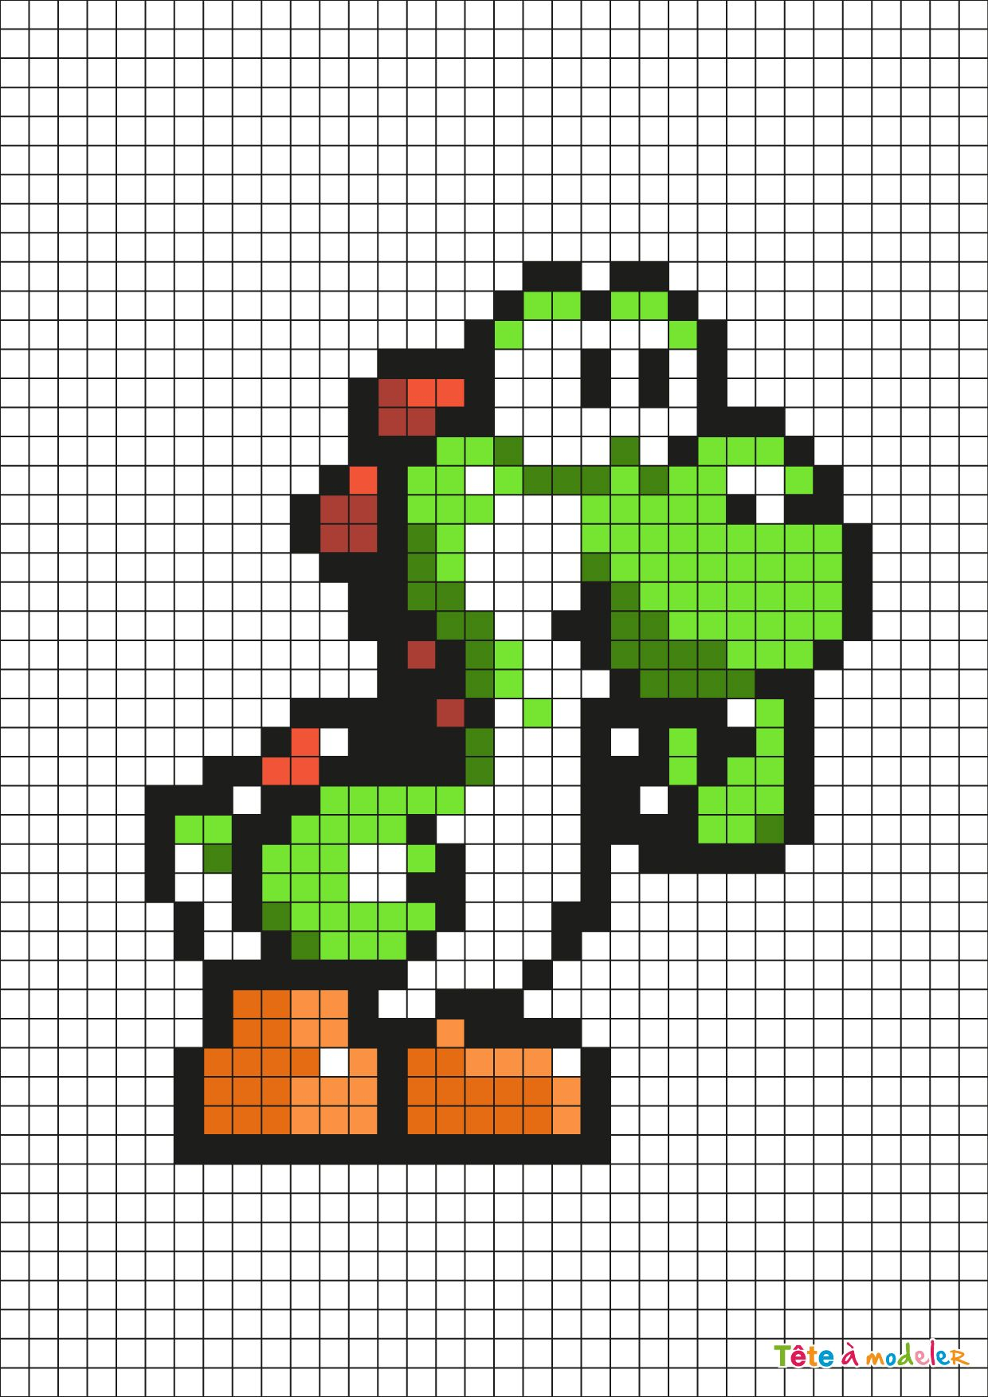
Creating Great Slides
3. Images: Photographs, drawings, and clip art are commonly found on slides.
= Graphics are more powerful that words: Adding photo, graph or drawing keeps your presentation alive and can add more emotional effects.
= Pay for copyright privileges: If you use copyrighted photos, graphs, or artwork, make sure to acknowledge the artist and pay the appropriate royalties.
= Use clear image: Check the quality and richness of your pictures. The more pixels in your photo, the richer and more accurate your projection will be.

Slide 15
Time to example of speech and topics of your speech
Ted talks
Ielts-exam.net

