Slide 1
Creating great slides

Slide 2
Creating Great Slides
1. Templates: Provide the overall background and theme for your slide presentation.
= Create style with your template: Choose a template that matches the style or an atmosphere as you intend to create for your audience. Choose colors that support your message.
= Choose templates with small borders: You will have more room for the content of your slides.
= Choose a background based on lighting: Dark background with light letters gives you the best results. But when you will be presenting in a bright room, a light background is a better choice.

Slide 3
Creating Great Slides: Speaking of Colors
Colors and What they mean?
= Black: Heavy, technical, formal, Authority, and Sophisticated.
= Blue: Secure, Peace, Trustworthy, Loyalty.
= Red: Caution, Excitement, Danger, Intensity.
= Yellow: Cheerful, Optimism, Fresh, Youth
= Green: Clean, Environmentally, Friendly, Calm, Wealth, Military
= White: Simplicity, purity, clean
= Pink: Feminine, Love, tranquil
= Purple: Royalty, Luxury, Wealth and sophistication

Slide 4
Creating Great Slides
2. Fonts: Provide the overall background and theme for your slide presentation.
= Capitalize words in your life: Capitalize the first letter of each word in
the title slide. Capitalize the first word the bullet only subsequent.
= Choose the large font size: Font size should be 24 points or larger.
= Use white space: Keep slides uncluttered for maximum effect.
= Don’t use more than 2 fonts format per slide: A change of font is good way to get attention, but more than 2 format in a slide is make districting.
** Bonus Point **
- Use the whole screen. Don’t use borders that take space you need for the data. Let your slides fill the screen and your graphics fill the slide.

Slide 5
Creating Great Slides
3. Wording: Many slides will contain words to convey your message.
= Use words sparingly: If everything you will say it’s unnecessary and redundant show on the slide. Use keywords and simple phrases to make you point
= Remember “6 by 6”: Use no more than 6 liner per slide and no more than 6 words per line. Use fewer lines and words if possible.
= Don’t repeat: If each bullet point starts with the same word, please use in the title followed by a colon.
= Use phrases rather than sentences: Short phrases are usually more effective than full sentences. Using a quote is the exception to this rule.
= Spell-check: Proofread and check again. Ask someone else to look at your slides with fresh eyes.

Slide 6
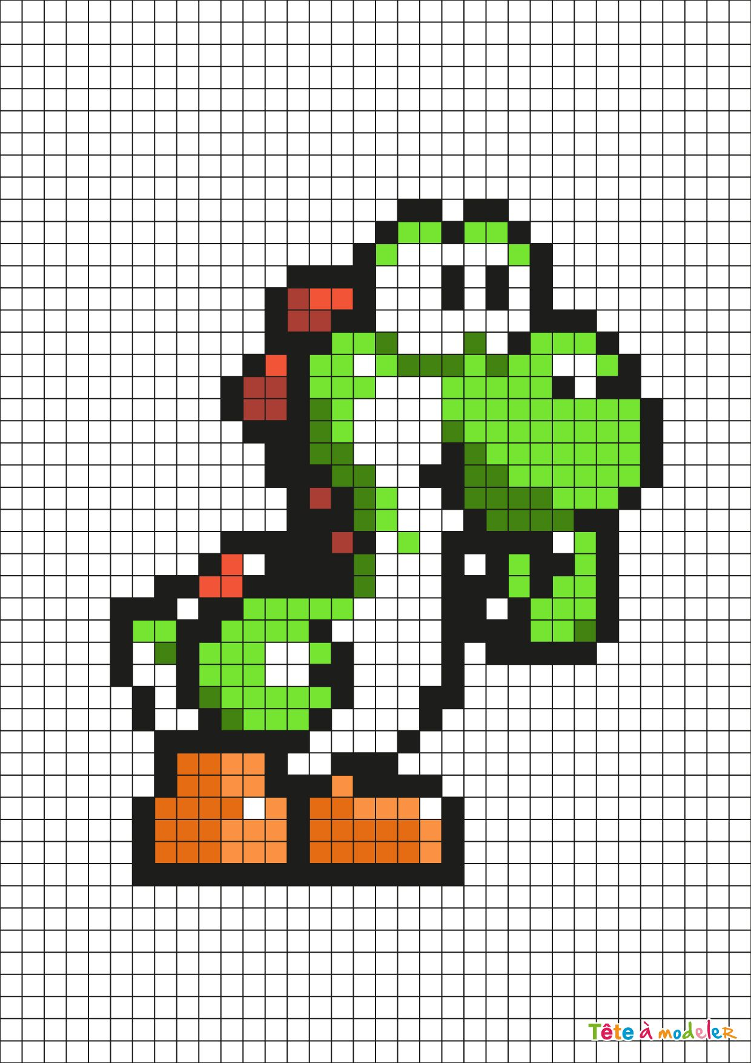
Creating Great Slides
4. Images: Photographs, drawings, and clip art are commonly found on slides.
= Graphics are more powerful that words: Adding photo, graph or drawing keeps your presentation alive and can add more emotional effects.
= Pay for copyright privileges: If you use copyrighted photos, graphs, or artwork, make sure to acknowledge the artist and pay the appropriate royalties.
= Use clear image: Check the quality and richness of your pictures. The more pixels in your photo, the richer and more accurate your projection will be.

Slide 7
PRESENTING AS A TEAM

Slide 8
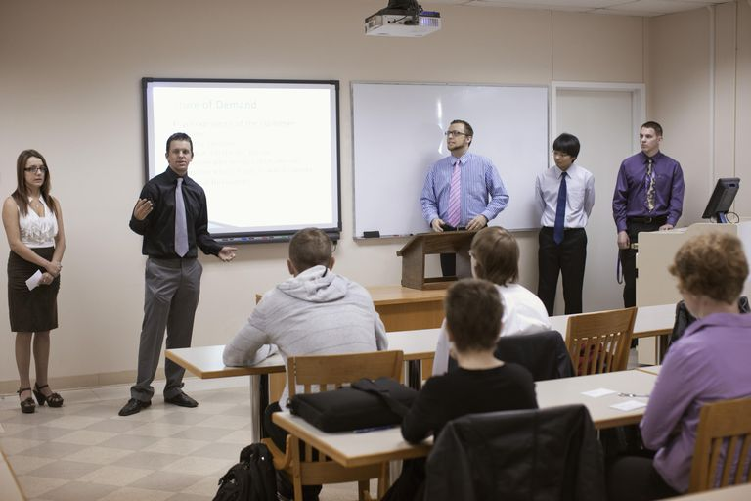
WHY USE A TEAM OF SPEAKERS?
Group presentations are often used for work group or project team. report, major sales meetings, and panels. Teams of speakers may be chosen to showcase the knowledge of certain people, introduce key members of the hierarchy, or just to add variety in a long presentation.

Slide 9
PREPARING FOR A GROUP PRESENTATION
PRACTICE TOGETHER
Practice your presentation together as a group as well as individually. Time spent together is essential for you team to check for tone, terms, and styles for all members.
Practice making the transitions from speaker to speaker until they are seamless. Your words, as well as your physical movements, should be appear smooth, natural, and professional.

Slide 10
PREPARING FOR A GROUP PRESENTATION
MANAGE YOUR TIME
Team presentations take more time and practice than individual speeches. Arrives for meetings on time, use e-mail and Web meetings to keep everyone up-to-date, and don’t procrastinate.
Begin immediately for high-stakes team presentations, create a communication plan, a simple form to document communication responsibilities and schedules.

Slide 11
PREPARING FOR A GROUP PRESENTATION
HAVE A BACKUP
Things will go wrong. If you prepare well enough, no one will know when the pieces don’t come together as planned. Have a person prepared to stand in for each speaker.
The backup must be comfortable with not only the words but also the appropriate style to get the message across.

Slide 12
PREPARING FOR A GROUP PRESENTATION
SHARE THE STAGE
Not all members of a large group must speak during the presentation. An ideal number is 4-6 presenters. Other participants can be assigned to gather data, make the visual aids, or prepare the script and notes.

Slide 13
PREPARING FOR A GROUP PRESENTATION
USE SLIDES WITH CONSISTENT FONTS, TEMPLATES, COLOURS, AND STYLES.
Putting one person in charge ensures a consistent appearance and reduces any confusion about the final version. That person can also ensure that the number of slides assigned to each person is relatively consistent.
A team’s coordinated presentation appearance supports the perception of teamwork.

Slide 14
PREPARING FOR A GROUP PRESENTATION
KNOW YOUR ENVIRONMENT
Check out the physical setup before the audience arrives. Prepare and practice with that setup in mind. If the room is rearranged when you get there, return it to the agreed-on style if possible.
If you can’t change the arrangement, hold a quick discussion among group members to determine any adjustments you must make. Make sure everyone understands the changes.

Slide 15
PREPARING FOR A GROUP PRESENTATION
LOOK LIKE A TEAM
Perception is important, dress in a similar style and complementary colors. Dress to match the setting, the topic and expectation of the audience.
A combination of suits and jeans sends a mixed message to the audience.

Slide 16
Speaking of …. Questions to help your team prepare.
Who needs what information?
How often will we communicate?
How will we communicate? By email, phone, web meeting.
How can we confirm that we understand each other?
When should we call a special meetings?
Do we have a checklist?
Do we have defined task?
Is the schedule clear?
How will we handle lst-minutes change?

Slide 17
PRE SENTING-AS A GROUP
LISTEN TO EACH OTHER
Pay special attention during the question-and-answer periods. Don’t step on each other’s lines, which means don’t begin speaking until another panel members have finished.
If a question has been answered incompletely or needs to be clarified, other members should feel free to add to the answer.
Do so tactfully and without making the first speaker or group feel embarrassed.

Slide 18
PRE SENTING-AS A GROUP
NONVERBAL COMMUNICATION COUNTS
Give full attention to the speaker; don’t look around the room, practice your speech, or talk with someone else on your panel. While one person from the group is speaking, all other members should keep their eyes on the presenter.

Slide 19
PRESENTING AS A GROUP
DEVELOP YOUR OWN LANGUAGE
Agree on a signal that the group members can use to indicate that a speaker’s time is up. The signal should be unrecognizable to the audience but clear to the group. Trust each other for posture, eye contact or other distracting behaviors.

Slide 20
PREPARING AS A GROUP
SHARE THE Q&A TIME
When the formal part of the presentation ends, all members of the group should stand together to take questions. For each question, the team member to answer should be the one who has the best information and is most comfortable with the topic.

Slide 21
PREPARING AS A GROUP
TAKE BACK YOUR POWER
At the end of the question-and-answer period, 1 person should be prepared to give wrap-up, reviewing the most important points. Return the audience’s focus to your message, not just the last question.

