Slide 1
Improve Your Public Speaking With Body Language

Slide 2
What is the physical message ?

Slide 3
The Physical Message?
Just as word from the spoken language, how we stand, where we look,
how we move our hands, and tone of our voice from the body language.
Posture: The way we stand and position our whole body.
Eye Contact: Where we look to keep in touch with the audience as we speak.
Gestures: How we move our hands to support our words.
Voice Inflection: The way we change the tone of our voice to emphasize key words.
Body Languages

Slide 4
What is the physical message important?
A good Physical Message sends a confident, positive, energetic and enthusiastic message to the audience.

Slide 5
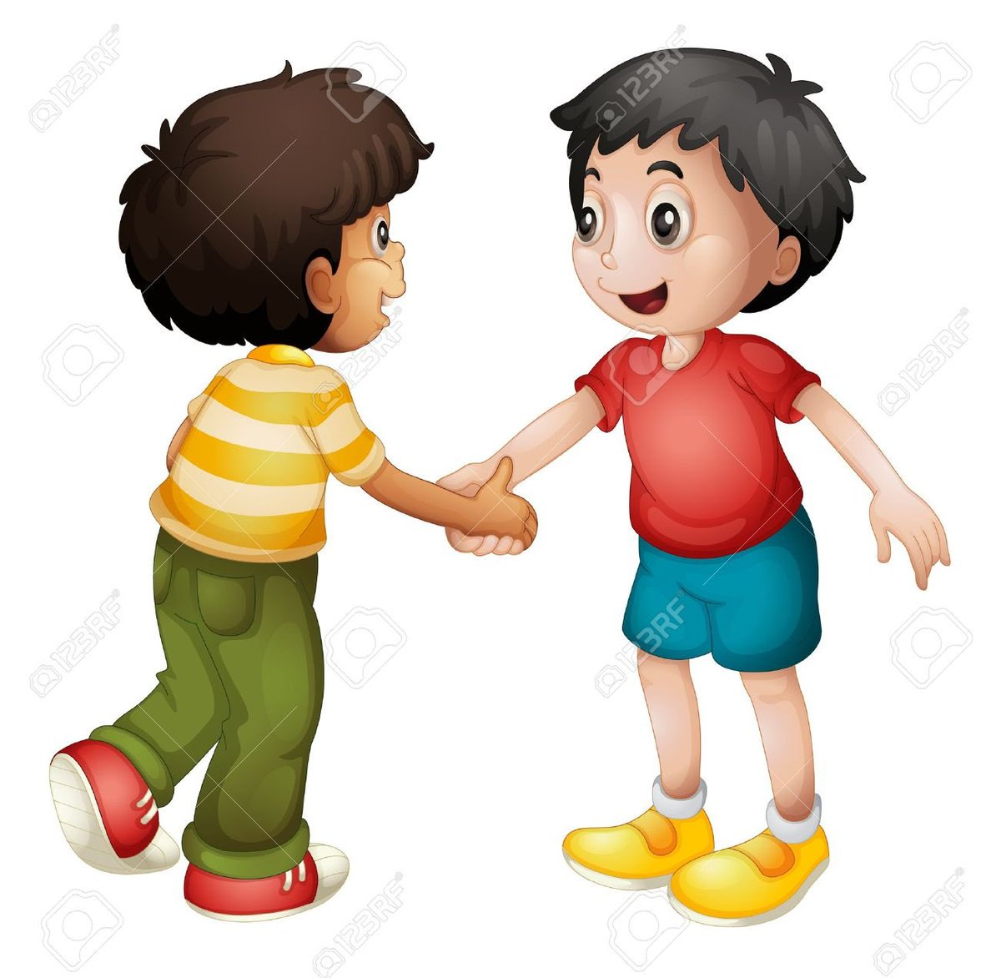
What are Posture and Eye contact?
The way you stand (posture) and where you look (eye contact) communicate a message. This is not a spoken message, but a physical message. Good posture and eye contact send a confident, positive message to the audience.
Posture = the foundation of the Physical Message. If your posture is solid, you look confident. If your posture is weak, you look nervous and unsure.
Good eye contact = gives you valuable feedback from the audience Such as Do they understand your speech? /Are they enjoying your speech?

Slide 8
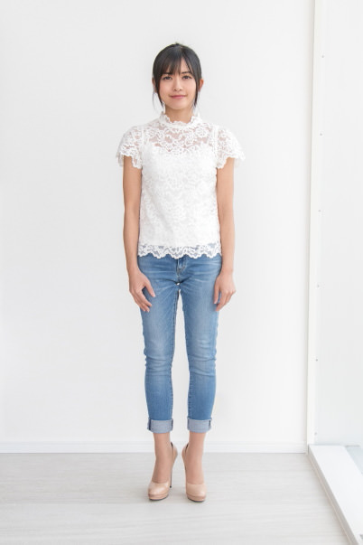
Posture: How to Do it !!!
Posture & Eye contact Checklist
SET YOUR FEET
Place your feet shoulder-width apart.
Balance your weight
evenly on both feet.

Slide 9
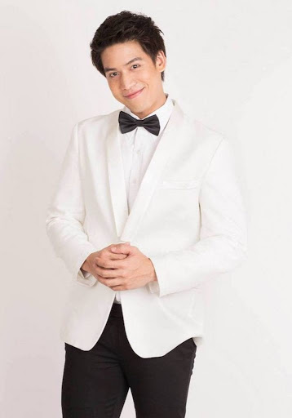
Posture: How to Do it !!!
Posture & Eye contact Checklist
SET YOUR HANDS
Hold your hands together.
Keep them about waist high
in front of you.

Slide 10
Posture: How to Do it !!!
Posture & Eye contact Checklist
EYE CONTACT
Look at the audience for three
Seconds before you begin. Look
at several people in the audience.

Slide 11
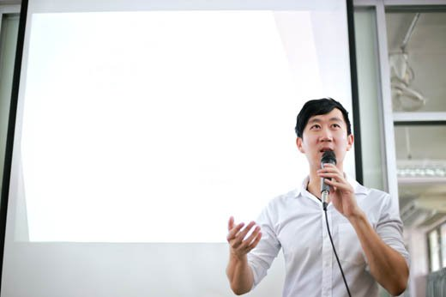
Posture: How to Do it !!!
Posture & Eye contact Checklist
PRESENTATION VOICE
Take a deep breath.
Begin speaking in a voice 150%
louder than you usual
conversation voice.

Slide 12
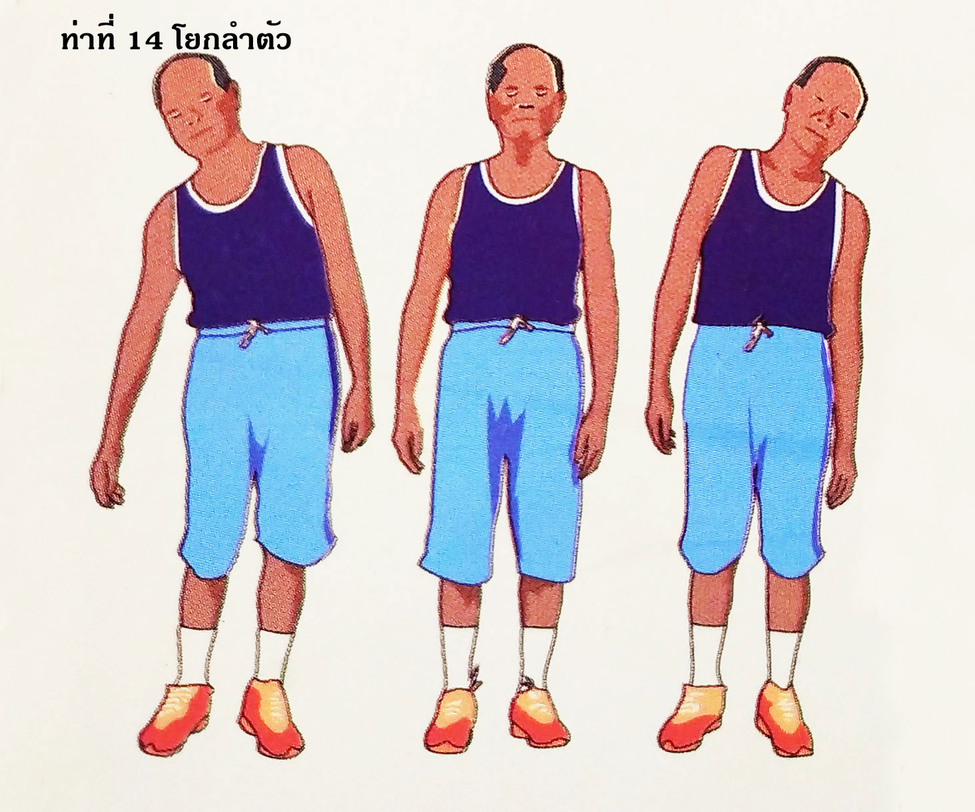

Slide 13
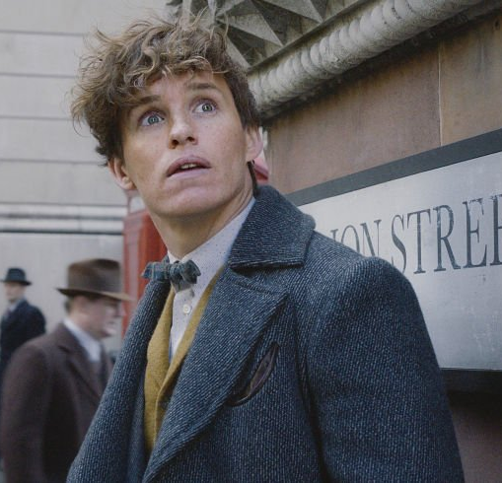

Slide 17
What are gestures?
Gestures from the vocabulary of body language. This physical vocabulary supports the words of your verbal message.

Slide 18
Gestures
Number / Sequence: These gestures signal a process, or a number worth remembering.
Emphasis / Focus: These gestures signal a key words, or an idea that you want the audience to focus on.
Illustration / location: These gestures help the audience visualize size, shape, and dimension, or help the audience visualize how to do something.
Comparison / Contrast: These gestures help the audience understand similarities, difference, and changes.

Slide 19
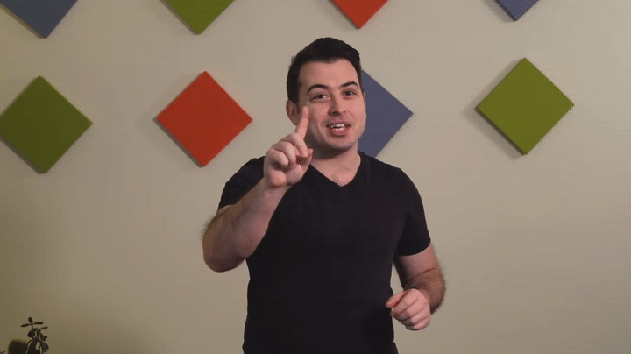
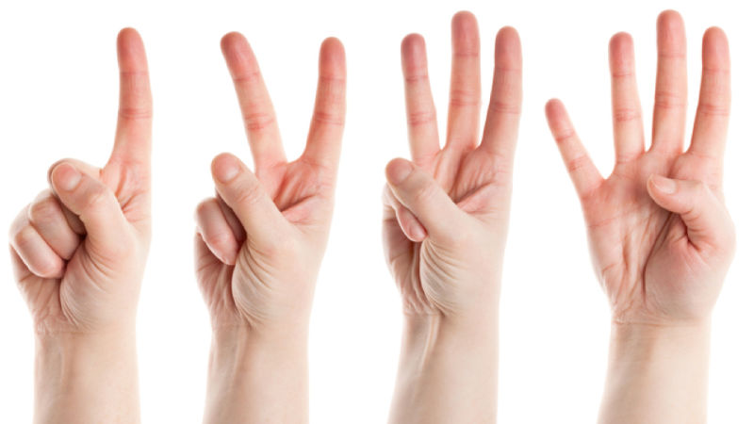
How to use Gestures
Number / Sequence: These gestures signal a process, or a number worth remembering.

Slide 20
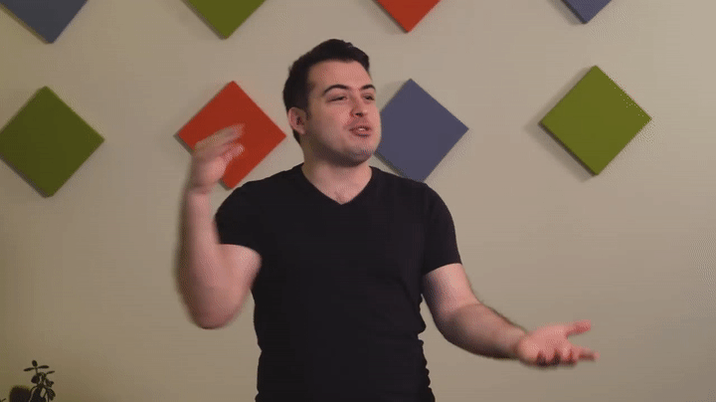
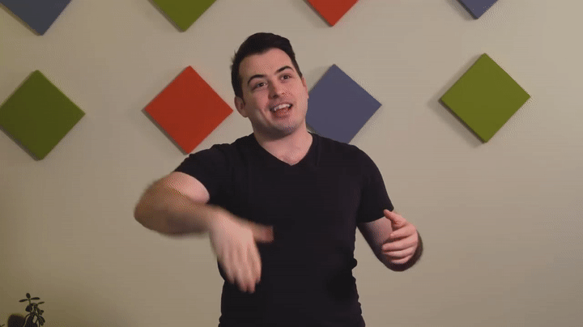
How to use Gestures
Emphasis / Focus: These gestures signal a key words, or an idea that you want the audience to focus on.

Slide 21
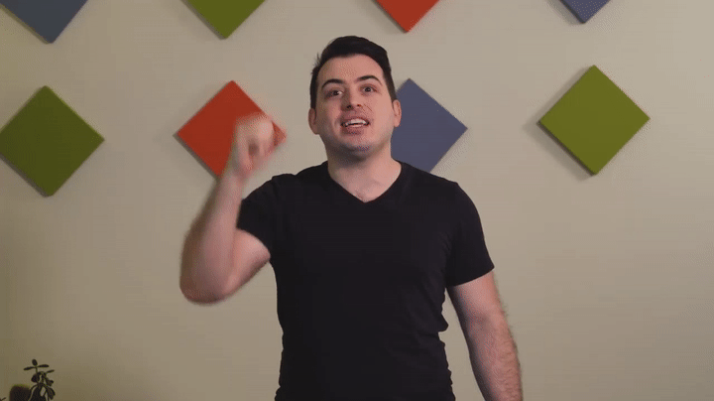
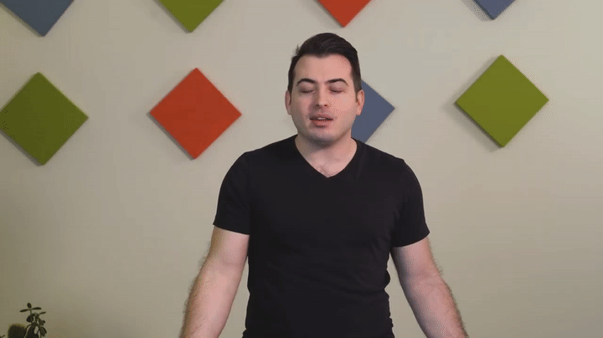
How to use Gestures
Illustration / location: These gestures help the audience visualize size, shape, and dimension, or help the audience visualize how to do something

Slide 22
What is Voice Inflection?
Voice inflection means changing your voice. You can change your voice in one of three ways. Inflection key words to add interesting and help more understand on your speech.

Slide 23
Voice Inflection
1. Stressing a word or phrase: I have a LOT of experience.
2. Stretching a word or phrase: No… I have a L000t of experience.
3. Pausing before a word or phrase: No … I have a ‘LOT’ of experience.

Slide 24
Practice: physical Message
Take turns trying to communicate the following words or phrase with your partner. Don’t say anything just use your body language.

Slide 25
I don’t understand.
Speak louder, please.
Don’t stand there.
Look over there.

Slide 26
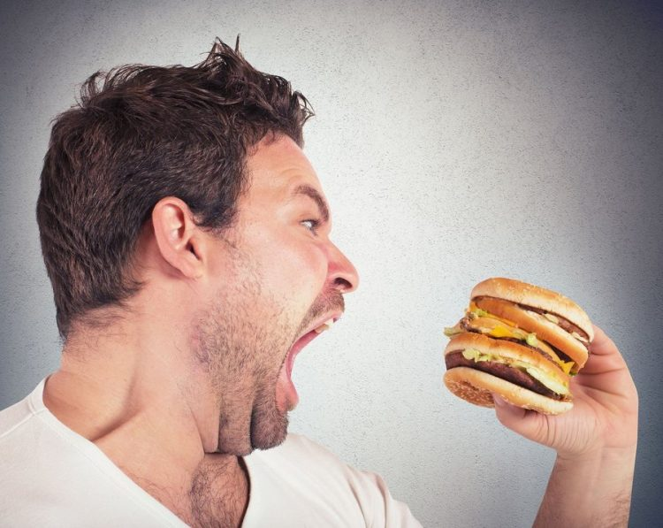
Follow me.
I’m hungry.
I have a question.
Please sit over there.

Slide 27
Practice: gestures
Read the words above to your partner and add gestures.

Slide 28
Small.
Triangle.
Equal.
Big.
Long.
Better than.
Short.
First.
Round.
Square.
Three points.
Third.

Slide 29
Practice: voice inflection
Try to practice this words with your partner.

Slide 30
We can decrease pollution.
We have cut prices in half.
The universe is only 6,000 years old.
Nobody gives better service than us.

Slide 31
China has the world’s largest population.
There are over one billion people in China.
Its history is divided into many periods.
China has a very long history.

