Slide 1
IMPROVING YOUR CONFIDENCE

Slide 2
IMPROVING YOUR CONFIDENCE
It’s normal to be nervous about giving a speech. More than 80% of people are feeling anxious about public speaking. Some student feels highly apprehensive about speaking in front of others. Give these facts, your goal is to manage your nervousness so that it doesn’t create so much internal noise that it keeps you from speaking effectively.

Slide 3
Understand your nervousness
The reasons people feel nervous when they speak in public are include;
Fear of humiliation
Concern about not being prepared
Worry about how they look
Pressures to perform
Personal insecurity

Slide 4
Understand your nervousness
The reasons people feel nervous when they speak in public are include;
6. Concern that the audience won’t be interested in them or the speech
7. Inexperience
8. Fear of making mistakes
9. Overall fear of failure

Slide 5
Build your confidence
There are several more things you can do to help manage your nervousness and anxiety.
Know your apprehension style
- Confrontational = speakers have the most and highest heart rates as they begin speaking, They can make good use of strategies that good use and help them prepare, calm down themselves before begin speaking.

Slide 6
Build your confidence
There are several more things you can do to help manage your nervousness and anxiety.
Know your apprehension style
- Inflexible = speakers feel high levels of anxiety, and show the highest heart rates, all the way through their speeches. These speakers can be benefit from many ways used before, during. And after speeches.

Slide 7
Build your confidence
There are several more things you can do to help manage your nervousness and anxiety.
Know your apprehension style
- Average = speakers generally approach public speaking positively and show average heart rates increases while speaking. The most helpful ways for them may vary speech by speech.

Slide 8
Build your confidence
There are several more things you can do to help manage your nervousness and anxiety.
Know your apprehension style
- Insensitive = speakers are usually experienced speakers. They feel little apprehension and have heart rates while speaking. They may already be using many strategies.

Slide 9
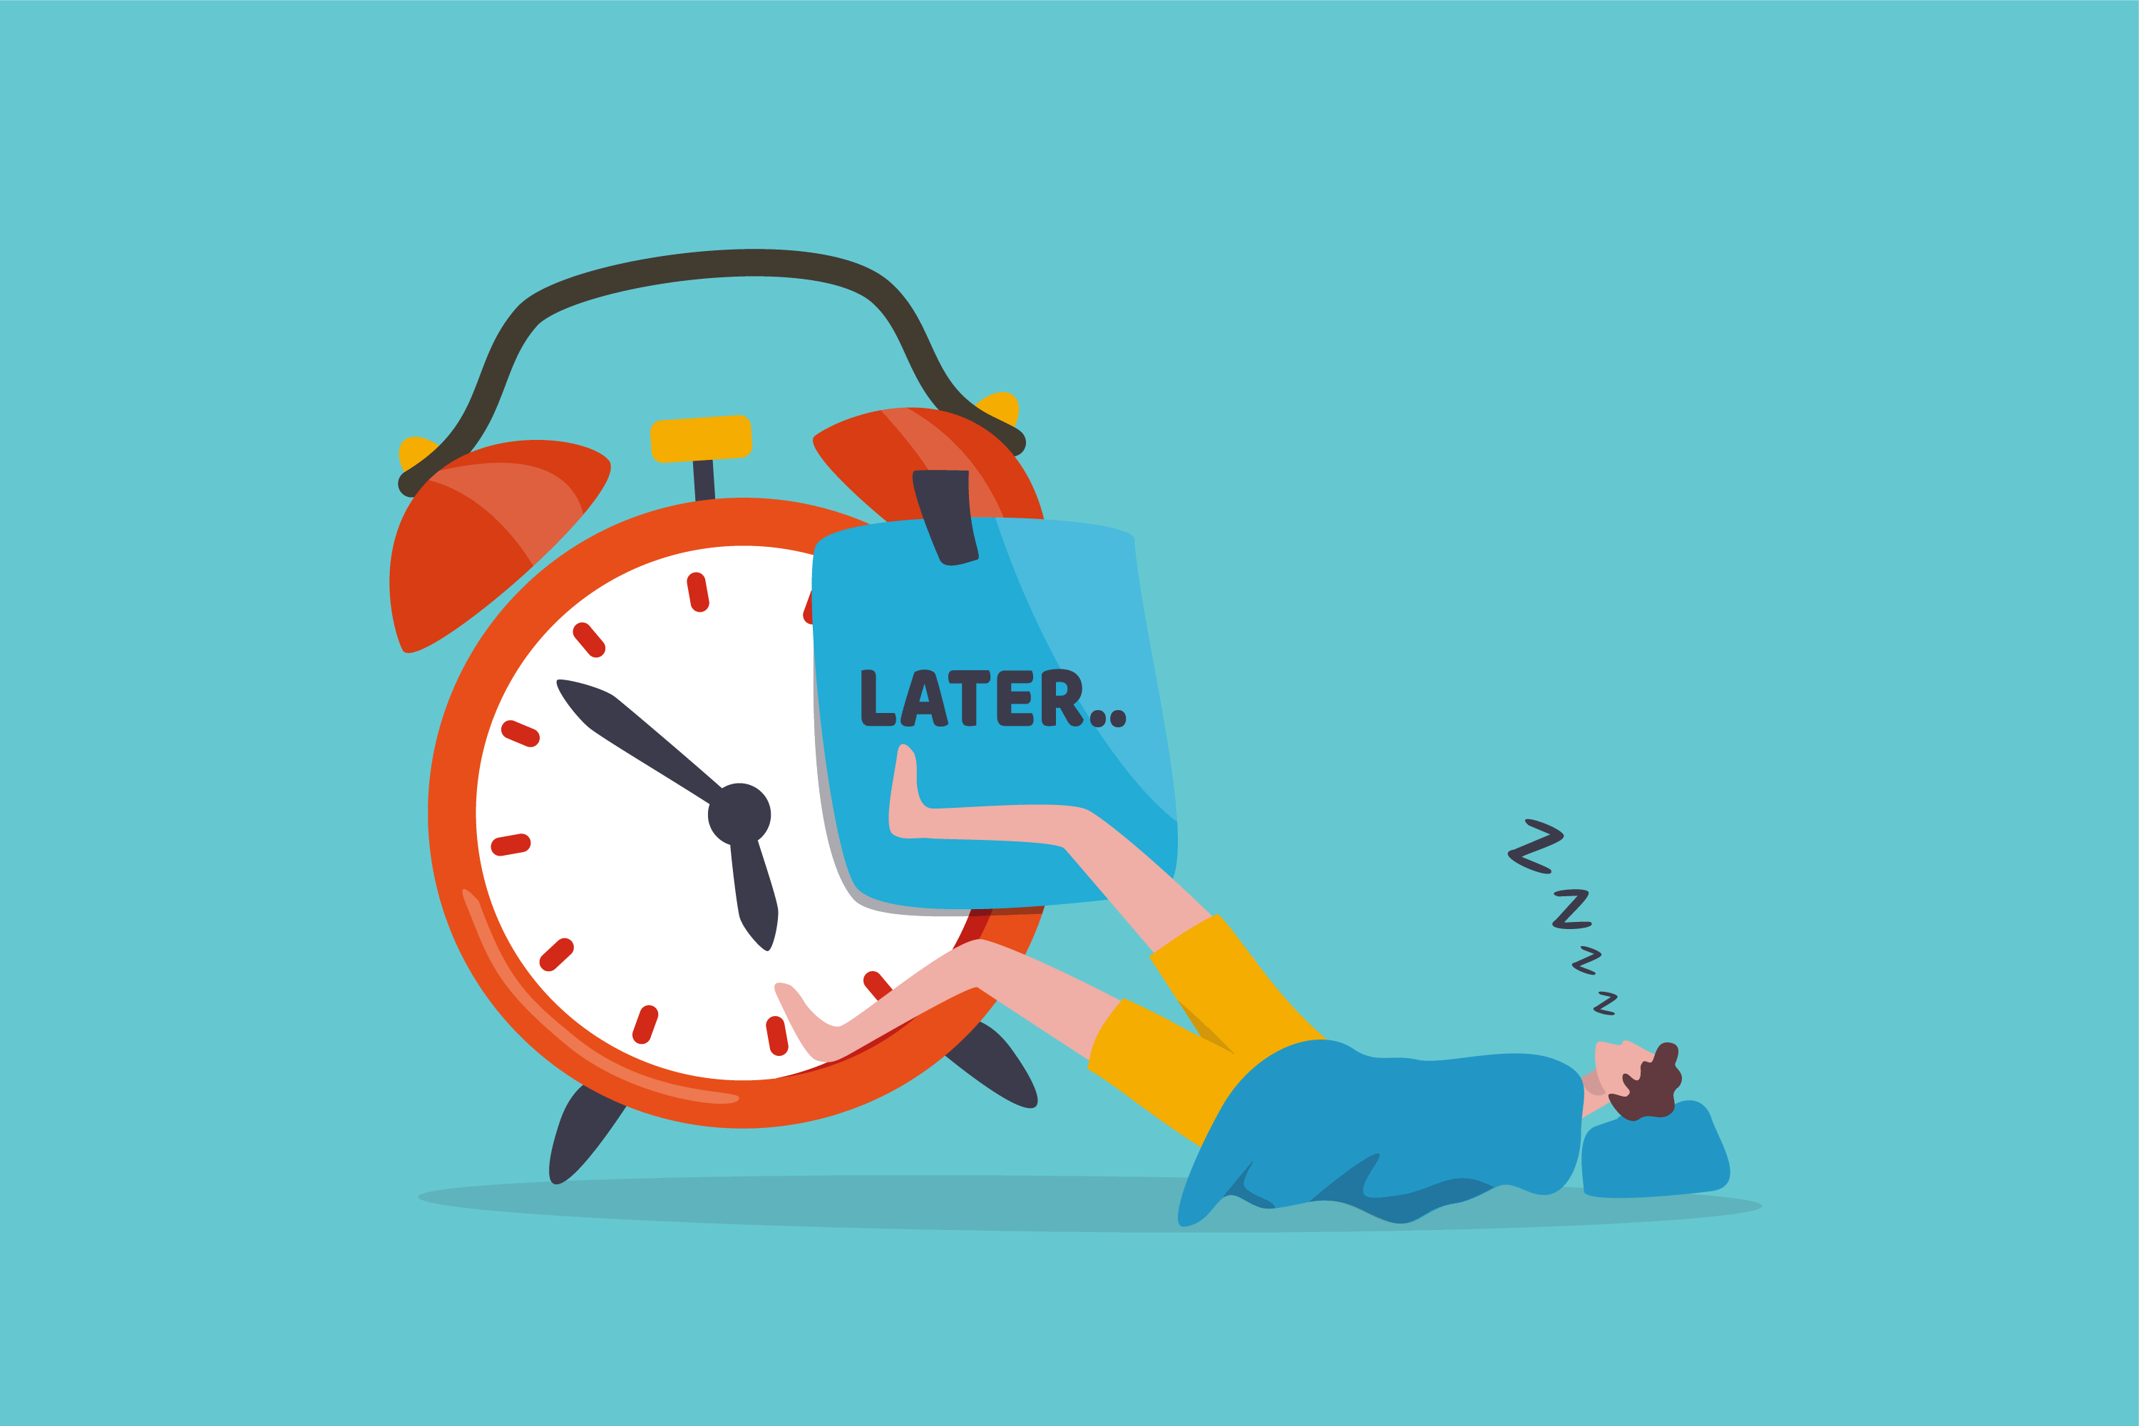
Build your confidence
2. Don’t procrastinate in preparing your speech
Fear of speaking often leads speakers to delay preparing a speeches until the last minute. The lack of thorough preparation often results in a poorer speech performance, which reinforces a speaker’s perception that public speaking is difficult. Don’t let fear freeze you into inaction. Take charge by preparing early.

Slide 10
Build your confidence
3. Select an appropriate topic
You will feel less nervous if you talk about something with which you are familiar or have had some experience. Your will comfort with the subject of your speech will be reflected in your delivery.

Slide 11
Build your confidence
4. Be prepared
- Research your topic
- Developed a logically coherent outline
- Practiced your speech several times before you deliver it.

Slide 12
Build your confidence
4. Know your introduction and conclusion
All you are likely to feel the most anxious during the opening moments of your speech. Therefore, have a clear plan for how you will start your speech. Being familiar with your introduction will help you feel more comfortable about the speech and if you know how you will end your speech, you will have safe harbor in case you lose something and you will well-delivered conclusion to make a graceful exit.

Slide 13
Build your confidence
5. Make practice real
Practice aloud. Stand up. Imagine the room where you will give your speech or consider rehearsing in the actual room. Picture what you will be wearing and what the audience will look like.

Slide 14
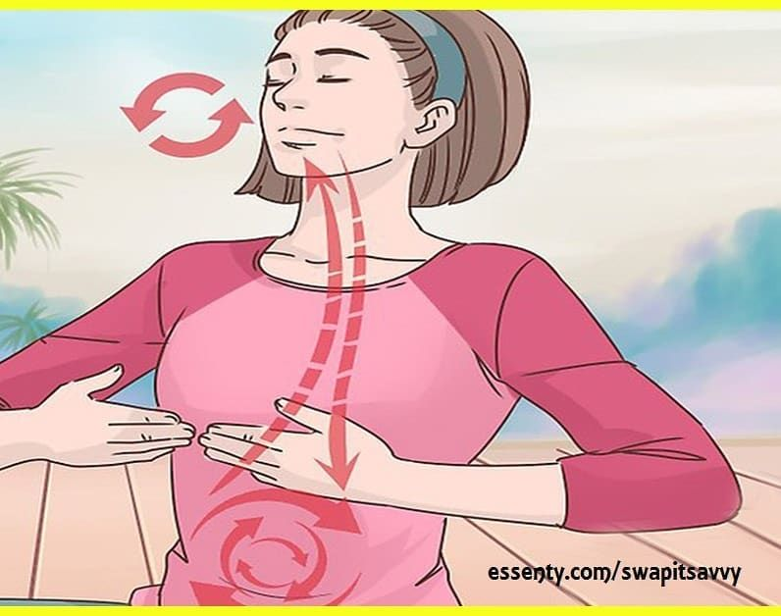
Build your confidence
6. Breath
Nervous speakers tend to take short, shallow breaths. To help break pattern, take a few slow deep breaths before you rise to speak. Besides breathing deeply, try to relax your entire body.

Slide 15
Build your confidence
7. Give yourself a mental pep talk
Negative Thought | Positive self-talk
I’m going to forget what I’m supposed to say So many people are looking at me. | I’ve practiced this speech many times. I’ve got notes to prompt me. If I lose my message, no one will know that I’m not following my outline. I can do this! My listeners want me to do a good job. And will seek out friendly faces I feel nervous

Slide 16
Build your confidence
8. Focus on your message, not on your fear
The more you think about being anxious speaking, you will increase your level of fear instead think about what you are going to say. Focus on your ideas, your introduction and conclusion as rather than your fear.

Slide 17
Build your confidence
9. Look for positive listener support
When you are aware of positive audience support, you will feel more confident and less nervous. Although there may be some audience that won’t respond positively to you message. It may help to prepare speeches and support all you full attention.

Slide 18
Preparing a Speech

Slide 19
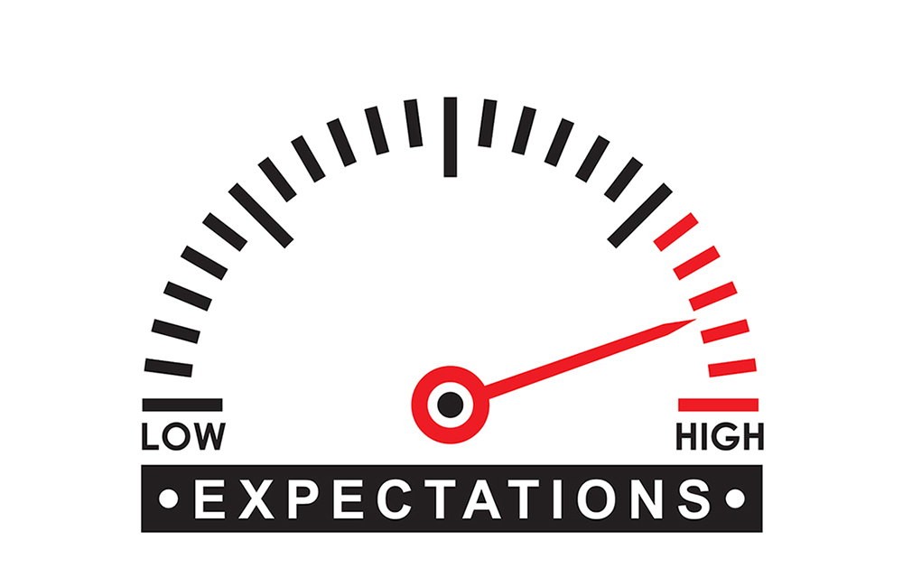
Select your topic
Consider the audience
As you search for speech topics, keep in mind each audience’s will interests and expectations. Your topic should be relevant more interests of your listeners and should be take into a knowledge for the listeners already have about the topics.

Slide 20
Choose important topics
Sample audience with the topics
Audience | Topic
Retirees Civic organizations Church members First graders Teachers College fraternity | Preserving social security benefits The special Olympics Starting a community food bank What to do in case of a fire at home Building children’s self-esteem Campus service opportunities

Slide 21
Choose important topics
1. Consider yourself
The best public speaking topics are those that reflect your experience or especially interest you things. To selecting a topic which you are ready familiar it as you would know more about. If topics its interest will motivate both of you research and your eventual delivery of the speech.

Slide 22
Choose important topics
2. Brainstorm
Use brainstorming to find ideas for speech topics. For listing and write down the first topic that comes to mind. Don’t allow yourself to evaluate it. Just write it down in a word or phrase.

Slide 23
Choose important topics
3. Don’t procrastinate !!!
For most brief speeches, you should allow at least one week give enough time to develop and research your speech. If you delay work until the night before you are supposed to deliver your speech.

Slide 24
Narrow the topic
Now that you have a topic already; you need to narrow it within the time limits of your speech. You need to write a general ideas and be careful not to narrow your topic so much that you can’t find an information for even 3 minutes talk.

Slide 25
Determine your purpose
Speaking inform: For describe a thing, person, place, concept, and process
Speaking persuade: May offer information that they use it to try an information to try change for audience’s convictions and often some sort of action.
Speaking to entertain: Tries to get more relax, smile, laugh and enjoy themselves.

Slide 26
Determine your specific purpose
1. Identify a behavioral objective: You must think in precise terms about what you want your audience to be at the end of your speech. This kind of goal is called a behavioral objectives because you specify the behavior you seek from the audience.
2. Formulate the specific purpose: Use verbs such as list, explain, describe or write and not use words such as know, understand or believe. Yon can discover which words that listeners know and understand on your speech.

Slide 27
Develop your central idea
The central idea is a one-sentence as summary of your speech. This idea like the purpose statement, restates the speech topic. But whereas focuses on the audience behavior and content of the speech. The central idea should reflect consideration of the audience. You should consider your audience’s needs, interests, expectations and knowledge when you summary your idea. If you don’t consider your listeners, it will be risk of losing their attention before you even begin developing the speech.

Slide 28
Thank you for you attention !!

