Slide 1
Chapter2 Speaking in public

Slide 2
Speaking in public
As you study public speaking, you will learn and practice strategies for effective delivery and critical listening. You will discover new applications for skills you may already have such as focusing and organizing ideas and gathering information from print and electronics sources.
The ability to speak with competence and confidence will provide empowerment. It will give you an edge that other less skilled communication lack even those who may have superior ideas, training, or experience.

Slide 3
The rich heritage of public Speaking
When you study public speaking, you are also joining a long history with many traditions, including this;
Fourth Century (BCE) | Golden age for rhetoric in the Greek Republic, where the philosopher Aristotle formulated guidelines for speakers that we still follow today.
Nineteenth Century | Students of public speaking practiced the arts of declamation as the delivery of an already famous address and of elocution as the expression of emotion through posture, movement, gestures, facial expression, and voice.
Twenty-first Century | A new era of speechmaking that draws on age-old public speaking traditions and expands to meet some of the most difficult challenges in history.

Slide 4
public speaking vs conversation
Public speaking is Planned
Public speaking is more planned than conversation. The speaker may spend hours or even days for planning and practicing a speech.
Public speaking is Formal
Public speaking is also more formal than conversation. The slang or casual language you often use in conversation. Audiences expect speakers to use standard English grammar and vocabulary.

Slide 5
The communication process
Even the earliest communication theorists recognized that communication is a process. The models they formulated were linear, suggesting a simple transfer of meaning from a sender to a receiver.

Slide 6
The communication process
Communication as Action
= A speaker is a source of information and ideas for an audience.
= The message in public speaking is the speech itself both of what is said and now it is said.
= A message is usually transmitted from sender to receiver via two channels as visual and auditory.
= The receiver is the individual audience whose decoding of message will depend on own experiences, attitude, and belief.

Slide 7
The communication process
Communication as Interaction
= One way in which public speaking differs from conversation is that the public speaker does most or all of the talking. But public speaking is still interactive. Without an audience to hear and provide feedback, public speaking serves little purpose.
= It depend on the nods, facial expressions, and adjust a rate of speaking, volume, vocabulary, type and amount of supporting material.

Slide 8
An interactive Model of communication
Channel
Noise
Receiver
Feedback
Source
Message
Message

Slide 9
Speechmaking process

Slide 10
Speechmaking Model
Talking to people may have seemed such a natural part of your life, that you never stopped to analyze the process. But as you think about preparing your first speech, you may wonder “What do I do first?” You need some idea of how to begin.

Slide 11
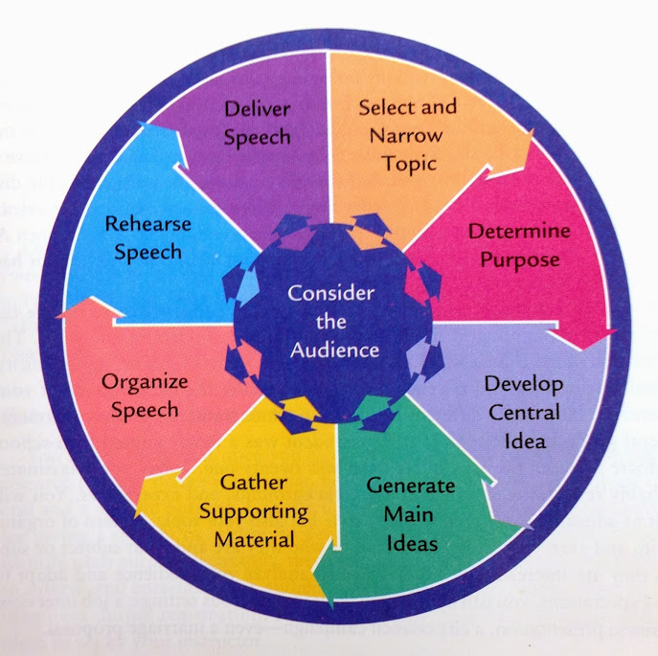
Consider your audience
This model of the speechmaking process emphasizes the importance of considering your audience as you work on each task in the process of designing and presenting a speech.

Slide 12
Consider your audience
= Considering your audience is the model because the needs, attitudes, beliefs, values, and other characteristics of your audience influence the topic that you choose.
= Being audience involves making decisions about the content and style of your speech before you speak based on knowledge of your audience’s values and beliefs.
= If you learn to analyze your audience and adapt to their expectations the skills can be apply in numerous settings.

Slide 13
Select and narrow your topic
= While keeping your audience foremost in mind, determine what you will talk about and how to limit your topic to fit the constraints of your speaking assignment.
= You may discover a topic by asking on three standard question?
Who is the audience?
What is the occasion?
What are my interests, talents and experiences?

Slide 14
Determine your purpose
= Decide on both a general and specific purpose before you start the process. There are three general purpose for giving speeches;
To inform: The primary objective of class lectures, seminars, and workshop is to inform. When you inform. You teach, define, illustrate, clarify or elaboration on a topic.
To persuade: Ads on TV and radio, political speeches and sales presentations are the examples of speeches design to
To entertain. After-dinner speeches and comic are intended mainly for entertainment. The key in your voice of stories, examples and illustration as well as your delivery.

Slide 15
Develop your idea
= You should be able to write the main idea of your speech. Your idea can identify the essence of your message. Think of it as a one-sentence as summary of your speech.

Slide 16
Generate the main ideas
= Effective speakers are good thinkers as say something and know how to play a words and thoughts to develop their main ideas.
= Once you have a topic, a specific purpose, and a well-worded idea as identify the major divisions of your speech and key points that you wish to develop.
= You time limit, topic and information will determine how major ideas will be in your speech. A 3-5 minute of speech might have 2 major ideas but in a very short speech, you may develop only one major idea.

Slide 17
Organize your speech
= A clearly and logically structured speech helps your audience remember what you say. A logical structure also helps you feel more in a control of your speech and helps you feel more comfortable while delivering your message.
= You need to present ideas, information, examples, illustrations, stories and statistics in an orderly sequence so that listeners can easily follow what you are saying.

Slide 18
Organize your speech
Divide your speech: Every well-prepared speech has 3 major division
= The introduction (helps capture attention, serves an overview of speech, provides the audience with reasons to listen you)
= The body (presents the main content of your speech)
= The conclusion (summarizes your key ideas)

Slide 19
rehearse your speech
= Practice making eye contact with your imaginary audience as often as you can
= Be aware of volume of your voice as need to practice speaking loudly enough for all the room to hear.
= If you are not sure what to do with your hands just keep them at your side and focus on your message.
= Avoiding jingling change with your hand in your pocket or using other gestures that could distract your audience.

Slide 20
Deliver your speech
= When you are introduced, walk calmly and confidently to the front of the room.
= Establish eye contact with your audience.
= Smile naturally.
= Deliver your attention-catching opening sentence.
= Concentrate on your message and your audience.
= Deliver your speech in a conversational style.

Slide 21
Deliver your speech (cont.)
= Try to establish rapport with your listeners.
= Deliver your speech just as you rehearsed it before your imaginary audience as
- Maintain eye contact
- Speak loudly
- Use some natural variation

Slide 22
Ethics and free speech

Slide 23
ethics
= The beliefs, values and moral principles by which people determine what is right or wrong.
= Serve as criteria for many of the decision that make in personal and professional lives and for judgments of other’s behavior.

Slide 24
Ethically considering the audience
= Ethical public speaking is inherently audience as always considering needs and rights of the listeners. Consider the beliefs, values, and morals of your audience as well as your own. When you
1. Select your topic
2. Determine the goal of your speech
3. Outline your arguments
4. Select your evidence

Slide 25
Deliver an Ethical speech
= Have a clear, responsible goal.
= Provide your listeners with choices and use sound evidence and reasoning.
= Share all evidence that will help your audience reach a sound decision.
= Be sensitive and tolerant of differences and avoid language that be bias or offensive.

Slide 26
Deliver an Ethical speech
= Be honest and do your own work.
= Avoid plagiarism and give credit for any ideas and information that are not your own ideas.
= Acknowledge your sources accurately and completely.

Slide 27
the Ways to improve your presentation skills

Slide 28
So, what do you need to know?
Good presentation requires preparation and planning. You should be clear about;
= Who your audience is
= What you are expected to talk about (the brief)
= Where you will be giving the presentation
= What facilities you have available (OHP, computer, projector, flip chart)
= How long you have to speak – possibly only 5, 10 or 15 minutes
= What memories you want to leave your listener with
It is your responsibility to be audible, speak clearly and include relevant content information. Your audience will give up if they can’t hear or understand you.

Slide 29
Practice is very important
It will help you to get the timing right – remember that if you over run you may be cut off in mid sentence.
Practice will make you sound more natural and get the words right – remember that you are not reading words but using words to communicate.
A good presentation will do four things – inform, entertain, touch the emotions and inspire action. Look for ways to do all four.

Slide 30
The process
The following format will help you organise your presentation:
Outline what you propose to cover
Give the body of the presentation
Include any facts or statistics
Summarise and conclude
Invite questions from the audience

Slide 31
How to keep your audience interested
Vary the pace of the presentation and the tone of your voice. Speak clearly and use silence to emphasise points. Maintain eye contact (with the whole group rather than one person alone)
Use visuals to illustrate your points (OHP, PowerPoint) but don’t rely on long and complicated slides to ensure your audience don’t suffer from PowerPoint fatigue
Use clear, descriptive language and analogies to illustrate your points – but be brief and don’t get distracted
Use pictures, graphs or charts to prove a point but make sure they are not too over complicated for your audience
A handout with miniature slides and room for notes can be a nice addition
Avoid too many gesticulations and don’t fiddle with keys in your pocket, a pen or your jewellery

Slide 32
Take a deep breath. Relax!
Take a deep breath. Relax!
Don’t huddle over a desk or table - stand up tall, move around. Remember, how you say something is as important as what you have to say
Try to strive for the 5 C’s. You should look and sound confident, credible, competent, convincing, and comfortable

Slide 33
Keep eye contact
Use note cards instead of a completely scripted speech so that you can look up and make eye contact with your audience
Always avoid the urge to read a presentation
One tip is to try and look at someone at the back of the audience and then shift your gaze to the front, middle and back again
When using visual aids such as a board or flip chart, don’t turn your back to the audience and don’t get between the screen and the projector

Slide 34
Key points to remember
Identify the purpose and your objectives
Plan your presentation thoroughly to time and re-emphasise at least three things you want the audience to remember you by
Use visual aids, such as pictures and table graphs
Rehearse, rehearse

Slide 35
1. Practical
Try to practice where you’ll be delivering your talks
Acting as rehearsing lines such as standing up, arms open wide and, more comfortable feeling while you get speech
Practice run for your friends or colleague
Try recording your presentation and play it back to evaluate which areas need work
Listening to recording of your past talks can clue you in to bad habits that should be aware it.

Slide 36
2. Transform Nervous Energy Into Enthusiasm
Down an energy drink and blast hip-hop music before presenting.
Separating between the enthusiastic and energetics together before you going to the stage
Avoid as caffeine overload.

Slide 37
3. Attend Other Presentation
Try to attend some of the earlier talks by other presenter to scope out their presentation skills
Looks for about the mood of the crowd, the presentations more strategic or tactical in nature
How to solve-problem for an audience of the presenter

Slide 38
4. Arrive Early
= Best to allow yourself plenty of time to settle in before your talk.
= Extra time ensures if you won’t be late
= Shut down on Google Map, if it possible !!!!

Slide 39
5. Adjust to Your Surroundings
= Make sure to spend some in the room where you will be delivering your presentation.
= If possible, practice with the microphone and lighting
= Make sure you understand the seating and be aware of any distraction potentially posed by the venue

Slide 40
6. Meet and Great
= Do you best to chat with people before your presentation
= Talking with audiences makes you seem more likeable and approachable
= Ask event attendees questions and take in their responses

Slide 41
Thank you & take care yourself !!

