Slide 1
Chapter 1 PUBLIC SPEAKING
Oraphan Decha​​

Slide 2
CHAPTER 1
What Is Public Speaking?
A History of Public Speaking
The Importance of Public Speaking
How to Become Better at Public Speaking
Example of Best TED Talks

Slide 3
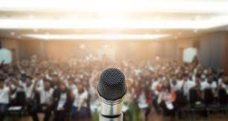
What Is Public Speaking?
Basically, it's a presentation that's given live before an audience. Public speeches can cover a wide variety of different topics. The goal of the speech may be to educate, entertain, or influence the listeners. Often, visual aids in the form of an electronic slideshow are used to supplement the speech. This makes it more interesting to the listeners.
A public speaking presentation is different from an online presentation. The online presentation is available any time. A public speech is typically limited to a specific time or place. Online presentations often use slideshows. Or they use pre-recorded videos of a speaker. This includes recordings of a live public speaking presentation).
Because speaking in public is done before a live audience, you need to consider some special factors. We'll touch on those shortly. Now you've got an understanding of the meaning of public speaking so let's take a quick look at the history of (and the importance of) public speaking.

Slide 4
A History of Public Speaking

Slide 5
What is the history of public speaking?
There's a good chance that there's been public speech, in one form or another, if there've been people. But most public speaking experts involved with public speaking in business communication, trace the origins of modern public speaking back to ancient Greece and Rome.
Of course, those societies didn't have slideshows to help with public speech. But they did have a need for speaking in public. As a result, they developed public speaking methods that are still studied today.
The ancient Greeks used public speech primarily to praise or persuade others. At one point, all Greek citizens had the right to suggest or oppose laws during their assemblies. This resulted in a need for skilled public speakers. Speaking in public became a desirable skill and was taught. Public speaking in the time of the Greeks was called rhetoric.
Later, when Rome came to power, speaking in public was used during the Roman senate sessions. The Romans adopted the public speaking rhetoric methods of the Greeks.
The Latin style of public speaking was popular in the U.S. and Europe until the mid-20th century. After World War II, a less formal and more conversational speaking style of speaking became popular. Also, electronic tools became available to enhance public presentations. Towards the end of the 20th century, those electronic tools migrated to the computer. They evolved into the computer software tools. PowerPoint, is one of those tools that we know and use today.

Slide 6
The Importance of Public Speaking
If you ask most people, they'll probably say they don't like public speech. They may even admit to being afraid of it since fear of public speaking is a very common fear. Or they may just be shy or introverted. For those reasons, many people avoid speaking in public if they can. If you're one of those people who avoid speaking in public, you're missing out.
Over the years, public speaking in communication has played a major role in education, government, and business. Words have the power to inform, persuade, educate, and even entertain. And the spoken word can be even more powerful than the written word in the hands of the right speaker.
Whether you're a small business owner, or a student, you'll benefit from improving your public speaking skills. Some benefits to speaking in public include:
= Improves Confidence
= Better research skills
= Stronger deductive skills
= Ability to advocate for causes
Speaking in public is especially important for businesses to market their offers. This allows them to get their message in front of potential customers. Salespeople and executives are often expected to have good public speaking skills. To learn more about some of the benefits of speaking in public, review the following article:

Slide 7
The Importance of Public Speaking
1. Increase in self-confidence
Public speaking will help you to dramatically add to your self-confidence. Since our society is a materialistic society, you can’t avoid ignoring our self-worth and self-esteem which is acquired by our insight of what we think other people think about us.
By engaging in public speaking, you are in effect increasing your communicating skills with others and gaining more confidence around people naturally, which leads to you being able to effectively understand what people are thinking and thereby change what you are saying and your manners to make them think and act the way you want them to.

Slide 8
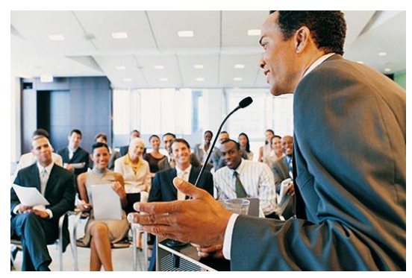
The Importance of Public Speaking
2. Makes you more relaxed around other people
One of the most awful things about being around other people is those embarrassing moments when you don’t know what to say or you say something stupid.
Your ability to feel relaxed and confident when meeting and talking to someone is greatly enhanced through public speaking.

Slide 9
The Importance of Public Speaking
3. Enhance a better career prospective
The ability of public speaking is very useful in securing a better job or getting promotion in the workplace. Your public speaking skills play important role in getting a better job.
The way you present yourself at a job interview is the ultimate decider as to whether or not you land that higher paying job and whether or not you get paid in the higher bracket or lower bracket of pay rates.

Slide 10
The Importance of Public Speaking
4. Skills learned can improve performance in other areas of life
Public speaking helps to improve your communication skills, your leadership skills, your self-confidence and increases your ability to better understand people. The multiple skills you will learn from public speaking can boost your performance and accomplishment in other areas of your life.

Slide 11
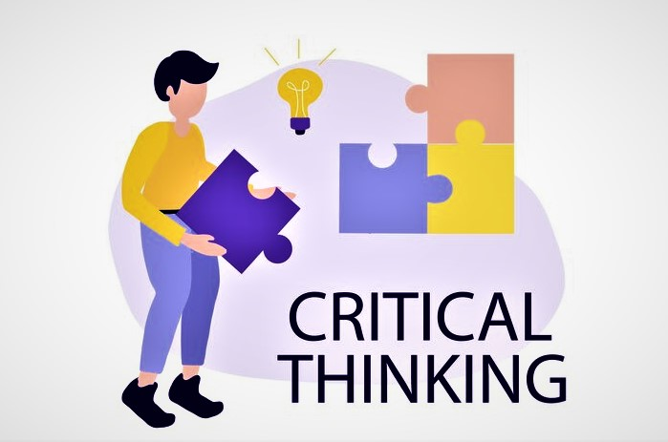
The Importance of Public Speaking
5. Developing Critical Thinking Skills
When engaging in the process of preparing a speech, you will have to think critically and go through the process of research in order to produce a better speech, and thereby improve your critical thinking skills.

Slide 12
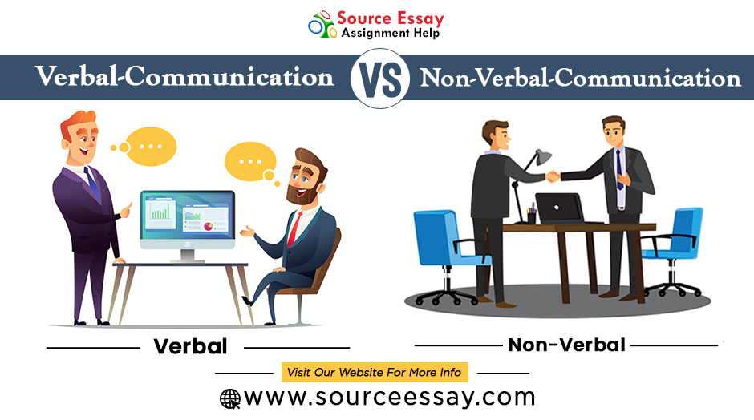
The Importance of Public Speaking
6. Developing Verbal and Non-verbal Skills
A public speaking course is very effective in helping you to finetune your verbal and non-verbal communication skills.
As you start to present your speech in front of the class, you will also get the opportunity to receive beneficial feedbacks from both your classmates and your instructor which will help you to become a better speaker.

Slide 13
The Importance of Public Speaking
7. Change the World around You
If there is anything going on in your city which you don’t like, then you can speak out about the issue! A powerful speech is one of the best ways to bring change to our society.

Slide 14
How to Become Better at Public Speaking (5 Quick Tips)
Okay, so now you understand the benefits of public speaking. You might be a little more interested in the topic. Still, you might think it's not for you. Maybe you gave a speech once and it didn't go well. Maybe you're afraid of speaking in public. Or maybe you think you don't have a natural ability for giving speeches.
The truth is that speaking in public is a skill. And you can learn any skill. While some people may have more natural speaking ability than others, anyone can learn to be a better public speaker. It just takes some know-how and some effort.
To help you become better at giving public speeches, we'll look at these five areas:
writing the speech
overcoming a fear of speaking
practicing the speech
preparing your presentation slide designs
giving the speech

Slide 15
1. Write an Effective Speech
The first thing you'll want to do is work on writing a well-organized, engaging speech. Because even a great speaking voice or a great deal of charisma isn't enough if your material isn't any good. The following tutorials can help you learn to write better speeches:
2. Overcome the Fear of Speaking
Fear of public speaking is very real and can hold you back if you let it. If you don't feel confident when giving your speech, your listeners may pick up on that. This can make your presentation less effective. Fortunately, there are some techniques to help manage the fear of speaking in public. They also help you become more confident.
First, let's tackle fear of public speaking. The following tutorials can help you overcome a fear of public speaking:
3. Practice the Speech
Even if you're not afraid of speaking in public, practice helps you give a more effective speech. If you're in a rush, you may be tempted to skip practicing your speech to save time. While skipping practice may seem like a good idea, it's not.
Practicing your speech improves your public presentation skills. It also increases your familiarity with the presentation. As a result, your speech will go smoothly. This tutorial includes a handy checklist to help you practice your speech (and other tips):

Slide 16
4. Prepare Your Presentation Slide Designs
Your slide design needs to be on point. You’ll want to make sure it looks professional and is easy to read. Luckily, you can find plenty of modern and professional presentation templates on Envato Elements and Graphic River.
You'll also want to download The Complete Guide to Making Great Presentations eBook now. Download it for FREE with a subscription to the Tuts+ Business Newsletter. Learn how to get your ideas formed into a powerful presentation that'll move your audience.
Don't forget to make good use of tools like PowerPoint, Google Slides, or Keynote. The right template for your slide deck can make a huge difference in your presentation.
5. Give the Speech
You've written a good speech. You feel more confident about giving a speech in public, and you've practiced. You're ready to actually give the speech. There are some tips and tricks you can use on the day of your speech to make it go more smoothly, though. Remember, you're giving a presentation before a live audience at a specific place and time. So, you've got some concerns about the speaking venue that those who give online presentations don't have to worry about. Some common concerns for public speakers include:
Will the audience be able the hear me?
Does the venue have the equipment I need?
Are there enough seats for all my listeners?

Slide 17
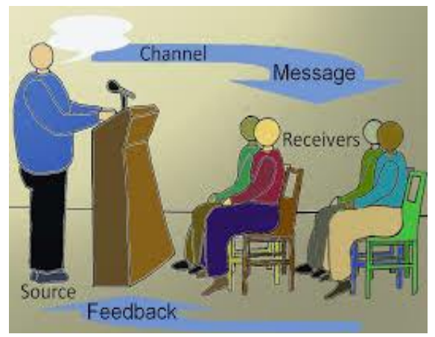
Model of Public Speaking

Slide 18
Model of Public Speaking
The interactional model of public speaking is based on the mathematical theory of communication. This model imitates how radio and telephone technologies functioned. The model involved three major parts: source, channel, and receiver. The source was the part of a telephone a person spoke into, the channel was the telephone itself, and the receiver was the part of the phone where one could hear the other person. Shannon and Weaver also documented that often there is static that hinders the listening to the telephone conversation, which they called noise. Noise refers to anything that interferes with message transmission or reception.

Slide 19
Understanding the Ethics of Public Speaking
Ethic refers to the moral principles that direct a person's behavior or the conducting of an activity. To simplify it, it means dealing with what is good and bad in relation to moral duty and obligation.
Should a speaker use proof within a speech that he/she is not sure is correct if it supports the speech’s central case?
As a listener, should you turn down a speaker with whom you basically disagree? These are some of the ethical questions that represent ethical choices speakers and listeners face in the public speaking framework.

Slide 20
Ethics Behavior in Public Speaking
Why would you need to even consider ethics in public speaking? First and foremost, your audience not only needs to believe in your words and message, but they need to trust you as the message giver. To engage in unethical behavior when speaking only erodes that trust. There are other reasons to engage in ethical behavior in public speaking:
To maintain your credibility and reputation.
To present a fair and accurate argument of your thesis.
To provide honest facts with integrity and without deception or distortion.
To abide by shared or common moral values and beliefs.
To speak ethically is to use your own original speech content. If you use any substantiating facts or passages from another, you must give appropriate attribution or credit, as necessary. Ethical speakers are ones who do not plagiarize their material or try to pass off words and ideas from others as their own.
Ethical speakers do not deceive their audience. It can also be stated that ethical speakers do not distort or warp facts, or worse yet, disguise opinions as fact in order to argue their thesis or make their point.
Acknowledging and responding to conflicts of interest is also regarded as ethical public speaking behavior. There may be times where you may be asked to speak on behalf of a certain topic in which you have a professional interest or may benefit from financially. In those instances, the ethical speaker will either excuse him or herself from speaking. If unable to do so, he or she may simply disclose the nature of the conflict of interest so that everyone is on the same page.

Slide 21
Types of
Speeches
Notes:
在左边的英文第一行可以替换LOGO图标
字体具体说明：
中文字体：思源黑体、思源宋体
谨慎事项：思源黑体、思源宋体的字体可免费商用，放心使用。
缺少字体：没有这些字体需要自行下载字体安装，否则自动转为默认宋体的字体，按照这些字体安装的效果为准。
蓝美视觉的店铺更多作品，正在更新：https://www.docer.com/works?userid=682883332
祝您使用愉快！！！

Slide 22
·Informative Speaking
GOALS OF INFORMATIVE SPEAKING
1. You speak to enhance understanding = Understanding occurs when a listener accurately interprets the intended meaning of a message.
2. You speak to maintain interest = May have carefully selected words, examples and illustrations that the listeners understand.
3. You speak to remembered = Most listeners remember only about 50% of what they told on that day. By 2 days later they can recall only 25%.

Slide 23
Examples of Informative Speech Topics
The Lives of Ants
The History of Africa
The Environmental Impact of Using too much Cars
The Biography of your Favorite Teacher
Types of Sea Animals
The Origin of Football
Exotic Pets
The Evolution of English Language
Twenty-first Century Useful Inventions
How to Get Good Grades

Slide 24
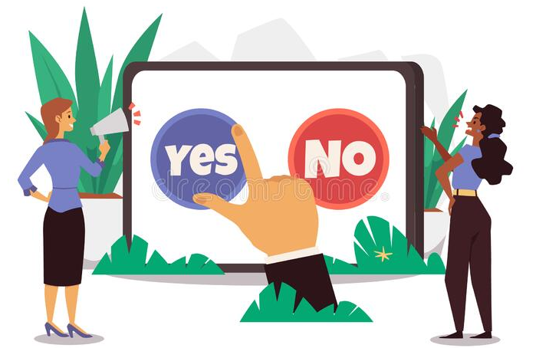
·Persuasive Speaking
GOALS OF PERSUAIVE SPEAKING
Convincing
= Designed to cause the audience to internalize and believe a viewpoint that they did not previously hold. In a sense, a convincing argument changes the audience's mind.
= For example, suppose you are giving a persuasive speech claiming that Coke is better than Pepsi. Your goal is not just for the audience to hear that you enjoy Coke more, but for Pepsi lovers to change their minds.

Slide 25
·Persuasive Speaking
GOALS OF PERSUAIVE SPEAKING
2. Actuation
= An actuation speech has a slightly different goal. An actuation speech is designed to cause the audience to do something, to take some action. This type of speech is particularly useful if the audience already shares some or all your view.
= For example, at the end of presidential campaigns, candidates begin to focus on convincing their supporters to vote. They are seeking to actuate the action of voting through their speeches.

Slide 26
·Persuasive Speaking
GOALS OF PERSUAIVE SPEAKING
3. Stimulation
= Persuasive speeches can also be used to enhance how fervently the audience believes in an idea. In this instance, the speaker understands that the audience already believes in the viewpoint, but not to the degree that he or she would like. As a result, the speaker tries to stimulate the audience, making them more enthusiastic about the view.
= For example, religious services often utilize stimulation. They are not trying to convince those of another religion to switch religions necessarily; there is an understanding that the congregation already accepts part or all the religion. Instead, they are trying to enhance the degree of belief.

Slide 27
Examples of Persuasive Speech Topics
How Pollution is Negatively Affecting Humanity
Should the Driving Age be 14?
The Danger of Texting and Driving
Why Parents should not Hit their Children
Why Alcohol should be Illegal
Cooking should be Taught in Schools
Money can’t Buy Love or Happiness
People should Eat Less Junk Food
The Minimum Wage should be Increased
Should Free College Tuition be Offered to Poor Children?

Slide 28
·Entertaining Speaking
GOALS OF ENTERTAINING SPEAKING
Aim is to present a speech in a manner that provides pleasure and enjoyment to make the audience to laugh. Just like the other two types of speeches we have discussed, entertaining speeches need to communicate a clear message, but the manner of speaking used are generally based on humor, stories, or illustrations.

Slide 29
Examples of Entertaining Speech Topics
The Right Way to Lie
How to Fall in Love in 308 Easy Steps
If I had a Million Dollars
The First Time I Got Caught
My Worst Date
The Worst Joke I Ever Heard
How to Fail a Driver’s Test
How to Ruin a Date
How to Stay a Bachelor
The Right Way to Lie

Slide 31
Chapter 1: Conclusion
Public speaking is generally seen as any type of speaking formally and informally that involves an audience and a speaker.
Public speaking is one of the most essential skills needed to develop interpersonal relationship and career development in today’s global integration.
Public speaking is very effective in helping you to fine-tune your verbal and nonverbal communication skills.
The main purpose of an informative speech is to present or share information about a particular person, place, object, process, concept, or issue by defining, describing, or explaining.
A persuasive speech is a speech commonly aims at convincing the listeners to act or take part in doing something.
Entertaining speeches are used to communicate a clear message, but the manner of speaking used are generally based on humor, stories, or illustrations. Entertaining speeches should include four key considerations: preparation, adaptation to the occasion, adaptation to the audience, and mindfulness of the time.

Slide 32
Business opportunities are like buses. There's always another one coming.
RICHARD BRANSON

Slide 33
THANK YOU
Oraphan Decha
(Aj. Tammy)
Oraphan.de@ssru.ac.th

