Slide 1


STOCK MARKET
AND STOCK EXCHANGE
OF THAILAND

Slide 2


essence
major financial institutions is the stock market
which is a place or source of funding
of long-term investors who hope for future profits
but not suitable for short-term investment
study of details and procedures
related to trading in the stock market
It will be a tool to help investors make better decisions.

Slide 3

general purpose
To have an understanding of the meaning of the stock market
and the Stock Exchange of Thailand composition of
stock market Qualifications of member companies and measures to protect investors

Slide 4

Definition of Stock Market
The stock market is a type of capital market.
It is a source of mobilizing long-term savings for more than 1 year.
Is a trading source for allocation
To those who need long-term funds to be used for various purposes.

Slide 5

the meaning of
stock market
of Thailand
The Stock Exchange of Thailand acts as a trading center for listed securities.
and develop various systems necessary to facilitate securities trading conduct any business related to securities trading

Slide 6
operation
The Stock Exchange of Thailand operates as follows:
1. Listing of securities
2. Securities Trading
3. Supervision _ _
Receive listed securities and supervise information disclosure of listed companies
Supervision of member companies related to securities trading as well as disseminating information and promoting knowledge to investors.
Securities Trading and Securities Trading Supervision

Slide 7
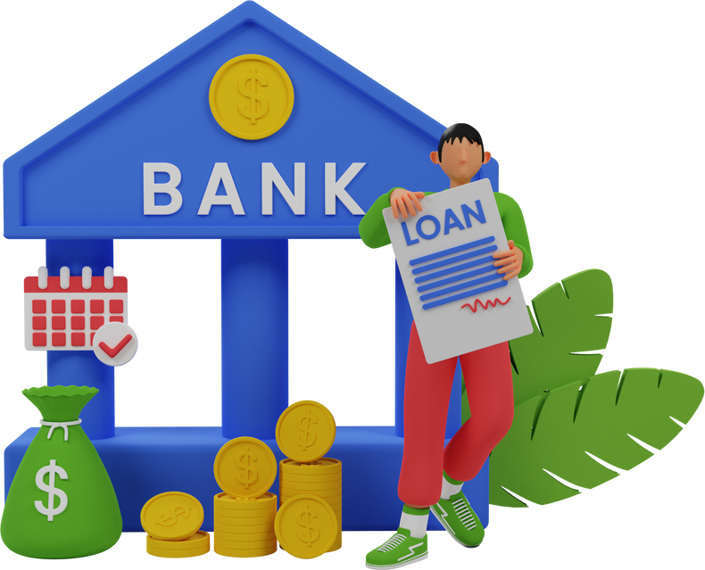



Is an internal funding source (INTERNAL SOURCES) if viewed in terms of a single owner or partnership Including the capital that the owner brings down in terms of a limited company, namely The proceeds from the sale of company shares to relatives in the family.
The source of funds is the Stock Exchange of Thailand.
internal funding source
external funding sources
It is an external source of funds (EXTERNAL SOURCES), including borrowing money from outsiders in various forms such as borrowing from banks. issuance of bonds Issuance of capital increase shares or debentures use of creditors' credit purchases on credit

Slide 8

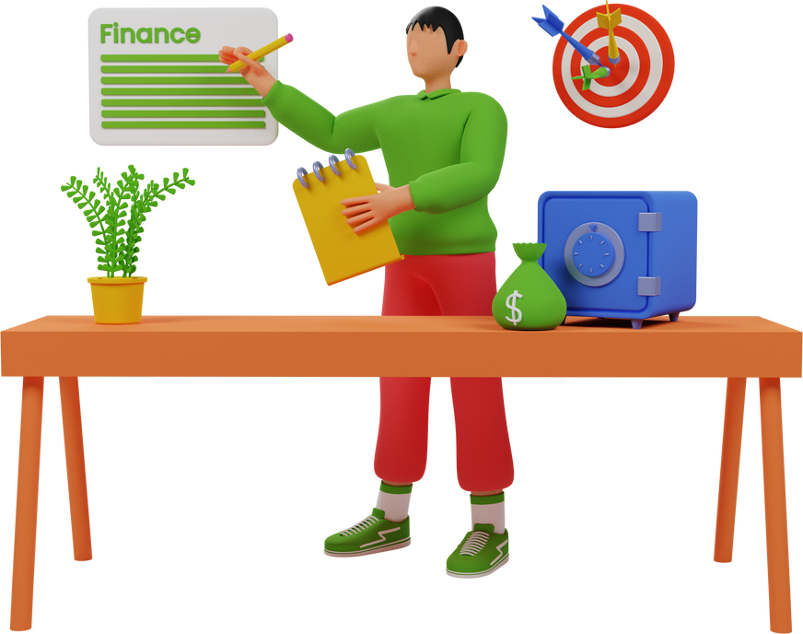
Components of the Stock Exchange of Thailand
Policy makers
1
stock market
2
Board of Governors of the Stock Exchange of Thailand
3
member company

Slide 9
Policy makers
1
stock market
There is a board of directors of the Stock Exchange of Thailand. Set policies and control the operations of the Stock Exchange within the scope of the law.
2
Board of Governors of the Stock Exchange of Thailand
It consists of 5 directors appointed by the SEC, 5 directors elected by member companies, and 1 manager of the SET appointed by the board of directors of the SET as ex officio director.
3
member company
as a policy planner on the determination of various regulations Through five representatives elected to join the Board of Governors of the Stock Exchange of Thailand

Slide 10

Components of the Stock Exchange of Thailand
management
Management has a manager who is responsible for the board of directors of the Stock Exchange. The manager is responsible for managing the affairs of the Stock Exchange in accordance with the policies set by the Board of Governors of the Stock Exchange of Thailand. Including commanding staff and employees The lower level stock market executives have deputy managers and assistant managers. and director of departments

Slide 11





Components of the Stock Exchange of Thailand
trading place
listed securities
investor
member company

Slide 12
Components of the Stock Exchange of Thailand
The Stock Exchange of Thailand is a center for securities trading. The stock exchange does not directly trade securities. But acting only to supervise the trading of securities to be in an orderly manner
trading place
Securities that have been listed for trading on the stock exchange Types of securities listed on the market may be divided into ordinary shares, preferred shares, debentures. Convertible debentures, bonds, warrants to purchase ordinary shares (WARRANT), preferred stocks, debentures or investment units
listed securities

Slide 13
Components of the Stock Exchange of Thailand
Investors are the most important component of the stock market. Investors can be divided into individuals. general public and juristic persons both domestically and internationally
investor
Securities companies and finance and securities companies licensed to operate securities brokerage business and has been selected as a member of the stock exchange
member company

Slide 14


Qualifications of member companies
The member company must be a securities company licensed to operate a securities brokerage business. which has good financial status and operating results Possess the capability and readiness to operate securities business
Member companies will be entitled to trade listed securities on the stock exchange and receive various services. provided by the stock exchange Including the right to elect directors of the Stock Exchange

Slide 15
The Stock Exchange of Thailand is responsible for controlling and supervising the securities business operations of member companies. and strictly complied with the rules, regulations and regulations of the Stock Exchange of Thailand
Control and Supervision of Securities Business Operations of Member Companies

Slide 16

setting standards for securities business operations
considering accepting customers Members must get to know customers. by providing sufficient details about customers
order acceptance Member companies are required to produce black invoices for purchase or sale. Cancellation of buy or sell orders along with the customer to sign completely
order fulfillment stock trading Member companies must record purchase or sale of securities in the daily buy or sell register.
notification of trading results and making records Notification of trading results and preparation of securities trading records

Slide 17
setting standards for securities business operations
Preparation of delivery records Preparation of deliveries, receipts, and storage of securities The member company must issue a delivery slip. or securities receipts for customers every time
Settlement The member company must always issue a securities settlement document to the customer. by showing the net amount from securities trading
document storage Member companies are required to keep documents for at least 2 years from the date of creation. Except for storing customer history files Keep it stored for at least 2 years.

Slide 18

Measures to protect investors
Improve the quality of listed companies
increase the return on investment
Enhancing stability and liquidity in securities trading
Build credibility on the stock market by supervising trading.
Develop information dissemination channels and organize knowledge-promoting activities for investors.

Slide 19



Responsibilities for conducting financial transactions of the Stock Exchange of Thailand
investment advisory
Advising clients on trading
securities trading
Underwriting
Securities trading to open a company account
Underwriting of securities to the public

Slide 20


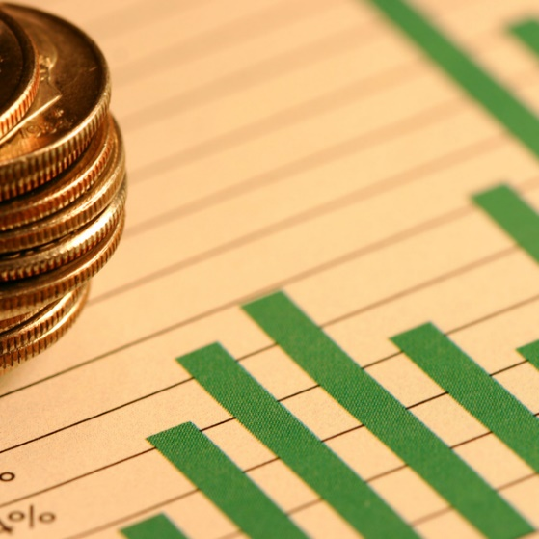
Responsibilities for conducting financial transactions of the Stock Exchange of Thailand
Private fund management
Managing funds for a group of 5 or more people
mutual fund management
finance company
Limited company licensed by the Minister of Finance
Project-Based Investment Management

Slide 21
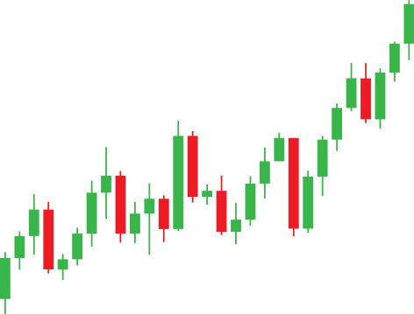
Caution in trading securities
Orders to sell securities
Because securities trading is a complex process and involves many parties. to prevent potential problems Every investor should thoroughly examine all documents related to securities trading as follows:
In the case of sending purchase orders - sales on securities trading room Be sure to write the details. complete , both name and customer code name of securities Accurate number and stock price and sign at the end of every order And should not take orders to sell and write alternately Because it will lose opportunities and money.

Slide 22
Caution in trading securities
CONTRACT and INVOICE
CONTRACT and INVOICE are documents that brokers will send to investors to sign for acknowledgment of official securities trading. what stock amount and price Total money to be paid ( in case of purchase ) or received ( in case of male ) how much After deducting the commission, how much money will be left? All numbers and details must be checked to be correct. therefore signing Copy of documents from every broker must be kept in a systematic and complete collection. because it will be an important evidence to verify in case of an error occurs

Slide 23
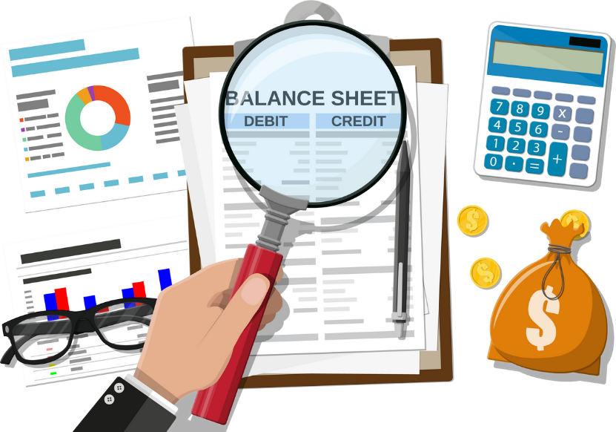
Account Balance Report
Sometimes investors may stop trading for a while. But at the end of every month, the broker will inform the balance of securities in the account. It's the same as commercial banks notify current account balances at the end of the month. Must verify that the securities are still available correctly or not because the broker may have many customers. or the computer system may not work properly causing the balance of securities to be wrong If something goes wrong or if not sure should contact back to the broker's marketing officer who takes care of the account to check the bruising

Slide 24
In the case of using a margin account for securities trading
You should check more about the remaining balance. The margin rate may change. or others need to be more detailed This is because the trading system with a margin account is complicated. The numbers move every day. and has very detailed steps Therefore, further study should be made. By asking the broker that the investor is a customer or is going to be a customer for a clear explanation.

Slide 25
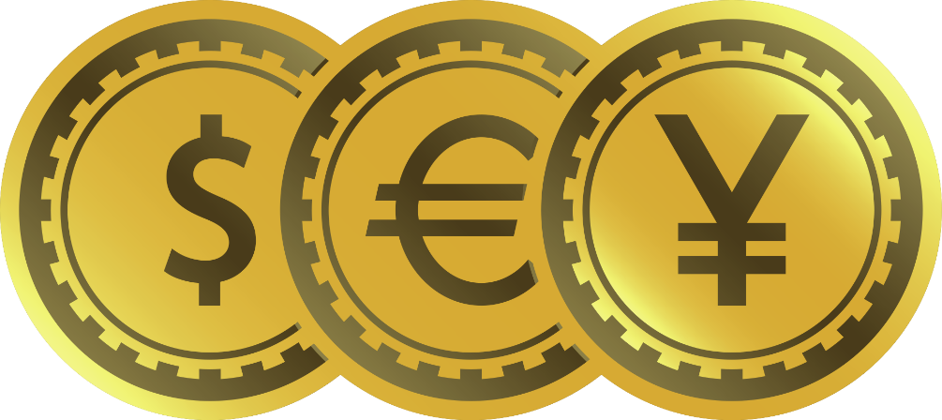
currency
In the case of using a margin account for securities trading
You should check more about the remaining balance. The margin rate may change. or others need to be more detailed This is because the trading system with a margin account is complicated. The numbers move every day. and has very detailed steps Therefore, further study should be made. By inquiring from the broker that the investor is a customer or is going to be a customer for a clear explanation.

Slide 26



stock market investor
like taking risks (ENTERPRISING)
In this type of investment, investors are more willing to take risks and will often sell and buy stocks.
speculator (SPECULATOR)
Risk-averse (CONSERVATIVE)
Be a stock player who buys high-risk stocks. expecting returns in the form of profits from selling stocks within a short period of time and not expecting dividends
It is a stock investment that focuses on the safety of funds.

Slide 27
THANK YOU
Stock Exchange and Stock Exchange of Thailand

Slide 28
exercise
1. What type of financial institution do you think the Stock Exchange of Thailand is? and how it is important to investors
2. Describe the qualifications of members of the Stock Exchange of Thailand in detail.
3. The Stock Exchange of Thailand is suitable for retail investors. who want to speculate on investment Do you agree with this sentence? And have any additional comments?
4. Explain measures to protect investors in the Stock Exchange of Thailand.
5. How many parties are involved in the Stock Exchange of Thailand and what are their duties?

Slide 29
end of chapter questions
1. Explain the meaning of the term financial statements.
2. What are the elements of financial statements? Explain.
3. What is the purpose of financial statements? Explain.
4. Explain the meaning of the word users of financial statements And how many types of financial statements users are divided into? What are they?
5. Explain the meaning of the word balance sheet and how many important elements of the balance sheet are there?

Slide 30
end of chapter questions
6. What is balance sheet equation?
7. Explain the meaning of the word profit and loss statement and how many important elements of the balance sheet are there?
8. Duties and Responsibilities of Finance Managers
9. Evaluation of financial management

