Slide 1



financial statements :
balance sheet
income statement

Slide 2



01.
Meaning and importance of financial statements.
TOPIC
02.
Purpose of Financial Statements
03.
Elements of financial statements
04.
Types of Users of Financial Statements
05.
balance sheet
06.
income statement

Slide 3


Meaning and importance of financial statements.
Financial statements present information about assets, liabilities, shareholders' equity. income and expenses so that users of the financial statements are aware of the financial position performance and cash flow of the business It will be presented in the statement of financial position. Statement of Comprehensive Income Statement of Changes in Owner's Equity and cash flow statement

Slide 4

Purpose of Financial Statements
It is a systematic presentation of the financial status and financial performance of the business. The objective is to provide information about financial status. performance and cash flow of the business

Slide 5

Statement of financial position at the end of the period
(Statement of Financial Position)
Statement of profit and loss and other comprehensive income for the period (Profit and Loss Statement)
Statement of changes in equity for the period
(Statement of Change in Shareholder's Equity)
Elements of financial statements
cash flow statement
(Cash flow statement)
Notes to financial statements
(Note to Financial Statement)

Slide 6


Types of Users of Financial Statements
internal user
external user
Executives at all levels and departments with decision-making authority on issues related to operations investment and financing of entities such as management
Non-management users of the entity's financial statements They are external stakeholders, such as investors who own (equity) and are creditors.

Slide 7




Assets Resources owned or owned by an entity.
current assets
balance sheet
non-current assets
A balance sheet is a statement of the financial position of a business at a particular point in time, generally showing information ending on a certain date. The balance sheet is divided into three types:
Liabilities
Obligations or responsibilities that the entity has to perform as agreed.
current liabilities
long term debt
owner's equity
(Owners' Equities) The difference between the total value of the assets of the firm and the liabilities of the firm.
share capital
capital surplus
retained earnings

Slide 8





Assets _
current assets
non-current assets
Cash or other assets that can be converted into cash within 1 year or the normal operating period of the business.
tangible assets which has a permanent condition and have a service life of more than 1 year

Slide 9




Liabilities
current liabilities
long term debt
An obligation that the entity must pay back within one year or the normal operating period of the entity.
Obligations that the entity expects to repay over a period of more than one year or the normal operating cycle of the entity.

Slide 10


Owners ' Equities
Assets = Liabilities + Owner's Equity
share capital
capital surplus
Capital of a legally registered entity and the number of shares and the value of shares sold by the business and called the shareholders to pay for their shares
Divided into 2 types: share premium and surplus from asset revaluation.
retained earnings
Profits that have not been shared and retained in the business Allocated sections are usually displayed separately. and has not allocated

Slide 11


The balance sheet is divided into two types.
report balance sheet
account balance sheet
(Report form)
(Account form)

Slide 12
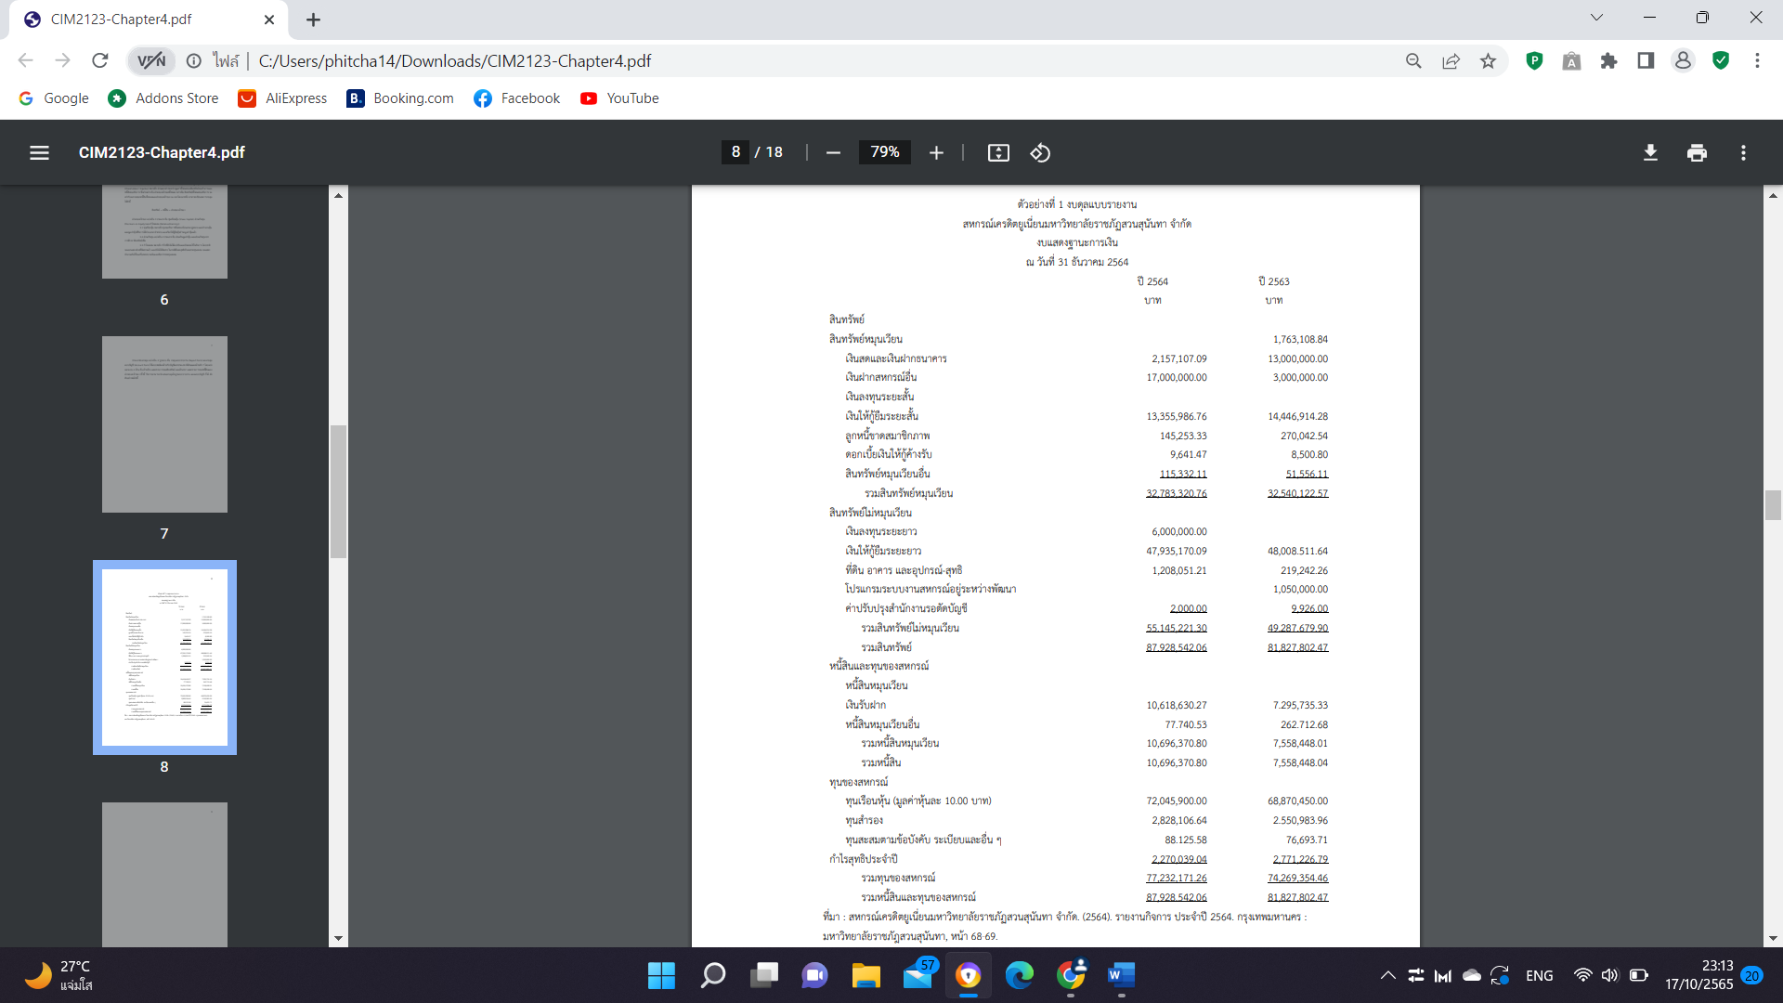
report balance sheet

Slide 13
report balance sheet

Slide 14
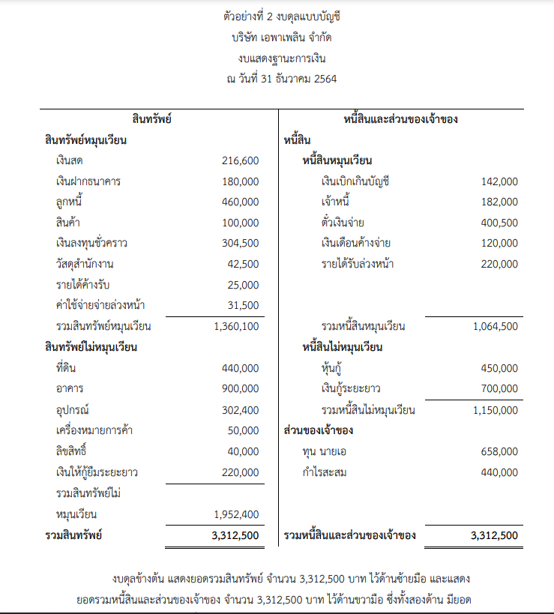
account balance sheet

Slide 15

income statement
Income Statement is a statement that shows the performance of a business in a particular accounting period. Which is generally specified for a period of 1 year or can make a profit and loss statement to report operating results for a period shorter than 1 year.
Profit = Revenue – Expenses
  Revenues are the assets that an entity receives from the sale of goods and services to its customers, including returns on investments.
  Expenses are the costs of goods and services that are used or exhausted to generate revenue and result in a decrease in equity .
  Net profit ( net loss ) means The surplus where income is higher than expenses in one accounting period.

Slide 16



Revenues are the assets that an entity receives from the sale of goods and services to its customers, including returns on investments.
Expenses are the costs of goods and services that are used or exhausted to generate revenue and result in a decrease in equity .
Net profit ( net loss ) means The surplus where income is higher than expenses in one accounting period.

Slide 17

The profit and loss statement can be prepared in 2 formats.
One-Step Income Statement
(Single-Step Income Statement)
Multi-Step Income Statement
(Multi-Step Income Statement)

Slide 18
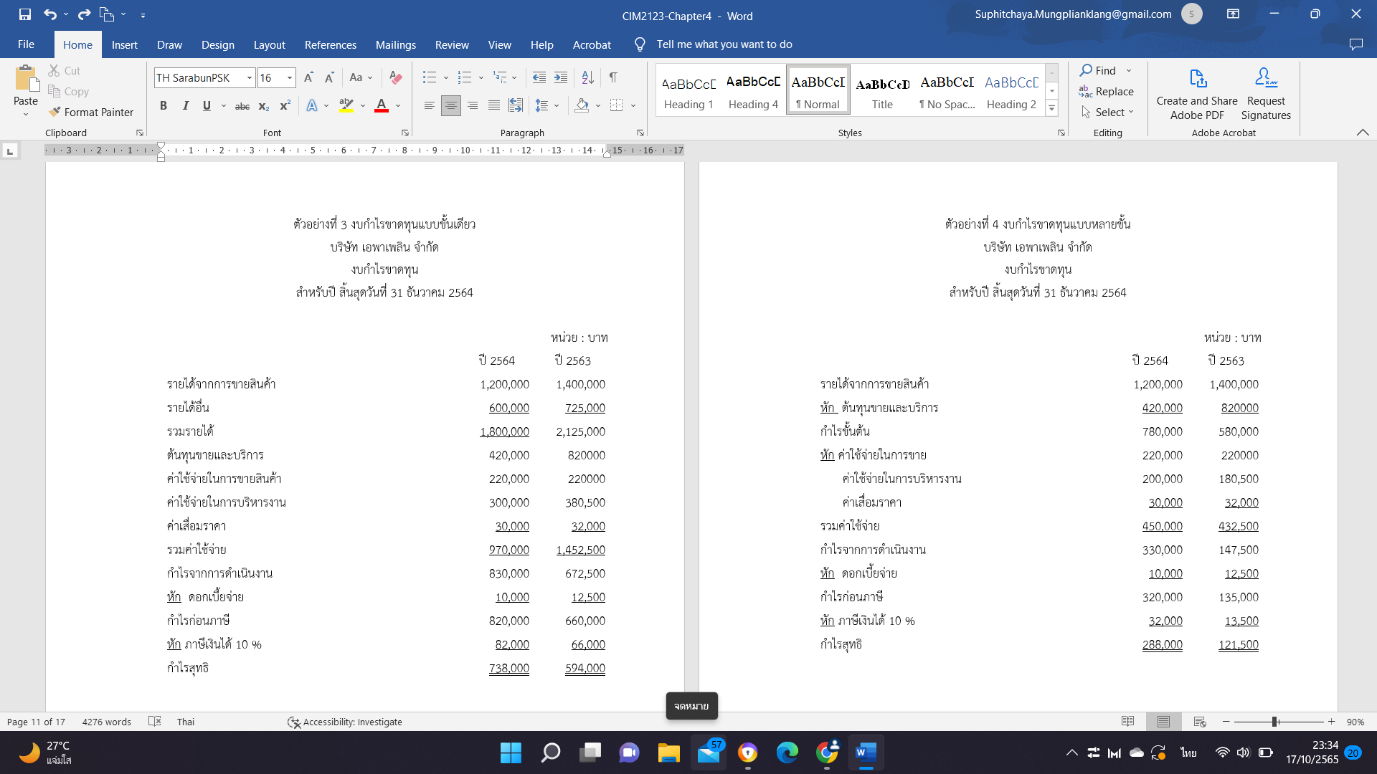
Single level income statement

Slide 19
multi-tiered income statement

Slide 20
THANK YOU
financial statements, balance sheets and income statements

Slide 21

01.
Explain the meaning of the term financial statements.
end of chapter questions
02.
What are the elements of financial statements? Explain.
03.
What is the purpose of financial statements? Explain.
Explain the meaning of the word users of financial statements And how many types of financial statements users are divided into? What are they?
04.
Explain the meaning of the word balance sheet and how many important elements of the balance sheet are there?
05.

Slide 22
06.
What is the balance sheet equation?
end of chapter questions
07.
Explain the meaning of the word profit and loss statement and how many important elements of the balance sheet are there?

