Slide 1
Introduction to Business Finance
Ajarn Naruemon Chomchom

Slide 2
TOPIC
Meaning and importance of business finance management.
Objectives of financial management
financial management goals
FINANCIAL FUNCTION
role of financial management
Duties and Responsibilities of Finance Executives
Evaluation of financial management

Slide 3
Meaning and importance of business finance management.
Ross Westerfield and jordan gave a definition of the term Business Finance means Study to find ways to answer 3 key financial questions. following

Slide 4
?
Three key financial questions namely
1. How does the company make long-term investment decisions? The money should be invested in any type of business or building, machinery and equipment that the company needs.
2. The company has long-term funding to invest in the business.
In the first verse from which source?
3. How does the company manage its daily working capital? such as debt collection and payment of creditors etc.

Slide 5
Objectives of financial management
1. To know that there is enough capital
in running the business in the long term
2. To know how the business returns
Get enough and worth the investment.
3. To know if available funds are used
in the transaction appropriately and accurately
4. To know that investment in business
It is appropriate and correct according to the objectives.
5. To know that various investment plans analyzed
Be as planned and pay off.

Slide 6
financial management goals
financial management goals It reflects a good business finance management system. It will help executives run their business towards business goals efficiently.
Wealth Maximization
Wealth Maximization can be measured from the market price of the highest common stock.
Value
The creation of increased business value (Value) can be measured from the profitable performance (Net Profit) shown in the income statement.

Slide 7
FINANCIAL FUNCTION
Fundraising duties (Financing function)
01
Duty to allocate funds
(Investment function)
02
Dividend function
03

Slide 8
Fundraising duties
(Financing function)
01
financing can be obtained from 2 major sources other is
1. Creditors or liabilities Which is divided into 3 types as follows
2. Owner namely issuance of ordinary shares Preferred stock and retained earnings , which financing from the owner's sources will incur high financial costs. But it has low financial risk.
1) Short-term liabilities
buy on credit overdraft bills paid
advance income accrued expenses etc.
2) Medium term debt
property rental installment purchase etc.
3) Long-term debt
long term loan Issuance of debentures or bonds
in financing from this debt source
There will be high financial risks. But there are low costs or financial costs.

Slide 9
Duty to allocate funds
(Investment function)
02
Fund allocation by investing in assets which can be divided into 2 types is
1. Current Asset
It is an investment to generate turnover in operations to generate income. investment in this section Also called
Working Capital such as cash
2. Non -Current Asset
It is an investment to build production capacity to generate long-term income. which will find the presence of non-current assets such as factory or their own machinery

Slide 10
Comparison table of financing and allocation of funds

Slide 11
Dividend function
03
Types of Dividend Policy are as follows
1. Policy for dividend payment from remaining net profit
(Residual Dividend Policy)
2. Stable or Predictable Dividend Policy
3. Dividend policy that determines a constant dividend payout ratio
4. A policy that pays a small amount of dividends per share and provides extra dividends when possible (Low Regular Dividend Plus Extras).

Slide 12
Dividend function
03
Non-Cash Dividend Alternatives
stock split
(Stock Split)
share buyback
(Stock Repurchase)
dividend stocks
(Stock Dividend)

Slide 13
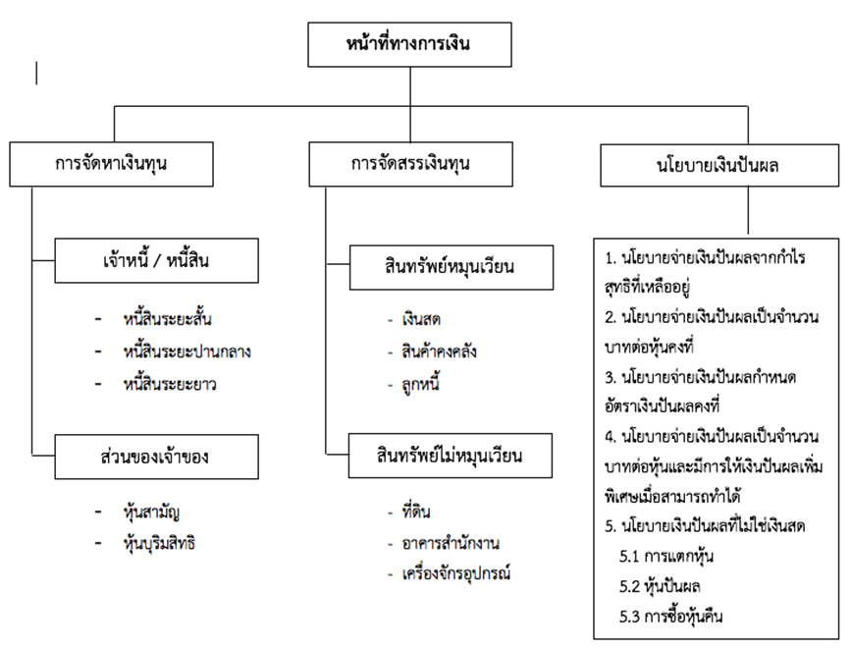
Dividend function
03
The diagram shows the salary base showing the financial position.
Source: Naruemon Chomchom. (2019).

Slide 14
role of financial management
In the past, financial management has played a small role. start with planning Or estimate how much money this business initially needs. and come back to see how much money the business already has how much more lack to be supplied additionally After that, it proceeded to raise money to invest in the business.
01

Slide 15
Duties and Responsibilities of Finance Executives
1. Functions of forecasting and planning
(Forecasting and Planning)
2. Responsibilities in making investment decisions and financing
(Investment and Financial Decision)
3. Duty to coordinate and control (Coordination and Control)
4. Duty to represent the organization Dealing with the Financial Market
5. Responsibilities in risk management
(Risk Management)

Slide 16
Evaluation of financial management
Tools for evaluating financial management are as follows:
1. Financial Ratios
(Financial Ratio)
3. Break even point
(Break Even point)
2. Capital Flow Statement
(Fund Flow Statement)
4. Financial risks
(Financial Leverage)

Slide 17
end of chapter questions
01
Explain the meaning of the word
" Business Finance "
05
What are the financial responsibilities?
explain
02
In doing business in general Financial management is an important aspect of financial management.
06
role of financial management
03
What are the objectives of financial management? explain
07
duties and responsibilities of
financial executive
04
The most important financial management goals What is explain
08
Evaluation of financial management

Slide 18
THANK YOU

