Slide 1
financial institution
digital currency

Slide 2
TOPIC
financial institution
financial evolution
currency
digital currency

Slide 3
Financial institutions play an important role in fundraising intermediaries.
and allocate economic resources to different economic sectors other
as well as providing payment services for goods and services.
Efficiently developed financial institution system and stable
would support sustainable economic growth

Slide 4
business finance
Stock Exchange of Thailand Has given the definition of the word " business finance " (Business Finance) means Using management principles to make important decisions directly related to planning, directing and controlling financial activities investment corporate financing and operations and activities Related with the objective of creating sustainable growth for the organization and create wealth for shareholders Knowledge of financial management will make the organization run smoothly. and effective financial management will enable the organization to achieve its objectives sustainably

Slide 5
Important components of the Thai financial institution system
1. Depository institutions
2. Financial institutions that do not accept deposits

Slide 6
1. Commercial Bank
2. Depository Specialized Financial Institutions
To be the main intermediary in mobilizing deposits from depositors to provide credit to the household and business sectors.
which has a specific law for its establishment The objective is to respond to the government's specific promotion and development policy.
1. Depository institutions
3. Savings Cooperatives and Credit Unions
4. Money market funds
It is a mutual fund that focuses on investing in bank deposits. or bond Short-term with residual maturity of not more than 1 year
Established voluntarily
Members in the same relationship
Members will accumulate assets together as working capital for members to use as borrowers.

Slide 7
1. Financial institutions that do not accept deposits
1. Mutual funds
2. Provident Fund
It is a fund jointly established by employers and employees. Employees must contribute part of the contribution to the fund. and another part of the employer sends contributions
It is a systematically managed investment tool. aims for best return

Slide 8
3. Companies that provide loans
1. Financial institutions that do not accept deposits
It is a business that does not accept deposits from the public. but lends to those in need of capital.
4. Asset management company
5. Securities company
Conducting various types of securities business
Responsible for managing non-performing assets of financial institutions

Slide 9
financial evolution
before it comes to money or banknotes that we use every day There have been many developments. Let's start with the oysters. with ( Terracotta with stamp ) Pod Duang money Tiles and coins are mediums of exchange.

Slide 10
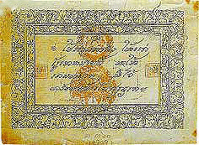
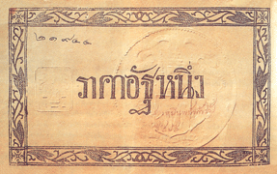
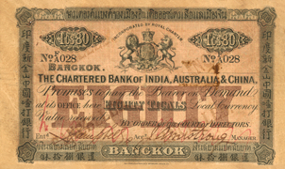
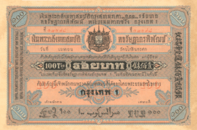
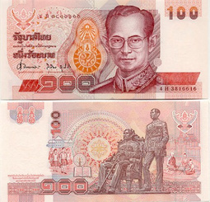
country's monetary system
mark
att paper
bank card
royal paper money
banknote
Source: Bank of Thailand https://www.bot.or.th/Thai/Banknotes/know_BMG/Pages/Evolution_Thai_Banknotes.aspx

Slide 11
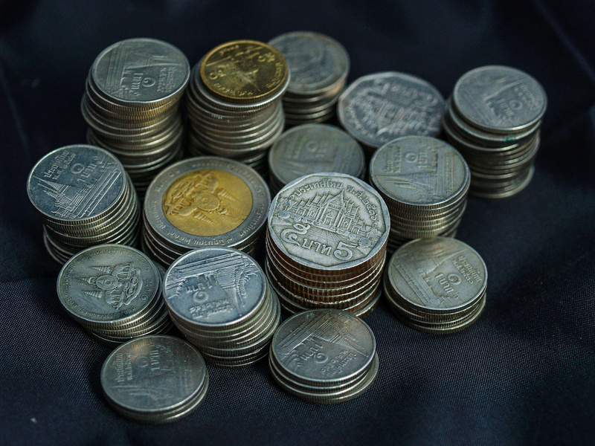
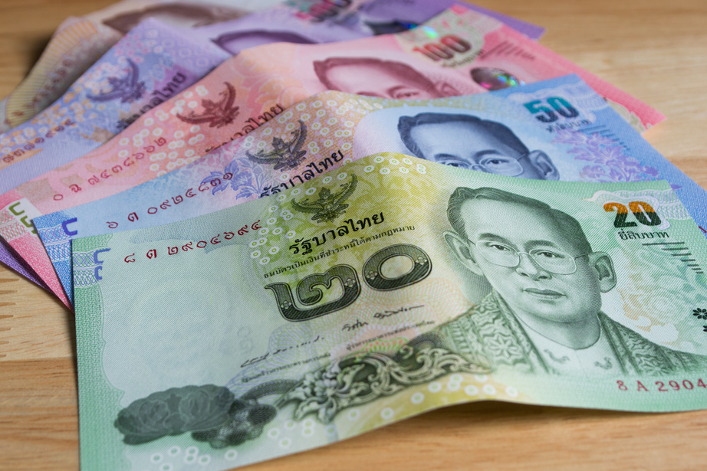
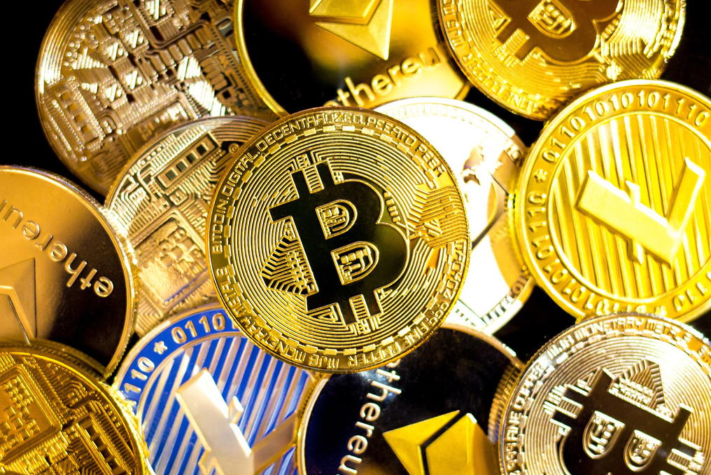
currency
digital currency
Thai currency is Thai Baht (Baht)
Amount 1 baht equal to 100 satang (Bank of Thailand, 2022)
It is a currency that is widely used on the internet world. And it is a type of digital asset that relies on encryption.
coin
banknotes
Bitcoin, Bitcoin Cash, Etheremu , Etheremu Classic, Litecoin, Stellar XLM, Ripple
Source: https://www.canva.com/photos/MAEHN_rM0nk/
Source: https://www.canva.com/photos/MADFP7WZI9Q/
Source: https://www.canva.com/photos/MAEed3_6dHU/

Slide 12
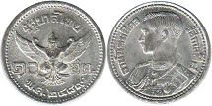
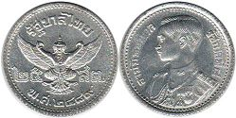
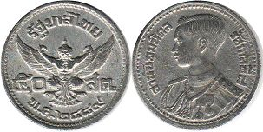
coin
coin 1 satang
coin 5 satang
10 satang coin
coin 25 satang
50 satang coin
Source : https://worldcoinsinfo.com/asia/thailand-coins-th.html

Slide 13
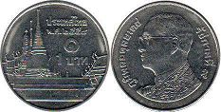
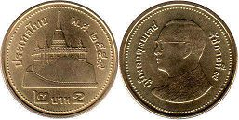
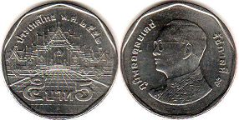
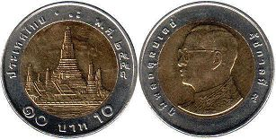
coin
1 baht coin
2 baht coin
5 baht coin
10 baht coin
Source : https://worldcoinsinfo.com/asia/thailand-coins-th.html

Slide 14
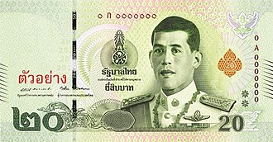
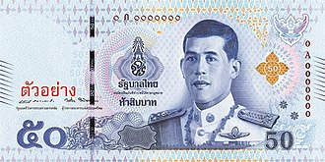
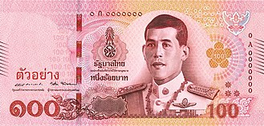
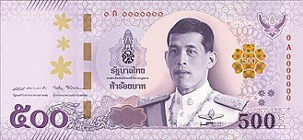
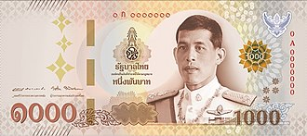
banknotes
20 baht
50 baht
100 baht
500 baht
1000 baht
Source : https://th.wikipedia.org

Slide 15
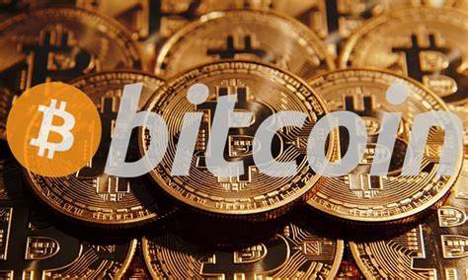
digital currency
Bitcoin
It is the first digital money that made the whole world know about digital currency and caused the Bitcoin mining trend all over the world. It is the most popular currency. and has a fixed value of approximately $

Slide 16
digital currency
Bitcoin Cash
As a fork of the Bitcoin Blockchain, many investors believe that Bitcoin Cash will outperform Bitcoin due to its high liquidity and faster transaction times. which can be transferred immediately when trading – selling occurs

Slide 17
digital currency
Ethereum
It is a Russian-developed digital currency that uses the Blockchain system behind Ethereum , second only to Bidcoin in popularity. With a unique technology like Smart Contract that can be applied to many businesses around the world, the value of Ethereum has increased tremendously since its launch.

Slide 18
digital currency
Ethereum Classic
It is a digital currency forked from Ethereum, arising from the old development group of Blockchain.

Slide 19
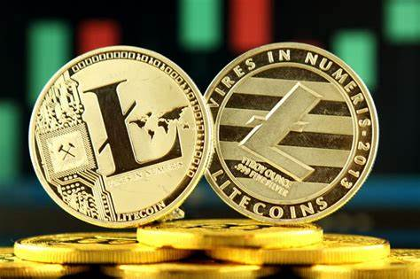
digital currency
Litecoin
Litecoin , or LTC , originated from the Bitcoin hard fork process, which changes the working process of the Blockchain until it isolates itself into a new network . That can add liquidity to transactions, more flexible and faster

Slide 20
digital currency
Stellar XLM
open-source Blockchain network designed to support international monetary transactions that support all currencies. Stellar cannot be mined. Investors must find out from trading coins. or attending Stellar events only

Slide 21
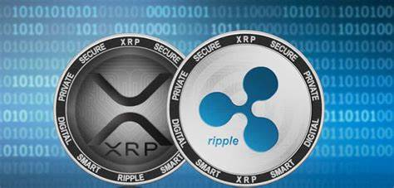
digital currency
Ripple
XPR differs from other currencies in that it cannot be mined by computers . But it was set by Ripple , a company that provides banking services around the world. It has the advantage of being able to increase the speed and transparency of transactions efficiently and is accepted by many banks as well.

Slide 22
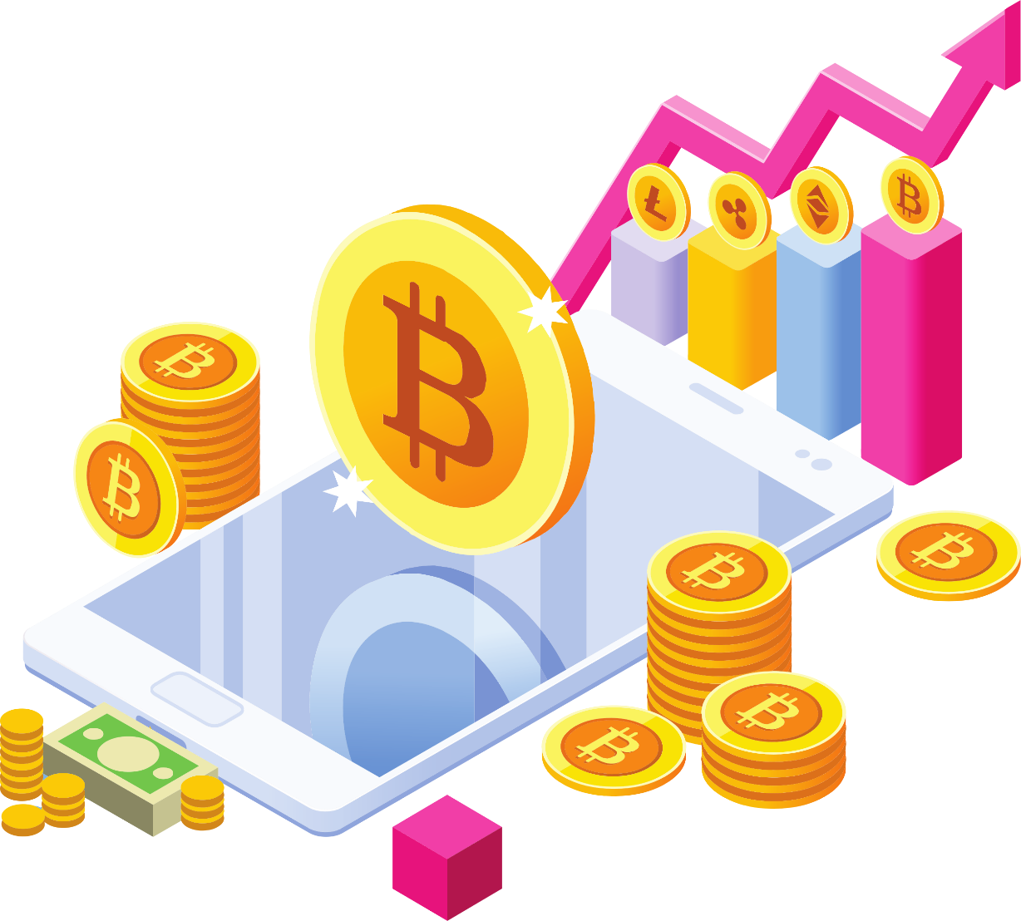
Financial innovations in the digital age
Innovation (Innovation) means introducing something new. It comes from the Latin root Novas or New, the same word used by economists. Innovation describes new policy initiatives such as Monetary Policy Innovation as well as responses to changing environments such as Euro Deposits.

Slide 23
finance in the digital age
Stepping into the digital age of Thai finance Because nowadays, consumers can access financial services on their mobile phones (Mobile Banking) without the hassle of remembering usernames and passwords. By applying technology to use personal identity information (Biometrics) that simply scans fingerprints or faces. Users can then verify their identity to access Mobile Banking .

Slide 24
Thank You
financial institution

Slide 25
1. Explain the meaning of the word business finance
2. In doing business in general Financial management is an important aspect of financial management.
3. What are the objectives of financial management? Explain.
4. What is your most important financial management goal? Explain.
5. What are the financial functions? Explain.
6. Role of financial management
7. Duties and Responsibilities of Finance Managers
8. Evaluation of financial management
end of chapter questions

