Slide 1
ITT2203 Documentation for International Trade

Slide 2
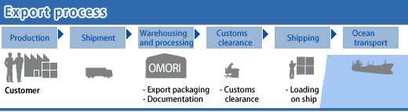
Export Processing

Slide 3
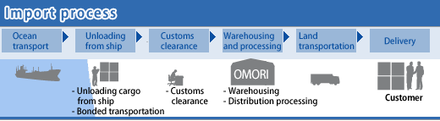
Import Processing

Slide 4


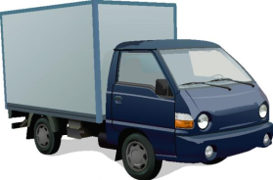
6. Send Documents
Exporter
1. Sales Contract
Importer
2. Int. Payment
3. Service
7. Send Documents
3. Service
Freight Forwarder
VOCCs
Freight Forwarder
4. Customs Clearance
8. Customs Clearance
Customs Department
Customs Department
5. Loading
9. Unloading
Port of Loading
Port of Discharge
10. Delivery

Slide 5
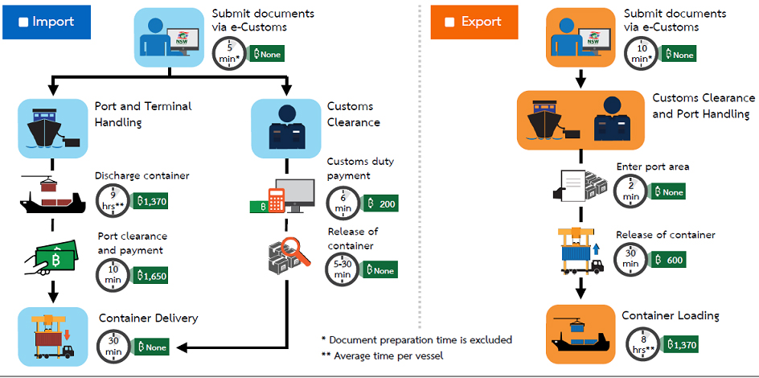
Customs Declaration Processing

Slide 6
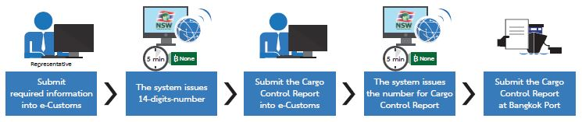
Export Customs Clearance

Slide 7
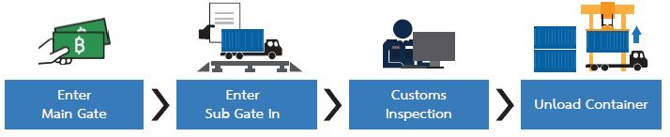
Export Customs Clearance

Slide 8
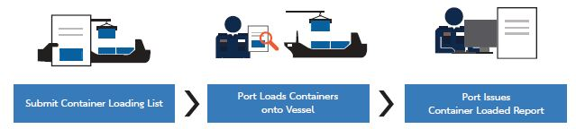

Slide 9
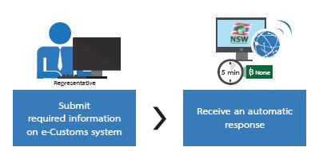
Import Customs Clearance

Slide 10
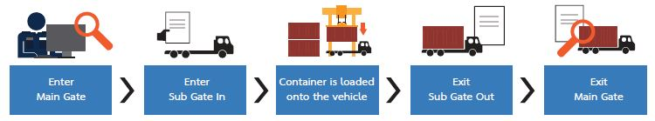
Import Customs Clearance

Slide 11
5. Commercial Inv.
Packing List
Exporter
1. PO, PI
Importer
2. 4 Types of Payment
3. Quotation
Booking Confirm
Bill of Lading
3.1 MB/L
6. D/O
Freight Forwarder
3.1 MB/L
VOCCs
Freight Forwarder
4. Export Entry Customs
- Certificates
7. Import Entry Customs
Customs Department
Customs Department
Port of Loading
Port of Discharge

