Slide 1
Lesson 2 GEN0111 Building Leadership Skill
Aj.Montipa Vilasthip
(Ben)

Slide 2
Objectives
1. Describe the characteristics of leadership.
3. Provides example of influential leadership.
2. Categorize behavioral leadership.
4. Categorize situational leadership.

Slide 3
Discussion Question : Are you interested in sharing leadership, or do you prefer to be a follower?

Slide 4
Chapter , Topics Content
Theory of Trait Leadership
Theory of Behavioral Leadership
Theory of Integrative Leadership
Theory of Situational Leadership
Notes:
Leadership Theories Are explanations of some aspects of leadership Have practical value because they are used to better understand, predict, and control successful leadership

Slide 5
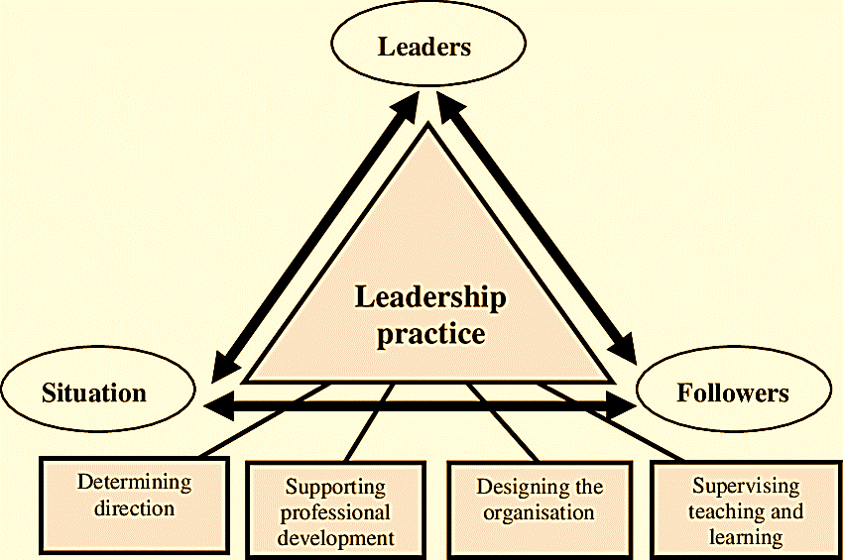
Leader-Leadership-Followers
Notes:
Leadership Theory is a description of the nature of leadership. In order to predict and control the effectiveness of leaders Paradigm in Leadership Studies has evolved in sequence In the beginning, the focus was on education. Leader Features The next phase focuses on the behavior of the leaders and the leaders according to the situation. At present, the perspective process in leadership education has changed with the combination of the same concepts. emerged as a new paradigm (New Paradigm) or Integrated Leadership Theory.
Leaders according to evolution can be divided into 4 paradigms as follows (Lussier and Achua. 2001: 16 - 17).

Slide 6
Who is a Leader?

Slide 7
Teories of Leadership
Leadership
Theory of Trait Leadership
What type of person makes a good leader ?
Leadership emerges from traits.
Theory of Behavioral Leadership
What does a good leader do?
Focus on how leaders behave.
Theory of Integrative Leadership
What is the source of the leader’s power?
Different way leaders use power and influence to get thing done.
Theory of Situational Leadership
How does the situation influence a good leadership do?
Predict which leadership style best in each circumstance.
Notes:
Theory of Trait Leadership :
What type of person makes a good leader ?
Leadership emerges from traits.
Theory of Behavioral Leadership :
What does a good leader do?
Focus on how leaders behave.
Theory of Integrative Leadership:
What is the source of the leader’s power?
Different way leaders use power and influence to get thing done.
Theory of Situational Leadership:
How does the situation influence a good leadership do?
Predict which leadership style best in each cicumstance.

Slide 8
Theory of Trait Leadership
Certain traits produce certain patterns of behavior.
Patterns are consistent across different situations.
People are "born" with leadership traits.
Notes:
Leadership Theory Classifications The four leadership theory classifications include: Trait Contingency Behavioral Integrative
Leadership Trait Theories Attempt to explain distinctive characteristics accounting for leadership effectiveness to identify a set of physical and psychological traits that all successful leaders possess High energy level Appearance Aggressiveness Persuasiveness Dominance Self-reliance

Slide 9
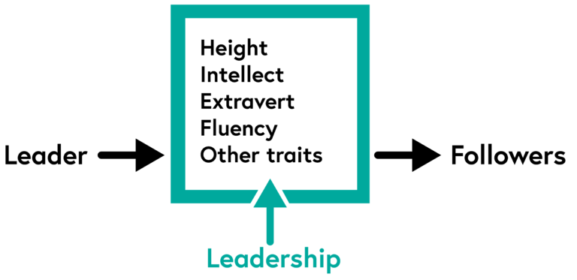
Theory of Trait Leadership
Adapted from Kotter (1990: 3-8)
Notes:
According to Name.., history is shaped by extraordinary leaders. This ability to lead is something that people are simply born with, Carlyle believed, and not something that could be developed. Carlyle's ideas inspired early research on leadership, which almost entirely focused on inheritable traits.
Carlyle's theory of leadership was based on the rationale that:
Certain traits produce certain patterns of behavior.
Patterns are consistent across different situations.
People are "born" with leadership traits.

Slide 10
Five major Leadership Traits
Honest
Inspiring
Forward-look
Competent
Intelligent

Slide 11
Problems with the leadership trait theory
Most people recognize that it is possible for someone to change their character traits over time.
Dose not take situation into account. A person who is a leader in one situation may not be a leader in another.
Sets forth numerous characteristics that are very general , contextual , and ummessureable.

Slide 12
Leaders are made Behavioral theory of leadership
A leader’s behavior is the best predictor of his leadership influences, and as a result, is the best determinant of his or her leadership success.
Anyone can be made a leader by teaching them the most appropriate behavioral response for any given situation.
Notes:
Behavioral Leadership Theories • Attempt to explain distinctive styles used by effective leaders, or to define the nature of their work • What the leader actually does on the job (behavior)

Slide 13
Behavioral theory of leadership Critical leadership behaviors
Leader engage in two types of behaviors:
Initialting Structure and Consideration
Initiating Structure (Task)
Concern for getting the job done
Like to keep controling
Leaders are concerned with their staff motivation.
Consideration (People)
Show a concern for people
Montivate people by emphasizing the relationship
Still focus on the task and the result; they just achieve them through different means

Slide 14
Born or Made?
Leadership Trait Theory
Born
Behavioeal Theory of Leadership
Made
Notes:
The key difference between trait and behavioral theories of leadership is that trait theory states that leaders have inborn traits, whereas behavioral theory rejects inborn virtues of leaders and states that leaders can be trained. ... Trait and behavioral theories are two such popular theories of leadership.

Slide 15
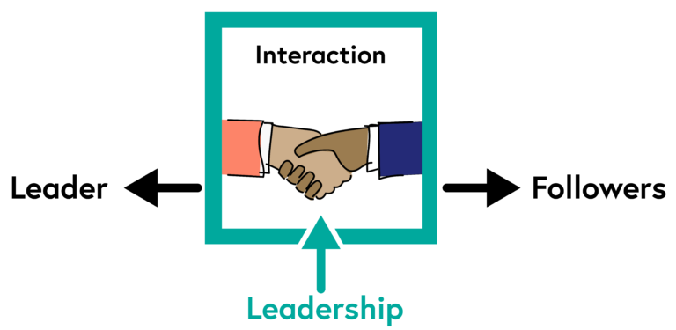
Theory of Integrative Leadership
Adapted from Kotter (1990: 3-8)
Notes:
In contrast, process leadership suggests that leadership is an event that depends on the interaction between the leader and the follower. Process theory makes leadership available to everyone, rather than restricting it to people with special qualities only. As a process, it can be observed, learned, and trained (Northouse 2018: 7).
Integrative Leadership Theories Attempt to combine the trait, behavioral, and contingency theories to explain successful, influencing leader–follower relationships

Slide 16
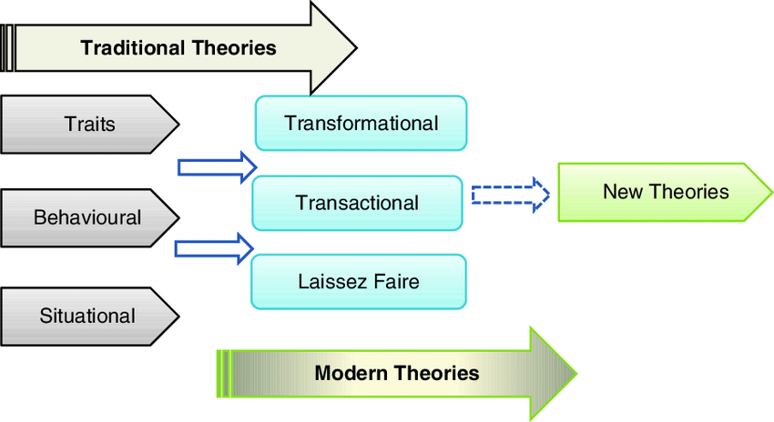
Notes:
Integrative Leadership Theories Attempt to combine the trait, behavioral, and contingency theories to explain successful, influencing leader–follower relationships

Slide 18
Notes:
The Situational Approach to leadership teaches us that leadership is a changing, fluid role that should adapt to the development stage of the subordinate. Leadership styles in the situational approach are also flexible based on needs and include directing, coaching, supporting, and delegating.

Slide 19
The 4 Stages of Team

Slide 20
Stage 1: FORMING
Define team
Alice
1.
Determine individual roles
2.
Develop trust and communication
3.
Develop norms
4.
Define problem and strategy
5.
Identify information needed
6.

Slide 21
Stage 2: STORMING
1
2
Separate problem issues from people issues
Clarify the core issues
4
3
Look for underlying needs, goals of each party rather than specific solutions
Listen carefully to each person’s point of view

Slide 22
Stage 3: NORMING
1
2
3
4
Competitive relationships become more cooperative.
Willingness to confront issues and solve problems.
Sense of team spirit.
Constructive Feedback

Slide 23
Stage 4: PERFORMING
1
2
Gained insight into personal and team processes
Better understanding of each other’s strengths and weaknesses
3
The ability to resolve differences

Slide 24
The Process of Great Leadership
The road to great leadership (Kouzes & Posner, 1987) that is common to successful leaders:
- Challenge the process
- Model the way
- Enable others to act
- Encourage the heart
Inspire a shared vision
Notes:
1.Challenge the process - First, find a process that you believe needs to be improved the most. •
Inspire a shared vision - Next, share your vision in words that can be understood by your followers.
2.Enable others to act - Give them the tools and methods to solve the problem.
3.Model the way - When the process gets tough, get your hands dirty. A boss tells others what to do; a leader shows that it can be done.
4.Encourage the heart - Share the glory with your followers' hearts, while keeping the pains within your own.

Slide 25
Strategic Leadership: The 10 Characteristics of a Good Leader
1. Strong Communication
2. Good Listening Skills
3. Passion & Commitment
4. Positivity
5. Innovation

Slide 26
Strategic Leadership: The 10 Characteristics of a Good Leader (cont.)
6. Collaboration
7. Honesty
8. Diplomacy
9. Empathy
10. Humility

Slide 27
10 most Important Leadership Skills for Team Success
Our Team
1
Ability to Lead
6
Trustworthiness
2
7
Effective Communication
Time Management
3
Commitment
8
Relationship Building
4
9
Industry Expertise
Confidence
5
Problem Solving
10
Perceptive of Team Needs
Notes:
(มีความสามารถในการเป็นผู้นำ)

Slide 28
Discussion Question : Some people say the hard skills are more important for managers than soft skills and some people say the opposite is true. What do you think?
Notes:
Discussion Question Some people say the hard skills (finance, quantitative analysis) are more important for managers than soft skills (developing relationships, leadership), and some say the opposite is true.

Slide 29
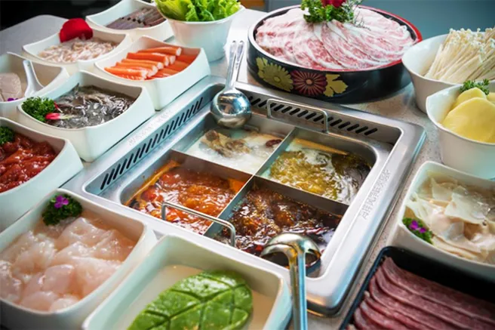

Slide 30
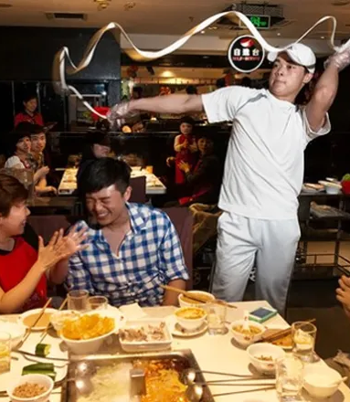
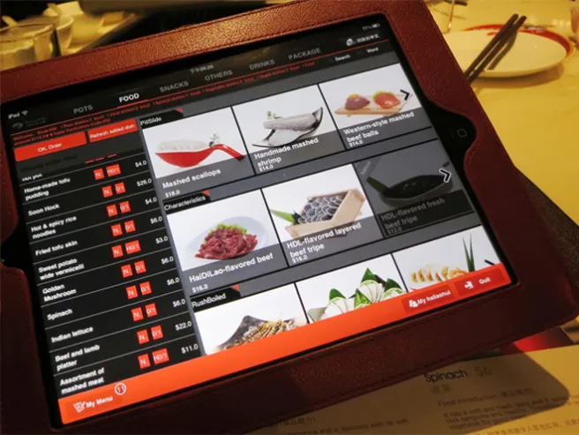
Haidilao: Selling hotpot or selling service?
How to create a differentiation when the product differentiation is not possible?
How to motivate employees?
How to create a service-oriented culture?

Slide 31
Notes:
Hai Di Lao (in Chinese: 海底捞) is a popular hot pot restaurant chain with 130 eateries in 35 Chinese cities, and 6 branches overseas[1]. The hot pot restaurant business is extremely competitive because it is quite challenging to distinguish oneself from others in taste. Hai Di Lao, however, stood out due to its exceptional customer service, introduction of showmanship into the restaurant business, and standardized lean supply chain management.

Slide 32
Haidilao’s founder, Zhang Yong

Slide 34
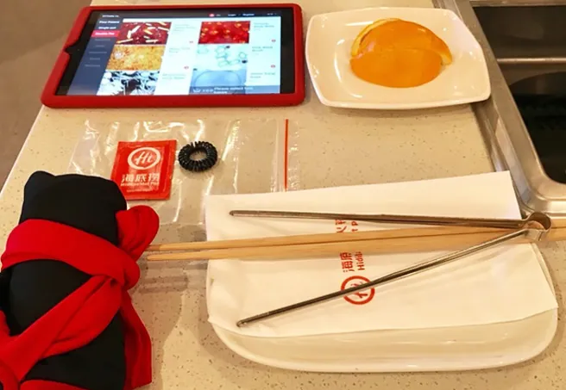

Slide 35
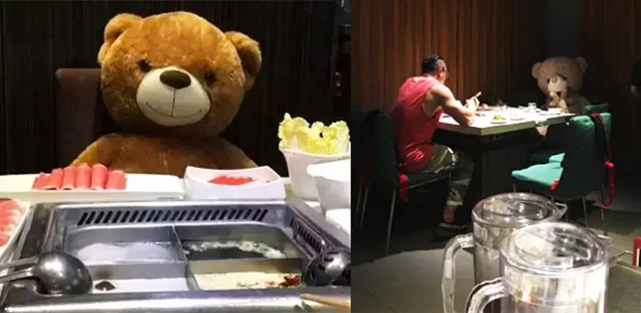

Slide 36
Covid-19 pandemic

Slide 38
How a hot pot chain creates and captures value from focusing on customer services in China?

Slide 39
How to leadership with a team?
Service Beyond Imaginations
Business
Model
Learn to lead yourself first
Seek feedback: up, down, and across
Be open to new ideas
Supply Chain Management
Employee Management
Measure the performance of your team along several dimensions.
Push yourself outside of your comfort zone
Pay attention to team dynamics
Notes:
Learn to lead yourself first. ...
Seek feedback: up, down, and across. ...
Be open to new ideas. ...
Push yourself outside of your comfort zone. ...
Pay attention to team dynamics. ...
Measure the performance of your team along several dimensions.

Slide 40
Characteristics of Good Team Leader
Build Trust
Develops Common Commitment
Train members for empowerment
Provide full information to team
Know all team members
Develop team spirit
Encourage members to excel
Create an enthusiastic environment
Shares success with members
Notes:
Rather, team members seek a leader who believes in themselves and in their ability to make good decisions. Additionally, a self-confident leader will naturally possess many other important leadership qualities like decision-making skills, effective communication, and courage

Slide 41
A fully functioning team can…
1
Work together successfully
2
Solve problems and reach decisions in a way that incorporates individual input
3
Reach decisions through consensus
4
Can adapt to change
5
Achieve or exceed desired results

Slide 42
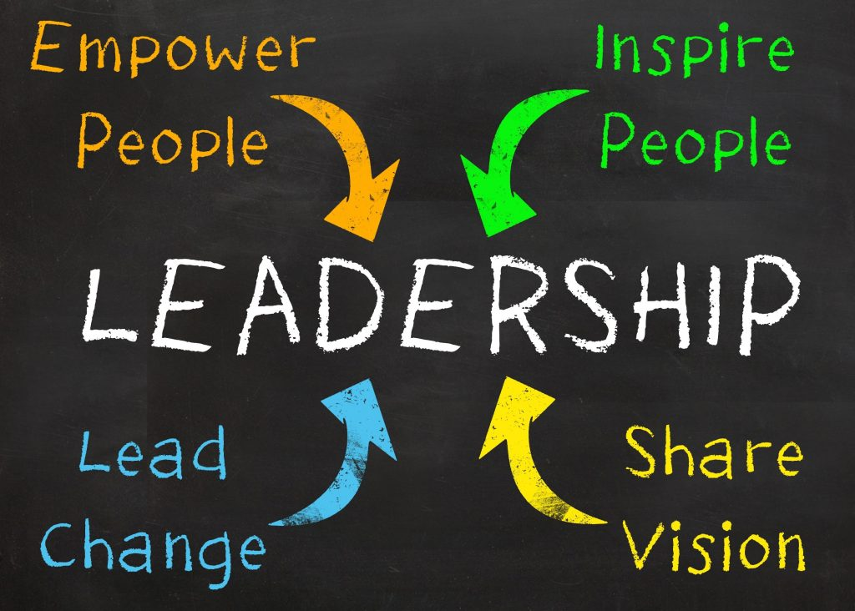
Conclusion
Leadership development is vital because organizations take on the personality of their leaders. Leadership development maximizes productivity.
Teamwork is essential for the proper functioning and successful development of any company or organization

Slide 43
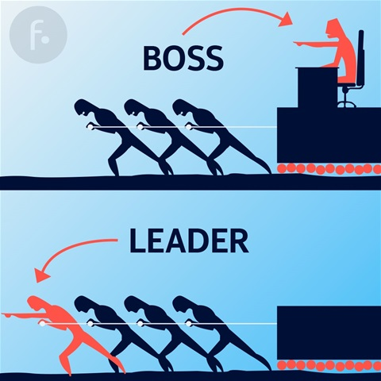

Slide 44
