Slide 1
Hazard Analysis and Critical Control Points (HACCP)
Asst.Peof.Dr.Supattra Pranee
College of Innovation and Management
Suan Sunandha Rajabhat University
https://www.researchgate.net/publication/301091277_Product_Standards

Slide 2
Introduction to Hazard Analysis and Critical Control Points (HACCP)

Slide 3
Introduction
HACCP was developed in the early 1960 when the National Aerospace Agency (NASA) asked Pillsbury a United States food company to produce food that could be used under zero gravity [1]. The problem of unknown behavior of food product under zero gravity was solved quickly, but Pillsbury company recognized that the existing destructive quality control techniques for food safety are not reliable for such special food products to assure complete eliminating potential contamination in such special foods from biological, chemical or physical hazards that could cause illness or injury to astronauts in space flight. The cooperation of Pillsbury food scientists with researchers from Natick Research Laboratories, and National Aerospace Agency (NASA) resulted in developing a non-destructive quality assurance system for food safety relied on preventive action by control and record keeping over complete food process steps from raw materials to the end product distribution [2]. This developed non-destructive quality assurance system for space program food safety project was the initiation for the current HACCP plan system

Slide 4
The initial developed HACCP system was presented in the year 1971 by Pillsbury food company at the Conference on Food Protection (CFP) sponsored by Food and Drug Administration (FDA). This presented HACCP system consists of three HACCP plan principles [3]. These three HACCP principles are:
• Identification and assessment of hazards associated with food from farm to fork.
• Determination of the Critical Control Points (CCPs) to control any identified health hazard in food process.
• Establishment of a system or systems to monitor the critical control points.

Slide 5
The outcome from this 1971 conference is a training program managed by Pillsbury Food company scientist to FDA inspectors for the inspection of canned foods. The title for this training program was “Food Safety through the Hazard Analysis and Critical Control Point System” and this was the first time HACCP plan was used as subject for education. Toward the end of 1980s training for developing and implementing HACCP plan for food safety management systems are offered by several food safety companies. These training programs, and, scientific journals publications on HACCP concept for food safety were instrumental in making HACCP the predominant non-destructive food safety system. Finally, In the year 1998, it became a requirement for all food businesses to obtain a food safety certification under HACCP guidelines with the exception of smaller food business that do not have the financial capacity to implement HACCP plan [4]. In the year 1993, The National Advisory Committee of Microbiological Criteria for Foods (NACMCF) revised HACCP guidance standard, adding five preliminary steps to the developed seven principles of HACCP system [5]. This revised HACCP guidance provided significant input to the hazard analysis process. Currently, HACCP is an internationally recognized system for reducing the risk of safety hazards in foods for both domestic and international food production

Slide 6
Current seven HACCP principles and application guidelines
HACCP is a preventative food safety system in wish every step-in food manufacturing process, plus food products storage, and distribution is scientifically analyzed and controlled for biological, chemical, and physical hazards. The current seven basic HACCP principles (Figure 1) that are developed and implemented internationally are:
• Identify hazard analysis accessing les risk.
• Identifying Critical Control Points (CCPs).
• Establishing Critical Limits (CL).
• Implementing continuous Monitoring.
• Implementing Corrective Measures.
• Verification and Validation.
• Documentations and Records keeping.

Slide 7
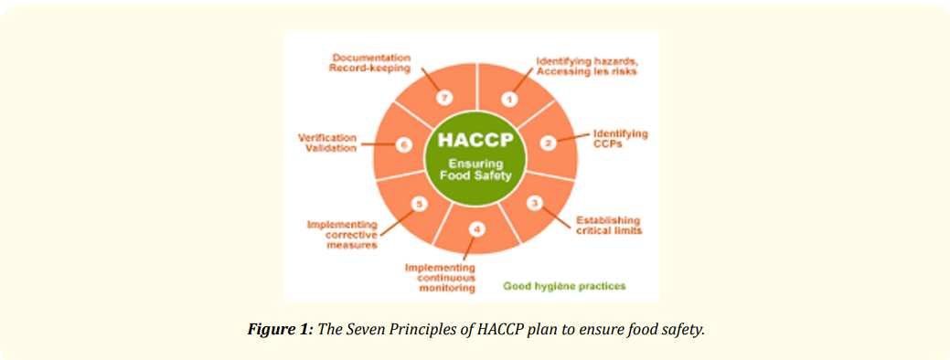
The Seven Principles of HACCP plan to ensure food safety

Slide 8
HACCP team listing steps in the food process, identify significant hazard or hazards that might occur in each step-in food process, and develop method or methods that must be used in their HACCP plan to prevent, eliminate, or control these identified hazards in food production process.

Slide 9
Principle (2): Identifying critical control points (CCPs)
Identify a control procedure that can be applied in each food process step to eliminate food safety hazard or reduce the hazard to acceptable limit in the end product. Identify CCPs that might be required in food process steps are by using a CCP decision tree method (Figure 2). In some cases, one CCP may control more than one step in food process, or control more than one food safety hazard. In other cases, more than one CCP is needed to control a single hazard in a single food process step. Having said that, the number of CCPs for food process depend on the nature of food and the type of the control needed to assure the food safety of the end product.

Slide 10
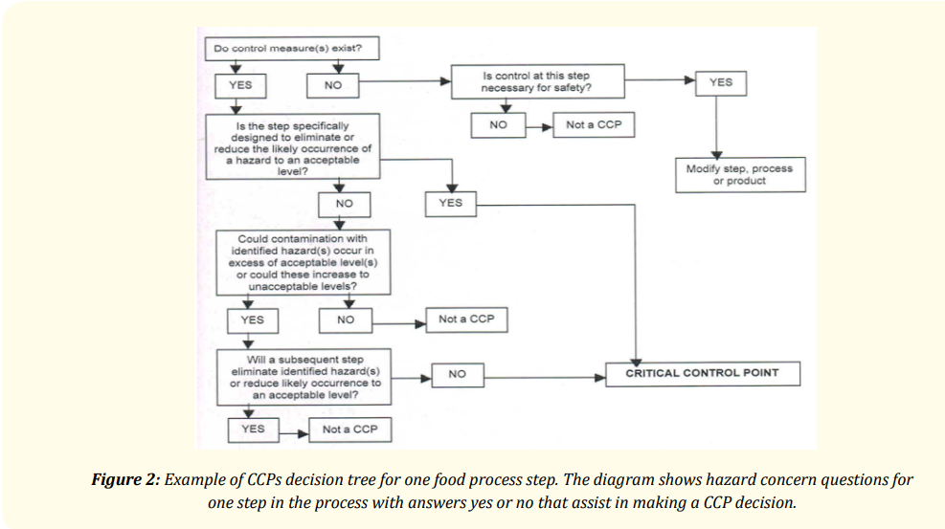
Example of CCPs decision tree for one food process step. The diagram shows hazard concern questions for one step in the process with answers yes or no that assist in making a CCP decision.

Slide 11
Principle (3): Establishing critical limits (CL)
Critical Limit (CL) is the limit to which biological, chemical, or physical hazard that must be controlled to prevent, eliminate or reduce the hazard into an acceptable limit at the identified CCPs in a in food process steps. Critical limit measurement methods can be time, temperature, moisture, pH, water activity (Aw) or any other methods that are acceptable by regulatory standards.

Slide 12
Principle (4): Implementing continuous monitoring Monitoring food process steps by the measurement of the critical limit (CL) at each designated critical control point (CCP) must be described including how, when, frequently the measurement taken and who is responsible for taking these measurements during production process.

Slide 13
Principle (5): Implementing corrective measures Corrective actions are the procedure that must be taken when monitoring indicate that there is a divination from the established critical limit (CL) in a critical control point (CCP). Taking appropriate corrective action in the event of a divination at CCP is essential for producing safe food. Corrective measures are usually including identification of the problem and steps taken to assure that such problem will never occur again

Slide 14
Principle (6): Verification and validation The validity of a HACCP system is to determine that the process is operating according to the plan. Verification involves taking suffusion steps such as auditing of CCPs, calibration of instruments used for CCPs measurements, in process food product testing, recordreview, and prior food shipment review to ensure that the validity of the HACCP system is operating according to the plan. It is important that the individual doing verification have appropriate technical expertise to perform this function and sometimes it is prefer to be carried by third party or by regulatory agencies.

Slide 15
Principle (7): Documentations and records keeping Recording the information that can be used to prove the safety of food produced for consumption is the key component of HACCP plan. Documentation should include information on the HACCP team, product description, flow diagrams, hazard analysis, CCPs identification, critical limits, monitoring systems, record keeping procedures, and verification procedures.

Slide 16
Finally, it important to highlight that the application of HACCP plan in food manufacturing is not suffusion for food safety if standalone in food operation [5]. The HACCP plan must be built with other food safety programs of Good Manufacturing Practice (GMP), and Sanitation Standard Operation Procedures (SSOPs).

Slide 17
References
Osama O Ibrahim (2020). Introduction to Hazard Analysis and Critical Control Points (HACCP) .Consultant Biotechnology, Gurnee, Illinois, USA https://www.researchgate.net/profile/Osama-Ibrahim-26/publication/340579693_Introduction_to_Hazard_Analysis_and_Critical_Control_Points_HACCP/links/5e91d9eb299bf130798fc6e3/Introduction-to-Hazard-Analysis-and-Critical-Control-Points-HACCP.pdf

