Slide 1
PRODUCT STANDARDS
Asst.Peof.Dr.Supattra Pranee
College of Innovation and Management
Suan Sunandha Rajabhat University
https://www.researchgate.net/publication/301091277_Product_Standards

Slide 2
Product Standards and Trade: An Overview

Slide 3
It is common to distinguish three broad groups of standards, based on the types of activities to which they apply, as defined by the International Organization for Standardization (ISO): product standards, process standards, and management systems (see ISO 2006, 2008). Product standards have to do with the characteristics of goods or services, in particular with respect to aspects such as quality, safety, and fitness for purpose. A simple example of a product standard

Slide 4
is the limit, set by the U.S. Food and Drug Administration (FDA), of one part per million of methyl mercury (a potential toxin) in fish marketed for human consumption. Process standards apply to the conditions under which goods or services are produced, packaged, or refined. An example is the production of dairy products without hormones: milk from hormone-free cows is indistinguishable from milk from cows treated with hormones, but only farms that meet a particular set of production conditions can describe their milk as “hormone free.” Management systems assist organizations in running their operations and create a framework within which the requirements of product and process standards can be consistently met. Management systems are often referred to as meta-standards; an example is the ISO 9000 series of quality standards (see box 10.1).

Slide 5
A well-functioning standards system will usually incorporate elements of all three groups of standards. This chapter focuses mainly on the first group—the product standards that apply to everything from primary produce and agricultural products to sophisticated manufactured goods such as electrical equipment (box 10.2). The remainder of this section briefly discusses the rationale for product standards before moving to a more detailed discussion of how they are designed and implemented.

Slide 6
Economic Rationale for Product Standards

Slide 7
Why are product standards necessary at all? Broadly speaking, standards can be seen as a way of bringing the outcomes of a decentralized market economy more closely into line with social objectives that may not otherwise be achieved (see, for example, Maskus, Otsuki, and Wilson2000; Ganslandt and Markusen 2001). Two of the most common reasons why standards might be necessary relate to spillover effects (externalities) from certain activities and to information asymmetries between buyers and sellers. These effects are clearly relevant for standardization at the national level, but they also set the scene for regional and global coordination on standards

Slide 8
Externalities. Packaging is an example of an externality. In the absence of any rules or standards, producers and consumers do not directly pay the cost of disposing of packaging materials after the product has been bought and unpacked. These materials must be taken away to a landfill, where they will break down over time, perhaps releasing pollutants into the environment. A standard setting out biodegradability requirements for packaging materials can help reduce this problem and limit the negative environmental spillovers from useful economic transactions. Social objectives such as environmental protection and public health are common externality-based rationales for the development of product standardsAnother example of externalities relates to network effects and interoperability (see, for example, David and Greenstein 1990; Gandal and Shy 2000; Barrett and Yang 2001).

Slide 9
What Are Meta-Standards?
Closely associated with standards are the quality assurance processes that users employ to effect and manage compliance. Indeed, a “new” category of standards has evolved that defines and describes such meta-systems. Meta-standards do not concern a specific product or production process but, rather, set overall principles and rules to be followed in broad areas of activity. Examples include the ISO 9000 series of standards for quality management systems and the ISO 14000 series for environmental management systems. In certain industries, compliance with these standards is itself becoming a commercial necessity, alongside more traditional product and process standards. For instance, in the area of food safety, meta-standards include hazard analysis and critical control point (HACCP) standards, good manufacturing practices (GMP), good agricultural practices (GAP), and ISO 22000 on food safety management systems.
Source: Henson and Jaffee 2007.

Slide 10
Proliferation and Growing Importance of Product Standards

Slide 11
Product standards represent an important and constantly growing set of regulatory measures that have potential effects on trade. The available evidence suggests that these standards cover all sectors, from simple agricultural products (Disdier, Fontagné, and Mimouni 2008) to the most complex electronic goods (Moenius 2007). Many countries produce their own standards but are also increasingly involved in efforts aimed at regional or international standardization. Before looking in more detail at the regional dimension of standards and their trade effects, it is useful to get an idea of the phenomenon’s extent and development over recent years through a few stylized facts:

Slide 12
The International Organization for Standardization comprises 3,000 working groups and committees. • The ISO has issued about 15,000 international standards (WTO 2005). • A survey of national product standards in a selection of member countries of the Organisation for Economic Co-operation and Development (OECD) identified a total of nearly 300,000 documents (Moenius 2005). The Perinorm database on which Moenius drew contains about 650,000 standards from 21 countries (WTO 2005). • In 1975 there were only 20 Europe-wide standards, but by 1999 the number had grown to 5,500 (Moenius 2005). • The number of Europe-wide standards in the agricultural and textiles and clothing sectors grew at a rate of nearly 20 percent per year over the period 1995–2003 (Shepherd 2006)

Slide 13
Designing and Implementing Product Standards

Slide 14
Given the role that standards play in the economy, they should be set up to promote the desired social objectives
while minimizing costs to the extent possible. Standards may be mandatory or voluntary. Mandatory standards (also referred to as technical regulations) must be met by firms as a matter of law, and penalties are set for nonconforming products. Compliance with voluntary standards remains a matter of commercial choice for individual firms. In practice, both types of standards exist side by side, although the bulk of standards-related activity in most countries now consists of voluntary standards. Mandatory standards tend to be mostly confined to core public health and consumer safety areas, such as requirements governing food and medicines. This coexistence is also apparent at the regional level—for example, in the European Union’s (EU) “New Approach” to harmonization. (See European Commission 2000 and WTO 2005 for a discussion.)

Slide 15
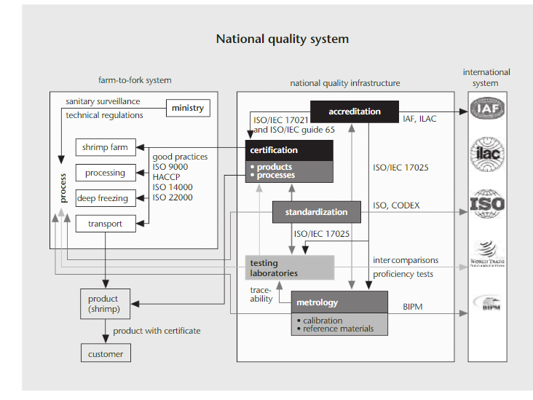
Elements of a Standards Infrastructure
Source: Sanetra and Marbán 2007.Note: The figure represents the infrastructure in developed countries. Accordingly, the term “national” infrastructure is used, but in practice, although all theelements of the standards infrastructure are necessary, functions can sometimes be distributed among countri

Slide 16
Regional and International Dimensions of Standardization

Slide 17
The rationales for standards discussed above also apply in a cross-border setting. Asymmetries of information betweenconsumers and producers are even more serious in a traded-goods context because of the ineffectiveness on the international plane of signaling mechanisms that work domestically, such as firm reputations built up over a long period. In addition, a number of important public policy goals—concerning environmental protection, for example— are now recognized as having regional and even global dimensions. In these and other areas, countries are increasingly keen to cooperate on standards, at least to some extent, at the transnational level, through PTAs or the WTO.

Slide 18
The ISO is just one among many transnational entities that issue standards. It is a network of national standards institutes, and, in keeping with the private-law character of many of these institutes, it is a nongovernmental organization. Its standards are, accordingly, private and voluntary.

Slide 19
Another example of international standardization is the Codex Alimentarius Commission, a public organization created as a joint venture between the World Health Organization (WHO) and the Food and Agriculture Organization of the United Nations (FAO). Unlike the ISO, the commission deals with only one area of standardization, food safety.4 Although its standards do not have direct legal force, they serve as the basis for legally binding rules in many countries (see box 10.3, below).

Slide 20
In addition to international structures such as the ISO and the Codex Alimentarius Commission, some regional bodies deal with standardization. Among them is CEN, which has a regionwide standardization function in the EU. Its members are the national standards bodies of 30 European countries; CEN itself is a private nonprofit organization. Although the standards CEN issues are voluntary, member organizations are required to issue its standards as national standards and to withdraw any inconsistent national standards. CEN’s standards are therefore often referred to as being “European standards” or “harmonized European standards” because they are expected to apply with equal force in all member countries.

Slide 21
Cost Effects of Standards

Slide 22
Policy makers need to be aware of the costs entailed by standards and of their potential to distort regional and global trade relations. The implementation of standards policies might lead to discrimination between national and foreign suppliers or between different categories of foreign suppliers. From the point of view of foreign exporters, product standards in an importing country can sometimes represent an additional source of costs (Maskus, Otsuki, and Wilson 2005). Moreover, even though national standards may be legitimate, their multiplicity and diversity can mean duplication of market access costs that may be inefficient from a global perspective. These effects can put foreign competitors at a disadvantage and generate— intentionally or not—a form of protection for domestic industries.5 Coordination among countries in implementing their standards policies may yield harmonized policies, reducing the cost of market access while preserving regulatory objectives. A potential difficulty with this kind of coordination—discussed in more detail below—is its assumption that it is optimal for the same standard to apply across a wide range of countries. In fact, however, different economic and social conditions may call for different standards

Slide 23
What kinds of costs can compliance with product standards impose on manufacturers? It might, for example, be necessary to redesign a product, in whole or in part. New machinery may have to be purchased, or a new production process may have to be set up. All these adaptations are associated with increased fixed costs of production (including sunk ones), in the sense that they largely involve a one-off payment rather than a recurring expense.

Slide 24
In some cases, adaptations to deal with product standards can affect the level of variable production costs, as well. If the new production process uses more expensive inputs, or if the new machinery is more costly to run, the unit cost of production will increase. It might also be necessary to formally demonstrate compliance with a particular standard, in which case additional testing and certification procedures might be needed. These procedures also increase variable production costs

Slide 25
Maskus, Otsuki, and Wilson (2005) collected data from nearly 700 firms in 17 developing countries, as part of an effort to better understand the cost effects of foreign standards. The authors’ findings are in line with the types of effects discussed above. In their sample, the fixed costs of compliance with foreign standards are, on average, nearly 5 percent of firm value added. Moreover, increased compliance investment is associated with a small but significant effect on variable production costs.

Slide 26
In assessing the supply-side effects of standards, the distinction between fixed and variable costs is important. Recent advances in the theory of international trade (Chaney 2008) suggest that higher variable costs primarily affect trade by reducing exports per firm among the small subset of firms that already exports to foreign markets. Higher fixed costs, by contrast, tend to force some firms out of export markets entirely, thus altering the range of products exported, or the set of foreign markets served, or both.

Slide 27
The costs and benefits of standards will also depend on their dynamic effects in the long run. For instance, Jaffee (2003) shows how the horticultural industry in Kenya has used changing European regulations as a stimulus to innovation, competitive repositioning, and industrial upgrading. Diaz Rios and Jaffee (2008) find that developing-country firms responded differently to stricter aflatoxin regulations in the EU. The new rules only exacerbated the commercial difficulties of some exporters, but they offered an opportunity for others to upgrade their production techniques and gain additional market share. The reallocation of resources over time from small and relatively inefficient firms to larger, more efficient ones is associated with gains in sectoral productivity—a kind of technological upgrading that holds significant development promise.

Slide 28
Do Voluntary Standards Have Cost Effects, Too?
At first glance, it might seem that only mandatory standards would have measurable cost impacts. After all, manufacturers are, in principle, free not to comply with voluntary standards if they so choose. Legally speaking, they are not required to pay additional costs to access a particular market. In practice, the situation is not that straightforward. If compliance with voluntary standards is a commercial imperative, even if not a legal one, we might still expect to see some evidence of cost effects. Is this, in fact, the case?

Slide 29
As it turns out, there is substantial evidence that voluntary standards do indeed affect trade flows, which is consistent with their having a significant impact on cost. Two studies that look into voluntary standards find significant impacts of standards on trade—negative in the work of Czubala, Shepherd, and Wilson (2009), and a mix of sector-specific negative and positive results in the case of Moenius (2005). In addition, Shepherd (2007) finds evidence that voluntary standards affect export diversification in partner countries, which may be indicative of an effect on fixed, not just variable, costs of production. These findings, taken together, suggest that although compliance with voluntary standards may not be necessary as a matter of law, it is still of sufficient commercial importance to produce important links with production costs and trade flows.

Slide 30
References
https://www.researchgate.net/publication/301091277_Product_Standards

